Slide 1
ACTCR Meeting
Summer 2022 (June 7, 2022)
Texas Cancer Registry
Texas Department of State Health Services

Slide 2
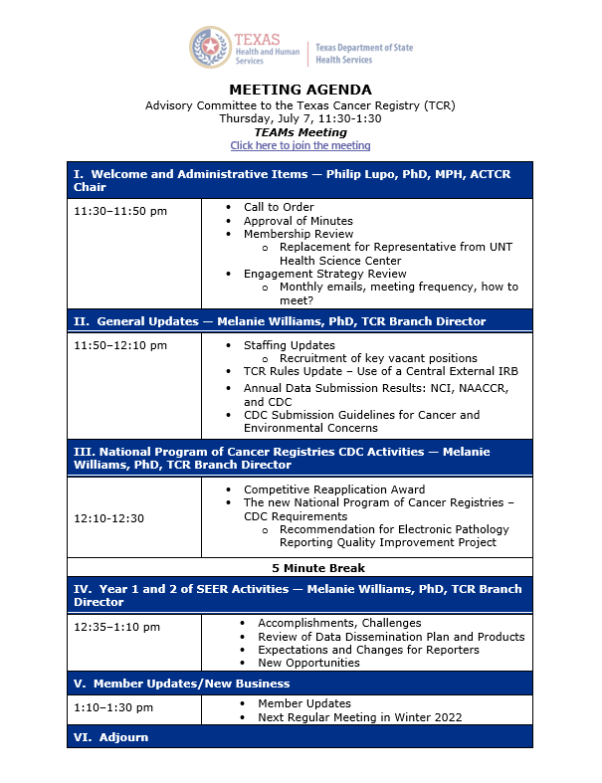
Agenda – July 7, 2022

Slide 3
General Updates

Slide 4
July 2022 Organizational Chart

Slide 5
Proposed Rules Change
BACKGROUND AND PURPOSE
The purpose of the proposal is to make amendments that will allow for greater flexibility in Texas Cancer Registry data request requirements. Current rule language requires researchers to obtain approval from the DSHS Institutional Review Board (IRB). However, most state cancer registries participate in the federal National Cancer Institute’s Virtual Pooled Registry (VPR) IRB, which allows researchers to use a single IRB to request cancer registry data from multiple jurisdictions. The proposed amendments will allow researchers to submit their study and obtain approval from either the VPR IRB or the DSHS IRB. Researchers with studies that do not meet the requirements for submission to the VPR IRB would still be required to submit their study for review and approval through the DSHS IRB. The proposal also amends current rule language to update the DSHS Texas Cancer Registry email address and make other clarifying, non-substantive changes.

Slide 6
Proposed Rules Change
The proposed amendment to §91.11 updates the DSHS Texas Cancer Registry email address and makes other clarifying, non-substantive changes.
The proposed amendment to §91.12 changes references to the “department’s” IRB to the “department or its designated” IRB. This change will allow DSHS to designate the VPR IRB as an acceptable alternative to the DSHS IRB. The proposed amendment also updates the DSHS Texas Cancer Registry email address.
Proposed to go into effect April 24, 2023

Slide 7
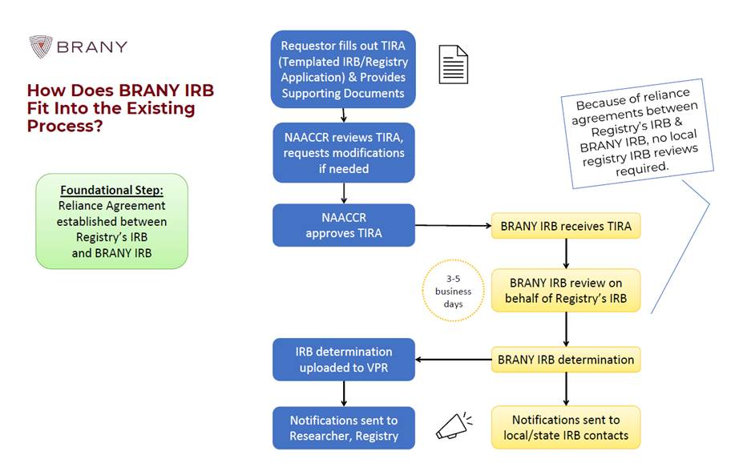
Proposed Rules Change
Example of data request flow once an agreement/contract is established.

Slide 8
Comment Period - New Draft CDC Patterns of Cancer and Environmental Concerns Guidance
Draft Guidelines for Examining Unusual Patterns of Cancer and Environmental Concerns

Slide 9
National Program of Cancer Registries – CDC Overview

Slide 10
CDC Award for 2022-2027
Scored 95/100 on 5-year reapplication
Requested more specifics on success and assistance of ACTCR to the Texas Cancer Registry (shorter page length was a challenge
Received 5 percent reduction, due to NCI SEER award.
Need a Quality Improvement Project

Slide 11
Proposed CDC QI Project
Need a Quality Improvement Project
Need to achieve more complete population-based electronic pathology reporting
Assess completeness of free-standing pathology reporting
Consider if we need to begin collecting hospital-based pathology laboratory reporting (SWOT or similar analysis)
Develop recommendations to improve and if possible, a plan

Slide 12
NCI Texas SEER Registry Overview

Slide 13
Background
The DSHS Texas Cancer Registry (also known as the Cancer Epidemiology and Surveillance Branch) has participated in the CDC - National Program of Cancer Registries (NPCR) since 1994.
Effective May 1, 2021, the Texas Cancer Registry is also an NCI SEER-designated registry! This has been a TCR goal since the 1980s.
The NCI’s Surveillance, Epidemiology, and End Results (SEER) Program provides information on cancer statistics to reduce the cancer burden among the U.S. population. It is supported by the Surveillance Research Program in NCI's Division of Cancer Control and Population Sciences.

Slide 14
Map of SEER Program as of June 1, 2021

Slide 15
SEER Registry Proposal Overview
Additional Funding — $8,887,705 (over 7 years)
Funding supports:
Migration to SEER*DMS software
10 new TCR staff positions to meet SEER new data collection and project requirements
Potential Future Funding
Participation in ancillary studies and additional projects
Patterns of Care Studies, National Childhood Cancer Registry
Participation in a Virtual Tissue Repository

Slide 16
SEER Traditional and Enhanced (New) Data
Data Traditionally Collected
New Data Being Integrated into SEER
Demographics
Geospatial data
Characterization of the tumor at diagnosis
Stage
Tumor characteristics (including 32 biomarkers)
Treatment (first course)
Surgery, radiation, Chemo/hormonal (y/n)
Survival and Cause of death
Treatment
Detailed & longitudinal Treatment
Infusion and oral medication (chemo/hormone/immuno)
Radiation
Both Initial & subsequent Rx courses
Expanded tumor characteristics
Genomics/Biomarkers (EGFR, ALK, BRAF MSI etc.)
Multigene panels for specific cancers (Oncotype, Decipher, Castle LS)
Capturing Metastatic Recurrence
Leveraging multiple data sources (pathology, radiology, claims, hospital reports)
Longitudinal Residential History

Slide 17
Resulting New Texas Requirements for 2022
99 Site Specific Data Items (SSDIs)
79 additional data items
Returning to normal reporting calendar timeline
2022 Updates — TCR Reporting Requirements (.pdf)
2022 New SEER Data Items (.pdf)
2022 Timely Reporting Calendar (.pdf)

Slide 18
Recent Additions to the SEER Data
Pharmacy Data—oral antineoplastic agents (2013–2021)
CVS, Walgreens/RiteAid
United Health Care Pharmacy Data Management (PBM) Data
Medical Insurance Claims – detailed longitudinal treatment, comorbidities, tests, hospitalizations
Unlimited Systems—claims processor for community oncology practice claims (2013–2021)
17% of cases to date
United Health Care Claims (2000-2020)
1,615,174 Patients
Covers between 6%- 25% of patients by registry (Mean 14.5% coverage)
In discussions with other large commercial insurers and Medicare

Slide 19
Recent Additions to the SEER Data
Genomic data linkages
Oncotype DX Breast 2010+
21gene assay 239,178 patients
16 gene assay 5,734 patients
Oncotype DX Prostate MultiGene Panel - 13,502 patients
Decipher MultiGene Panel - 15,309 patients
Castle Life Sciences – Cutaneous & Uveal Melanoma MultiGene Panel - 7,372 cases
Residential History
SEER has captured each patient’s residential history back to 2000
Purpose
Enable linkages longitudinally as cancer patients move – address information is essential
Enable linkages with exposure data pre-diagnosis when exposure most relevant
Registries capture address at the time of diagnosis only

Slide 20
Automation in SEER: DOE-NCI Collaboration
API for auto-extraction of key elements (site, histology, behavior, laterality, grade) developed and under refinement
Implementing to optimize work-flow in 6 SEER registries
Automated process 18,000X faster than manual extraction
Full automated extraction of 20% of all path reports + 50% partial auto-extraction
Initial test in GA registry- automated 24,000 report backlog in <2 minutes!
Developing Privacy Preserving version for sharing with CDC, VA and others.
Ultimate Goal: support near real time incidence reporting
API for reportability of cancer pathology reports developed
modifying for radiology reports (to capture missed cases- CNS tumors and HCC)
API for recurrent metastatic disease developed for pathology reports
modifying for radiology reports

Slide 21
SEER Data Access
SEER data collected by registries under state public health reporting authority
SEER Receives only a limited data set for dissemination
SEER traditionally broadly available (>4,500 downloads per year)
Increasingly detailed data increases risk of re-identifiability of individuals
Therefore, a new Multi-tiered Authentication and Authorization Process is in development with increasing requirements by tier
Tier 1- De-identified – no dates or geographic variables- available to all with minimal Data Use Agreement (DUA) (live)
Tier 2 – Limited Data set with minimal detailed characterization variables (live)
Tier 3 – Limited Data set with special variables (biomarkers, multi-gene panels etc.) (live)
Tier 4 – Limited Dataset with longitudinal treatment, dates etc., (May require IRB review) (in dev)

Slide 22
Virtual Pooled Registry (VPR)
Centralized process for linking cohorts/other studies to all registries in US to
Capture information on cancers and outcomes (Survival)
Currently 45 US registries are participating (87% US pop)
Central website for data submission and linkages
Templated IRB and DUA forms
Accepted by ̴50% of participating registries to date
cIRB contract for SRP May 2021
Enables central IRB submission and approval through reliance agreements with registries
Available to support other data access processes in SRP for SEER data (Tier 4 requests)

Slide 23
The National Childhood Cancer Registry (NCCR)
Centralized data system from 23 registries across the US (77% of all childhood cancers to date)
Base Data
Complete abstracts from participating state registries (1995+)
National Death Index (NDI)/State vital records
Lexis Nexis - Residential History
Virtual Pooled Registry (VPR) linkage – de-duplication/subsequent cancers
Planned Linkages
Pharmacy Data (Oral Therapies)
Longitudinal Radiation oncology data
Claims data (Comorbidity and treatment)
Radiology reports + images (case finding/ recurrence)
Genomic Data
COG Clinical Trials and Project Every Child DB – evaluate coverage and under representation for COG
Data Access
Creation of Data platform and data products to enable controlled access by investigators

Slide 24
Feedback and Suggestions

Slide 25
Member Updates/ New Business
Group Discussion

Slide 26
Next Meeting
Late Fall 2022
11:30 a.m. – 1:30 p.m.
Via teleconference

