Slide 1
Public Health Data Sharing in Texas​
Office of Public Health Data Strategy & Modernization
Texas Department of State Health Services
April 9, 2025

Slide 2
Agenda
Data Sharing
Vital Event
THCIC
Immunizations
NEDSS Provisional Data
Data Sharing Training and Feedback
LHE Enablement

Slide 3
Vital Event Data Sharing

Slide 4
Vital Event Data Sharing
Line-level data via Snowflake
64 users with approved access (13 LHEs)
Aggregate data via Tableau dashboards
12 users with approved access (5 LHEs)
41 total LHEs
Shared with 30 LHEs
November 4, 2024 – 11 LHEs
December 2, 2024 – 11 LHEs
January 22, 2025 – 7 LHEs
February 26, 2025 – 1 LHE
Remaining LHEs
Anticipated April 30, 2025 – 2 LHEs (MOUs signed)
Pending MOU signature – 9 LHEs

Slide 5
Texas Health Care Information Collection (THCIC) Data Sharing

Slide 6
THCIC Data Sharing
Line-level data via Snowflake
22 users with approved access (11 LHEs)
No new dashboards created – users are referred to Texas Health Data
40 total LHEs
Shared with 31 LHEs
October 21, 2023 – 6 LHEs (needing updated MOUs)
November 4, 2024 – 17 LHEs
January 22, 2025 – 6 LHEs
February 26, 2025 – 2 LHEs
Remaining LHEs
Anticipated April 30, 2025 – 2 LHEs (MOUs signed)
Pending MOU signature (7 LHEs)

Slide 7
Immunizations Data Sharing

Slide 8
Immunizations Data Sharing
Line-level data via Snowflake
Aggregate data via Tableau dashboards
50 total LHEs
Shared with LHEs on January 31, 2025
Provided information on requesting access via IAMOnline
14 users with approved access in Snowflake (6 LHEs)
13 users with approved access in Tableau (9 LHEs)
Provided information on training series that took place February-March and accessing training content in the HHS Learning Portal

Slide 9
National Electronic Disease Surveillance System (NEDSS) Provisional Data Sharing

Slide 10
NEDSS Provisional Data Sharing​
Sharing NEDSS basic case data via SHARP to LHEs to enhance public health surveillance and situational awareness
Includes aggregate data through a Tableau dashboard for all NEDSS users
Line-level data through Snowflake for two users per LHE

Slide 11
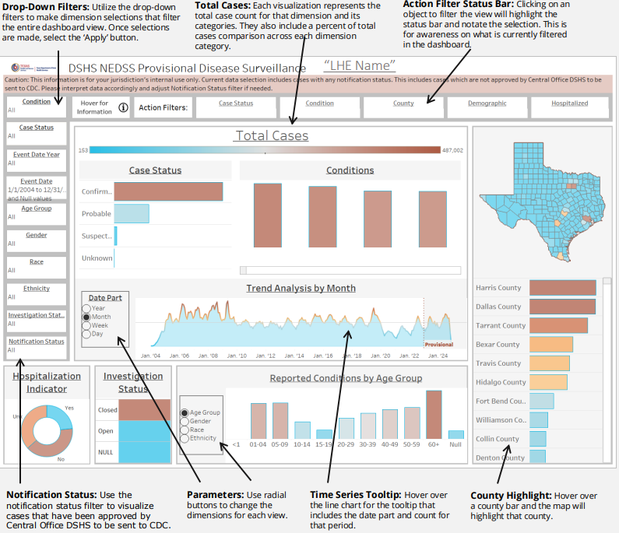
NEDSS Provisional Data Sharing: Phase 1
Tableau dashboard launched December 13, 2024
57 LHEs included in rollout
Dashboard can be used to support measles response
Utilization
Dashboard has ~1,600 views

Slide 12
NEDSS Provisional Data Sharing: Phase 2
Snowflake data views launched February 20, 2025
Additional training and support​
Two live webinar training sessions February 2025
Three office hours conducted in February and March 2025
Training resources included job aides and data dictionaries

Slide 13
Data Sharing Training and Feedback

Slide 14
Data Sharing Training
3 general webinars
Introduction to Data Sharing, Tableau, and Snowflake Training #1
Snowflake Training #2
Snowflake Training #3
Data set-specific materials to be shared via e-mail
Training content in HHS Learning Portal
Aligns with live training sessions (webinar content)
Allows users to refresh on training concepts (e.g. SQL)
Community of Practice
Monthly sessions by data set – launched January 2025
Encourage discussion among LHE peers on use of the shared data
Notes:
Need to discuss what the message should be for this upcoming meeting

Slide 15
Data Sharing Feedback Survey
Survey sent to authorized users who completed training through December
Received 6 responses
Additional surveys to be sent
Obtain feedback on IAMOnline, Snowflake, and Tableau:
Comfort level
Data use examples
Training and support provided during data sharing rollouts
Additional training needed
Use feedback provided to enhance training and communications

Slide 16
LHD Enablement Project

Slide 17
LHE Enablement Project
The goal of the project is to support building more effective partnerships and enhance collaboration with LHEs around public health data sharing
Over 100 LHE SHARP users responded to the survey - results are pending
The LHE Enablement Project is currently on pause

Slide 18
Thank you!

Slide 19
Appendix

Slide 20
Acronyms
IAMOnline – Identity and Access Management Tool
LHD – Local Health Department
LHE – Local Health Entity
MOU – Memorandum of Understanding
NEDSS – National Electronic Disease Surveillance System
SHARP – State Health Analytics & Reporting Platform
THCIC – Texas Health Care Information Collection

