Slide 1
Infectious Disease Prevention
Aelia Khan Akhtar
Associate Deputy Commissioner​
Texas Department of State Health Services​

Slide 2
Topics
Congenital Syphilis (CS)
Immunizations Data Sharing

Slide 3
State of the State for Congenital Syphilis (CS) in Texas, 2023
932 CS Cases
234.8 cases per 100,000 births
1% increase from 2022
113 Texas counties reported at least one case
CS Case Rates in the United States and Texas by Birth Year, 2014-2023
Notes:
In 2023, Texas reported 932 CS cases with a case rate of 234.8 per 100,000 births. This represents a nearly 1% increase in CS cases from 2022 when Texas reported 922 CS cases.
113 Texas counties reported at least one case of CS. This is a 7% increase in counties reporting at least one CS cases from 2022 when 107 counties reported at least one case of CS.

Slide 4
CS in Texas, Birth Year 2023
Classification | Case Count
Confirmed | 6
Stillbirth | 49
Probable | 877
Total | 932
Notes:
In 2023, Texas CS surveillance team investigated over 2,600 infants exposed to syphilis during pregnancy and Texas reported 932 CS cases. Texas saw an increase of 8 cases that resulted in confirmed (2 cases) and stillbirth (6 cases) case classification.

Slide 5
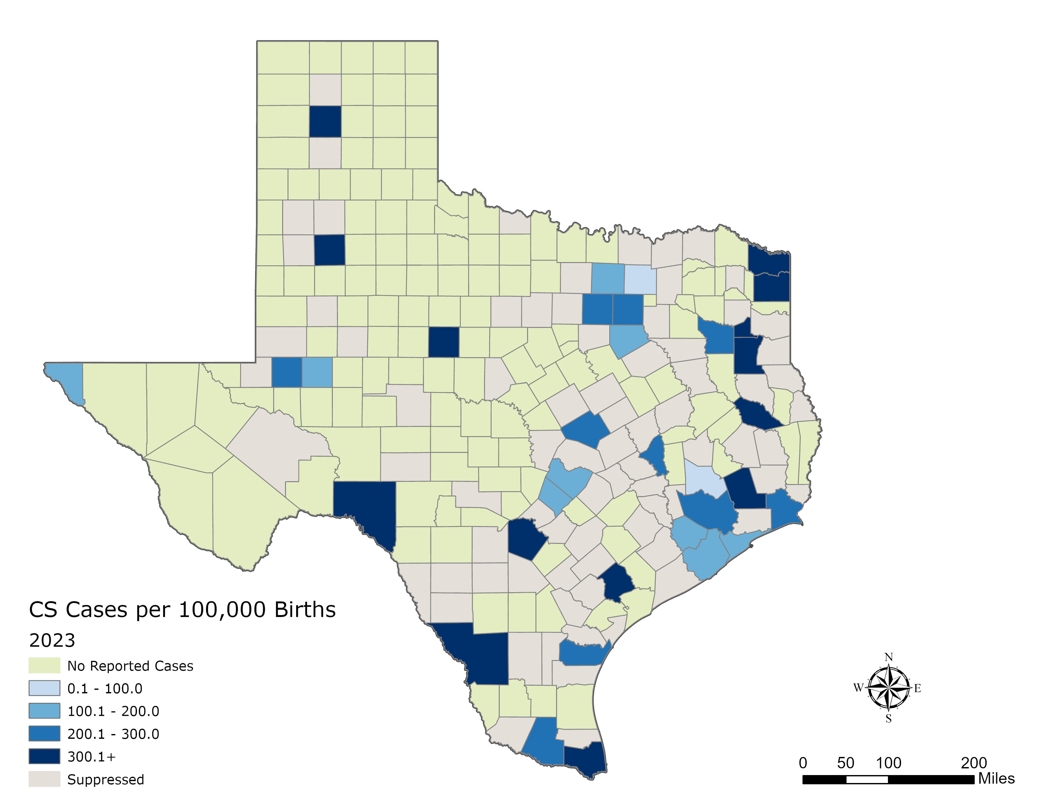
CS Rate in Texas by County, 2023
Notes:
While any county or region can be at risk of CS, a few counties reported a higher rate compared to the rest shown by the dark blue shading. Several counties (141 counties) did not report a single case of CS in 2023 as shown in green. And those shaded gray, display counties suppressed to ensure confidentiality of the data (reporting fewer cases <5 cases).

Slide 6
Immunizations Data Sharing

Slide 7
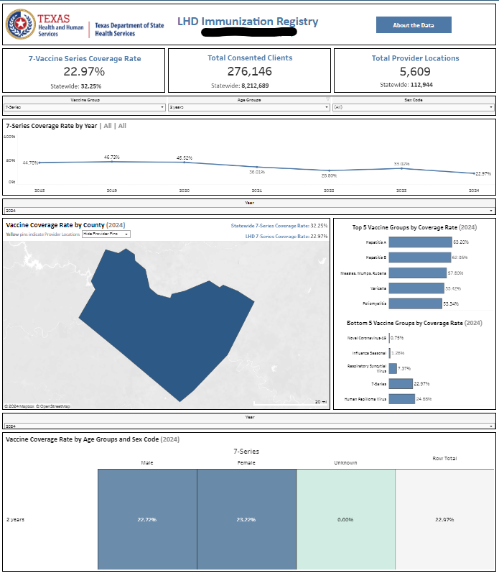
Immunizations Data Sharing
Every contracted LHD with the Immunization Section will have their own Tableau dashboard that includes coverage rate estimates based upon the data reported for their jurisdiction.
Statewide coverage rates will be included on the individual LHD dashboards for reference.
Example
Notes:
The Immunization line level data will transition from the current FTP server process to Snowflake in January. The provisioning process being used for the aggregate dashboard will be very similar to that provisioning process as well. LHDs should reach out to us if they have questions or run into problems.
A data use stipulation document has been created to help guide LHDs on how to utilize the data provided.
Client data does not include address and phone number since this data is not meant to be used in individual recall/reminder efforts.

