Slide 1
Welcome to
Let’s Talk - Safe Infant Sleep
Add instructions and/or QR code to complete the Community Training Pre-Test.
Notes:
The notes contained within this presentation are meant as suggested facilitator language and contain additional resources to support the facilitator and audience attending the Let’s Talk- Safe Infant Sleep Community Training
Image credit: Texas DSHS

Slide 2
Let’s Talk -
Safe Infant Sleep
Training Your Community with Conversations.
Notes:
The notes contained within this presentation are meant as suggested facilitator language and contain additional resources to support the facilitator and audience attending the Let’s Talk- Safe Infant Sleep Community Training
Image credit: Texas DSHS

Slide 3
Introductions
Please Share:
Notes:
Image credit: Texas DSHS

Slide 4
Pre-Work to Follow-Up
Pre-work
Training
Follow-up
Building on Campaigns Through Conversations modules
Let’s Talk -
Safe Infant Sleep
Community Training
Survey and Support
Notes:
This training is designed to include pre-work, training, and follow-up support led by facilitators who are safe sleep champions within their community and/or organization.

Slide 5
Ice Breaker
Find a partner and introduce yourself.
  Name
  Where you work
  How you interact with parents and caregivers
Find one set of the Memory Game cards on your table.
  Lay them all out “plain” side facing up.
  Mix them around.
  Play a quick game of “Memory,” taking turns with your partner to find the matching safe sleep topics.
  Save your “winning” matched pairs.
Notes:
Facilitator:
Ask participants to find a partner for the icebreaker activity
Partners will introduce themselves and will be asked to introduce their partner after the ice-breaker.
Memory Game Instructions:
This game is intended as an ice breaker for use during the train-the-trainer session of the DSHS Let’s Talk- Safe Infant Sleep Community Training. The cards can be printed on card stock and should be provided to each participant.
Ask participants to find a partner and introduce themselves.
Instruct participants to lay one set of cards out on the table with the symbols face down.
Set a short (2-3 minute) timer and instruct participants to take turns flipping two cards face up.
If the pair is a match the person can collect that pair in their “win stack” and take another turn.
If the pair is not a match, the person will flip the cards face down and let their partner have a turn.
Explain that participants may not understand all the symbols on the cards, but the goal is to match the most pairs by the end of time.
When the timer rings ask participants to count their “win stack” pairs.
Share the DSHS Safe Infant Sleep Environment Infographic with participants to identify their winning sets.
Ask participants to introduce the partner they played with – then identify and share a symbol from their “win stack” that they would like to learn more about during the training.
Ask participants to keep their “win stack” to use later in the training.
After Icebreaker:
1. Ask partners to introduce each other to the group.
2. Ask for volunteers to share one set of matched images. Follow this by asking:
What do they think the image represents?
How might this tie to our training topic- Safe Infant Sleep?
Facilitator may reassure participants that some of images maybe new to them, but they will begin to identify the images with safe sleep recommendations and materials provided during this training.
*Facilitator reminder for the later in the training*
Teach-back activity:
Included in the class agenda and training presentations is an opportunity for participants to partner up and practice the Let’s Talk Approach near the end of training.
Ask participants to find a partner and chose 1-3 of their matched pairs from the Ice Breaker Memory Game to use as topics in their practice.
Provide ample time and remind participants they may use any materials in the Let’s Talk Safe Infant Sleep toolkit to support their conversation.

Slide 6
Why Are We Here?
What Will We Learn?
Notes:
Image credit: Texas DSHS

Slide 7
Training Objectives
Describe evidence-based recommendations for parents and caregivers that reduce the risk of infant sleep-related deaths.
Demonstrate culturally supportive conversations to support caregiver knowledge intake of safe infant sleep practices.
Model the use of Let’s Talk- Safe Infant Sleep toolkit resources that may be used in community trainings.
Develop a Let’s Talk Circle of Support diagram of stakeholder within your organization to provide a Let’s Talk - Safe Infant Sleep community training.
Notes:
Describe evidence-based recommendations for parents and caregivers that reduce the risk of infant sleep-related deaths
Demonstrate culturally supportive conversations to support caregiver knowledge intake of safe infant sleep practices.
Model the use of Let’s Talk- Safe Infant Sleep toolkit resources that may be used in community trainings.
Develop a Let’s Talk Circle of Support diagram of stakeholder within their organization to provide a Let’s Talk- Safe Infant Sleep community training.

Slide 8
What Are We Learning Today?
Why safe infant sleep education remains a priority in Texas communities.
Safe sleep recommendations.
Strategies to spread safe infant sleep education to our communities.
How we can add a new strategy to the work we may already perform.
Notes:
Why safe infant sleep education remains a priority in Texas communities
Safe sleep recommendations
Strategies to spread safe infant sleep education to our communities
How we can add a new strategy to the work we may already perform

Slide 9
Building an Effective Training Key Considerations
What Is Our Role as a Trainer or Facilitator When Engaging Adult Learners?

Slide 10
Who Are We Trying To Reach?
Community Organizations
Community Educators
Parents and Caregivers
Notes:
Who are we trying to reach?
You! We are excited to have each of you here representing organizations that work within your community to support parents and infant caregivers.
This class uses a train-the-trainer model that will help you to replicate trainings within your community or organization. Today we will be discussing three distinct audiences as we learn about the new Let’s Talk- Safe Infant Sleep toolkit.
The Let’s Talk-Safe Infant Sleep Community Training and toolkit is meant for you to train safe infant sleep champions. These champions will train your boots on the ground contacts that we refer to as, “Community Educators."
Community Educators are individuals who work in a variety of community settings and support parents and other infant caregivers with health and quality of life.
The audience at the heart of all Let’s Talk- Safe Infant Sleep toolkit components are parents and other infant caregivers. A parent may include pregnant and post-partum mothers, their partners and extended family. While a caregiver is anyone who may support parents in caring for their child. Caregivers may include extended family members, friends, babysitters, childcare staff, and others.
Later today you will learn more about materials designed specifically for use with parents and infant caregivers- including class materials.

Slide 11
How Do Adults Learn Best? (1 of 2)
Let’s play a quick game and see if we can match our actions as facilitators of a training to elements that support learning in adults.
Example:
Adults learn best when the trainer values their contribution as learner and teacher.
Which answer is an example of this statement?
Avoid jargon and talking down to participants.
Encourage participation by all participants.
Give praise and encouragement.
Modify the teaching plan to accommodate learner experiences.
Notes:
Now that we have identified the audiences that today’s training will discuss and impact, let’s look at how we can reach audiences that are made up of mostly adults.
How many times have you attended a training and thought- Geez, I just wasted half my day?
We will have check-ins with you during the training to see how things are going and encourage you to do the same in your own trainings.
We hope that won’t be the case today as you take what you learn here back to your organizations!
Because we all come from different backgrounds it can be helpful to understand how we as adults engage and learn.
You'll also hear us use the term "facilitator” this is a safe sleep champion for a community or organization. The main goal of the facilitator is to prepare community educators to present information effectively, respond to participant questions, and lead activities that reinforce learning. Understanding how adults learn best is an important lesson in the train-the-trainer process.
*This activity can be played as an individual matching game, as whole class activity, or through electronic formats like Kahoot! or Blooket.
(Allow participants to play the game in the format you selected as the Facilitator of this training).

Slide 12
How Do Adults Learn Best? (2 of 2)
Adults learn best when:
They feel valued and respected for their experience and perspective.
The experience is active, not passive and reinforced.
The experience fills an immediate need.
New material is related to what they already know.
The environment is comfortable (small groups).
The trainer values their contribution as learner and teacher.
Notes:
Let’s see how well we did…
They feel valued and respected for the experiences and perspectives they bring to the training.
Therefore, they wish to speak, participate and contribute to the training. They dislike long lectures and one-way communication. Avoid the use of technical language or jargon- keep conversation suited to participants.
The learning experience is active and not passive. What is one example you discovered today?
Adults are accustomed to being active. They should be given an opportunity for active participation whenever possible.
Learning is reinforced.
Adults want positive reinforcement of desired behavior and feedback about errors at the moment they occur. Today we will practice this by modeling conversations with a partner.
The learning experience fills their immediate needs.
Adults learn best when content connects clearly and directly with tasks faced by the learner on the job or in life. This is important when planning and inviting participants to your own training.
New material is related to what participants already know.
Adults want courses that focus on real-life problems and tasks rather than academic material. A strong how-to focus is desired. They become restless if they believe their time is being wasted. We all dislike this right? Connect the content through active listening and facilitating discussion with participants where they can share their connections and grow.
The learning environment is conducive to learning. Adults learn best in comfortable settings.
Therefore, physical discomfort will distract or create negative feelings. Plan for a space that is suitable, breaks, and comforts that will support your participants.
Learning occurs in small groups. This may be especially helpful in the new strategies we will be sharing today. You will see this used throughout the training in partner activities.
The trainer values their contributions as both a participant and a teacher. Adults learn when mistakes are honored as well as successes. People learn from mistakes. Providing a training where all participants feel welcomed, respected, and valued is a critical element for adult learners.

Slide 13
Why Is Safe Infant Sleep Important?
Defining the Problem in Texas
Notes:
Image credit: Texas DSHS

Slide 14
Defining the Problem: (1 of 3)
Sleep-related infant death: A sudden, unexpected infant death that occurs during an observed or unobserved sleep period or in a sleep environment.
Sudden unexpected infant death (SUID): The sudden and unexpected death, whether explained or unexplained (including sudden infant death syndrome (SIDS) and ill-defined deaths), occurring during infancy.
Notes:
Before we look at the why, let’s review the common terms used with safe infant sleep.
Sleep-related infant death: A sudden, unexpected infant death that occurs during an observed or unobserved sleep period, or in a sleep environment,
Sudden Unexpected Infant Death (SUID): The sudden and unexpected death, whether explained or unexplained (including sudden infant death syndrome (SIDS) and ill-defined deaths), occurring during infancy.
Sudden Infant Death Syndrome (SIDS): Cause assigned to infant deaths that cannot be explained after a thorough case investigation, including a scene investigation, autopsy, and review of the clinical history.
Accidental strangulation or suffocation (ASSB): An explained sudden and unexpected infant death in a sleep environment (bed, crib, couch, chair, etc.) in which the infant’s nose and mouth are obstructed or the neck or chest is compressed from soft or loose bedding, an overlay, or wedging causing asphyxia.
Reference:
Moon RY, Carlin RF, Hand I; AAP Task Force on Sudden
Infant Death; AAP Committee on Fetus and Newborn. Evidence
Base for 2022 Updated Recommendations for a Safe Infant
Sleeping Environment to Reduce the Risk of Sleep-Related
Infant Deaths. Pediatrics. 2022;150(1):e2022057991
Source: https://healthdata.dshs.texas.gov/dashboard/births-and-deaths/infant-deaths

Slide 15
Defining the Problem: (2 of 3)
Sudden infant death syndrome (SIDS): The cause assigned to infant deaths that cannot be explained after a thorough case investigation, including a scene investigation, autopsy, and review of the clinical history.
Accidental strangulation or suffocation (ASSB): An explained sudden and unexpected infant death in a sleep environment (bed, crib, couch, chair, etc.) in which the infant’s nose and mouth are obstructed or the neck or chest is compressed from soft or loose bedding, an overlay, or wedging causing asphyxia.
Notes:
Before we look at the why, let’s review the common terms used with safe infant sleep.
Sleep-related infant death: A sudden, unexpected infant death that occurs during an observed or unobserved sleep period, or in a sleep environment,
Sudden Unexpected Infant Death (SUID): The sudden and unexpected death, whether explained or unexplained (including sudden infant death syndrome (SIDS) and ill-defined deaths), occurring during infancy.
Sudden Infant Death Syndrome (SIDS): Cause assigned to infant deaths that cannot be explained after a thorough case investigation, including a scene investigation, autopsy, and review of the clinical history.
Accidental strangulation or suffocation (ASSB): An explained sudden and unexpected infant death in a sleep environment (bed, crib, couch, chair, etc.) in which the infant’s nose and mouth are obstructed or the neck or chest is compressed from soft or loose bedding, an overlay, or wedging causing asphyxia.
Reference:
Moon RY, Carlin RF, Hand I; AAP Task Force on Sudden
Infant Death; AAP Committee on Fetus and Newborn. Evidence
Base for 2022 Updated Recommendations for a Safe Infant
Sleeping Environment to Reduce the Risk of Sleep-Related
Infant Deaths. Pediatrics. 2022;150(1):e2022057991
Source: https://healthdata.dshs.texas.gov/dashboard/births-and-deaths/infant-deaths

Slide 16
Defining the Problem: (3 of 3)
Room Sharing: When baby sleeps in the same room as parents, other adults, caregivers, or other children - but on a separate sleep surface (crib, bassinet, or play yard). Room sharing is known to reduce the risk of SIDS and supports continued exclusive breastfeeding.
Bed Sharing: When baby shares a sleep surface (adult bed, sofa, recliner, or other surface used for sleep) with a parent, other child, and/or another adult caretaker.
Notes:
Now that we’ve seen the data/numbers that shows we still have work to do. Let’s make sure we are on the same page with our language when we are talking about safe sleep.
Room Sharing: When baby sleeps in the same room as a parents, other adults, caregivers or children, but on a separate sleep surface (crib, bassinet, or play yard). Room sharing is known to reduce the risk of SIDS and supports continued exclusive breastfeeding.
Bed Sharing: When baby shares a sleep surface (adult bed, sofa, recliner, or other surface used for sleep) with a parent, other child, and/or another adult caretaker.
Tummy time: Placing your baby on his or her tummy on the floor while he or she is awake. A baby should never be left unattended, especially during tummy time.
Will this training address co-sleeping?​
Not at this time. The term co-sleeping may be used in other publications or trainings, but the definition is not always used consistently, so it lacks clarity. It can be variably used to describe sleeping in close proximity (e.g., room sharing) and/or sharing of sleep surface/space (example of bed sharing). This training follows the 2022 AAP safe infant sleep recommendations which focuses on infants having their own sleep surface and space.
Reference:
Rachel Y. Moon, Rebecca F. Carlin, Ivan Hand, THE TASK FORCE ON SUDDEN INFANT DEATH SYNDROME and THE COMMITTEE ON FETUS AND NEWBORN; Evidence Base for 2022 Updated Recommendations for a Safe Infant Sleeping Environment to Reduce the Risk of Sleep-Related Infant Deaths. Pediatrics July 2022; 150 (1): e2022057991. 10.1542/peds.2022-057991

Slide 17
Why Is Safe Infant Sleep Important?
Every year, approximately 3,400 infants die in the United States due to sleep-related death.
SIDS is the third highest cause of infant death in Texas.
In Texas, Non-Hispanic Black infants are 2.5 times more likely to die from SIDS than Non-Hispanic White infants.
Notes:
Research shows that improvements from the past 20 years have since stalled in reducing sudden infant death syndrome (SIDS) and other sleep-related infant deaths. Data from 2020* shows SIDS, unknown or unexplained cause, and accidental suffocation and strangulation in bed were the second, third, and fourth most common causes of infant mortality in the U.S. We especially need strategies to reach populations that show higher rates of infant death over others.
Reference:
Moon RY, Carlin RF, Hand I; AAP Task Force on Sudden
Infant Death; AAP Committee on Fetus and Newborn. Evidence
Base for 2022 Updated Recommendations for a Safe Infant
Sleeping Environment to Reduce the Risk of Sleep-Related
Infant Deaths. Pediatrics. 2022;150(1):e2022057991
Sources:
https://www.dshs.texas.gov/sites/default/files/healthytexasbabies/Documents/2022%20-%202023%20Healthy%20Texas%20Mothers%20and%20Babies%20Data%20Book.pdf
https://healthdata.dshs.texas.gov/dashboard/births-and-deaths/infant-deaths

Slide 18
Breakdown of SUID in U.S. by Cause, 2020
SOURCE: CDC/NCHS, National Vital Statistics System, Mortality Files. Rates calculated via CDC WONDER.
Notes:
In 2020, there were about 1,389 deaths due to SIDS, about 1,062 deaths due to unknown causes, and about 905 deaths due to accidental suffocation and strangulation in bed.
Reference: https://www.cdc.gov/sids/data.htm
SOURCE: CDC/NCHS, National Vital Statistics System, Mortality Files. Rates calculated via CDC WONDER.
This chart shows the breakdown of sudden unexpected infant deaths (SUID) by cause in 2020.
*SUID cases were reported as shown below:
Sudden infant death syndrome (41%)
Unknown cause (32%)
Accidental suffocation and strangulation in bed (27%)
*Exact values are as follows:
Sudden infant death syndrome: 1389
Unknown: 1062
Accidental suffocation and strangulation in bed: 905
Reference: https://www.cdc.gov/sids/data.htm
SOURCE: CDC/NCHS, National Vital Statistics System, Mortality Files. Rates calculated via CDC WONDER.

Slide 19
Which Texans Are Most at Risk? (1 of 3)
*2021 data are provisional
Source: 2012-2021 Live Birth Files, National Center for Health Statistics
Prepared by: Maternal & Child Health Epidemiology Unit
Jan 2023
Notes:
Looking at SIDS which is bright yellow we can see the leading cause of death by race and ethnicity in 2021. The graphs shows infant deaths per 10, 000 live births. Non-Hispanic Black infants rate of death is the highest and shows a disparity to other populations. The blue arrow indicates the difference in rates of sleep related infant death. It is our area of opportunity to move the needle and reduce infant mortality.
This statistic may be hard for families in high-risk populations to hear, sharing information and using the Let’s Talk approach can position you as a joint problem solver with the family or caregiver. This can help move the needle and reduce disparities among populations.
Reference: Healthy Texas Mothers and Babies Data Book, 2023
https://www.dshs.texas.gov/sites/default/files/healthytexasbabies/Documents/2022%20-%202023%20Healthy%20Texas%20Mothers%20and%20Babies%20Data%20Book.pdf

Slide 20
Which Texans Are Most at Risk? (2 of 3)
Mothers Who Reported Placing Infant on Approved Sleep Surface to Sleep and Placing Infant to Sleep Without Loose Bedding or Soft Objects by Race and Ethnicity, Texas PRAMS 2020
Texas Total
49.3 %
Texas Total
34.2 %
Error Bars: 95% Confidence Interval
Source: 2020 Texas PRAMS
Prepared by: Maternal & Child Health Epidemiology Unit
Oct 2022
Notes:
Two common practices that are monitored through the CDC Pregnancy Risk Assessment Monitoring System (PRAMS) survey are Mothers Who Reported Placing Infants on Approved Sleep Surface and Placing Infant to Sleep Without Loose Bedding or Soft Objects. Again, this information shows us that non-Hispanic Black Mothers are less likely to report placing their infants to sleep on an approved sleep surface.
What can we do? How can we close this gap?
Reference: Healthy Texas Mothers and Babies Data Book, 2023
https://www.dshs.texas.gov/sites/default/files/healthytexasbabies/Documents/2022%20-%202023%20Healthy%20Texas%20Mothers%20and%20Babies%20Data%20Book.pdf

Slide 21
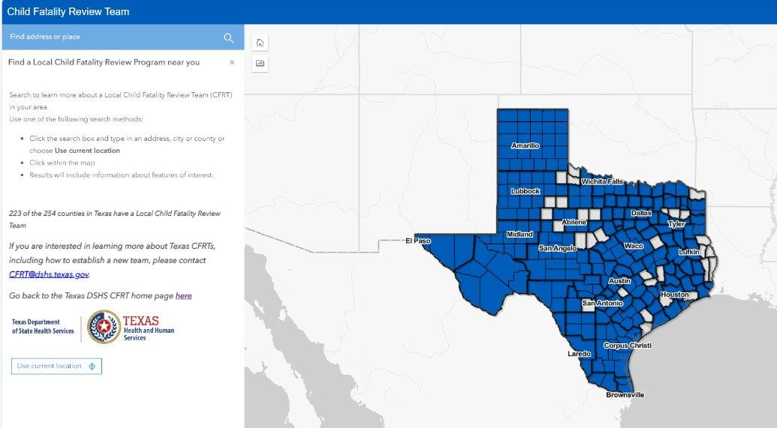
Which Texans Are Most at Risk? (3 of 3)
Local level data may be developed with support from your area’s Child Fatality Review Team (CFRT) or Fetal Infant Mortality Review (FIMR) team.
Local CFRTs can report on indicators related to the AAP safe sleep recommendations.
223 of the 254 Texas counties have a local CFRT or FIMR team.
Example of CFRT Directory website. Click on image to go to the website.
Notes:
Two common practices that are monitored through the CDC Pregnancy Risk Assessment Monitoring System (PRAMS) survey are Mothers Who Reported Placing Infants on Approved Sleep Surface and Placing Infant to Sleep Without Loose Bedding or Soft Objects. Again, this information shows us that non-Hispanic Black Mothers are less likely to report placing their infants to sleep on an approved sleep surface.
What can we do? How can we close this gap?
Reference: Healthy Texas Mothers and Babies Data Book, 2023
https://www.dshs.texas.gov/sites/default/files/healthytexasbabies/Documents/2022%20-%202023%20Healthy%20Texas%20Mothers%20and%20Babies%20Data%20Book.pdf

Slide 22
Why Do We Need to Include a New Strategy?
Recognize each family’s needs, beliefs, and context within their lives (social drivers of health, or SDOH).
Choose an individualized approach to promote safe sleep to increase the likelihood of changing behaviors.
Integrate breastfeeding and safe sleep, which mutually affect each other.
Have conversations with caregivers and families to shift their view of your role from “expert” to “problem-solver” using shared decision-making.
Develop a circle of support within your community that provides consistent messaging from multiple sources, multiple times.
Normalize newborn behaviors and expectations so parents are better positioned to manage feeding, crying, and infant sleep patterns.
Notes:
Do we need a new strategy?
YES!
Why do we need a new strategy?
The research shows us that while we made overall improvements in the past 20 years, we have stalled in our efforts to reduce and prevent these types of infant deaths. We especially need strategies to reach populations that show higher rates of death. How can we reach more people and reduce risks?
Recognize each family’s needs, beliefs, and context within their lives (SDOH).
Choose an individualized approach to promoting safe sleep to increase the likelihood of changing behaviors.
Integrate breastfeeding and safe sleep, which mutually affect each other.
Have conversations with caregivers and families to shift their view of your role from “expert” to “problem-solvers” using shared decision making.
Develop a circle of support within your community that provides consistent messaging from multiple sources, multiple times.
Normalize newborn behaviors and expectations so that parents are better positioned to manage feeding, crying and infant sleep patterns.
“Research depicts parents are more likely to change their behaviors and practices when they hear messages from multiple sources within their communities, underscoring the importance of delivering ISS and breastfeeding education across multiple venues.“
Before we dive into this new strategy let’s make sure we all feel up to date on accurate evidence-based information
Additional resource from NCEMCH: Is this really just motivational interviewing?
While the Conversations Approach has much in common with motivational interviewing (and those skilled in implementing motivational interviewing will be very effective), it is not the same. Motivational interviewing is a specific clinical intervention that takes a high level of skill and specific training to implement effectively. The Conversations Approach also requires skill and training and reflects the mind-set of motivational interviewing—a dialogue in which an individual can share and address their reluctance (resistance) to behavior change and work towards making some steps to change. It is different in that the goal is not moving the infant caregiver to a predetermined set of behaviors but to work with them to make the best decisions for their child within their parameters and supporting them to meet the challenges to maintain those behaviors. The hope is, over the course of the conversations, that caregivers will choose to implement the recommended safe sleep and optimal breastfeeding behaviors in total. However, the Conversations Approach recognizes the reality that families make other decisions and supports them to minimize risk and maximize benefits within their chosen approaches.
Reference:
Module 1: A New Approach - Building on Campaigns with Conversations | NCEMCH
https://bmcpublichealth.biomedcentral.com/articles/10.1186/s12889-023-15227-4

Slide 23
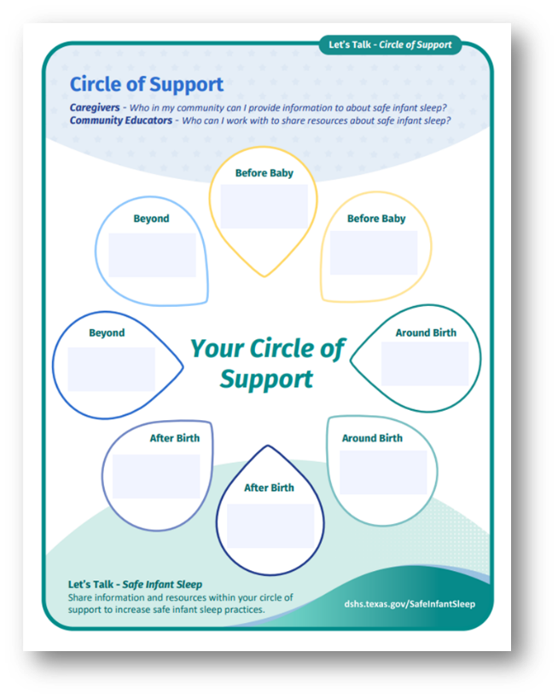
A Community’s Circle of Support
Where do you fit within the circle?
Parents and Caregivers may receive support from multiple sources at multiple times.
Example image of resource.
Notes:
(This slide can be used to stop and take a stretch break.)
Ask participants to find the Let’s Talk Circle of Support handout shown on the slide.
Activity:
Ask participants to stand and work together in forming a circle that includes each of the touchpoints shown within the circle of support:
Before baby
Around birth
After birth
Beyond
Once the group forms a circle ask them to recite where they work and which touchpoint they impact.

Slide 24

What Do We Know?

Slide 25
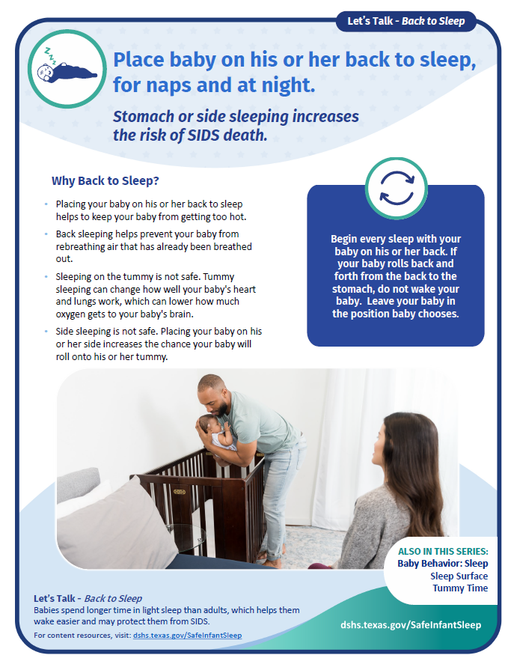
What Do We Know?
Baby behaviors
Recommendations
Myths and facts game
Example image of resource.
Notes:
Before we move into the next section, please find the Discussion Guides included in your toolkit for reference. The Guides include a parent-facing side (blue side) that helps to explain the “why” behind the AAP 2022 recommendations as well as a facilitator side that includes responses to common barriers experienced by parents (green side).
Now that everyone is ready, in this section we will cover: ​
Introduction of normal baby behavior​;
​ A discussion on the “why” behind the safe infant sleep recommendations​; and
Share information on special topics that can impact safe sleep practices.
Image credit: Texas DSHS

Slide 26
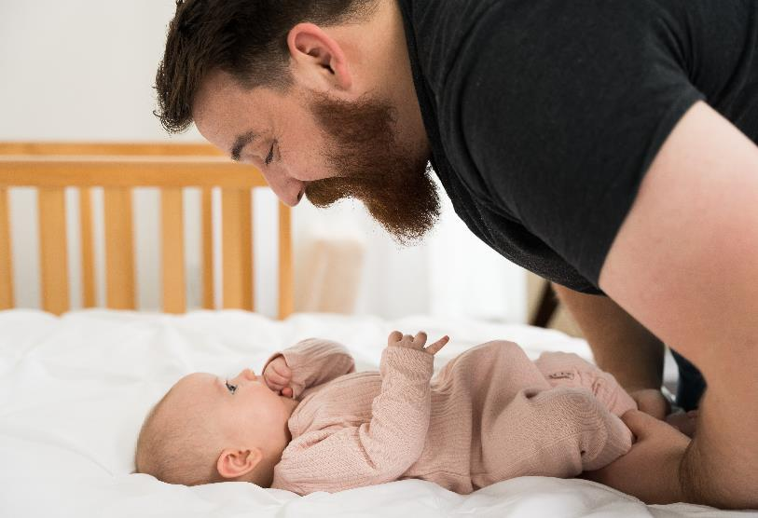
What Is Normal Baby Behavior?
Parents are often concerned with the following issues:
  Why their infant cries
  How their baby eats
  How well their baby sleeps
These issues may cause them to change how they adopt safe infant sleep practices.
Notes:
What are some concerns regarding their baby that come up frequently when you work with families? (prompt: crying, sleeping, feeding sound familiar?)
To help support these common concerns which can also have an impact on a parent or caregivers' adoption of safe sleep practices, we included these topics in the Discussion Guides were to help parents prepare for these common concerns which we refer to as “Baby Behavior.” When parents understand what their baby needs, or how their baby may be trying to communicate their needs, they are better positioned to manage these issues by developing a plan ahead of time so that when faced with it head on, they feel less stressed about finding a solution. ​
​
As we see with the safe sleep recommendations, when they don’t know the “why” behind the behavior, they may create solutions that include unsafe sleep practices.​
​
The training today focuses on:
Crying
Feeding​
Baby’s sleep patterns​
​
​​Information Source: Texas WIC (breastmilkcounts.com) and Dr. Jane Heinig, UC Davis California​
​
Image credit: Texas DSHS

Slide 27


Baby Behavior - Crying
Crying is a baby's way of saying, “something needs to change now!”
Teach parents and caregivers to calm their baby by:
Holding their baby close or in skin-to-skin contact​.
Speaking or singing softly to their baby using calming sounds or words​.
Rocking their baby gently with a back-and-forth motion.
Gently massaging their baby's back, arms, and legs.
Notes:
Baby Behavior- Crying- Crying lets parents and caregivers know that baby needs quick attention and is meant to move adults to action!​
Babies may use cues or signs to let their parents know what they need before they start to cry. But those cues might be hard to understand when you are first learning to care for your baby or can be easily missed when parents are tired. Encourage parents to look for the cause of baby’s distress- it could be they are too hot/cold, have trapped gas and need to burp, need to be held or have their diaper changed, are overstimulated, feeling pain, ​or are hungry. Often, parents and other caregivers believe that crying equals hunger which may cause them to try and feed baby each time. As parents learn their baby over time, understanding the “why” behind their cry gets easier to determine. ​
​​
Parents can try to calm their baby by: ​
holding baby in skin-to-skin, ​
talking or singing softly while rocking them back and forth​
offer baby massage​
taking them for a walk in a carrier, sling, or stroller ​
​
​
Information Source: Texas WIC (breastmilkcounts.com) and Dr. Jane Heinig, UC Davis California
​
Image credit: Texas DSHS

Slide 28


Baby Behavior - Feeding Cues
Babies use cues to signal a need.​
When babies are ready to eat, they may:
Move their hands or fists to their mouth​.
Make sucking motions or soft noises​.
Smack their lips​.
Nuzzle against the chest or search for the breast.
When babies are full and want to stop eating, they may:
Release or "fall off" the breast or bottle​.
Turn away from the breast or nipple​.
Relax their body and open their hands.
Notes:
Baby Behavior- Feeding Cues-Babies use signals or cues to let parents and caregivers know when they want to start or stop feeding.​​
[read slide]​
​
All babies give these signals, no matter how they are being fed, so teaching parents these cues can help them best respond to their baby’s needs. If parents don’t know how to tell when their baby is hungry, they may choose to provide formula to keep baby “fuller”, or they may add solids to their diet earlier than it is recommended, which can have an impact on mom’s milk supply, and limit how long she is able to exclusively breastfeed. Feeding a baby too much by bottle (with either formula or breastmilk) so that they sleep longer is not recommended and may limit their protection against SIDS.​
​
If parents have any concerns about their baby’s feeding patterns, encourage them to talk with their baby’s doctor, or if breastfeeding, visit a lactation consultant for help.​
​
Additional context (if needed):​
Parents and caregivers may also express concerns that their baby wants to feed all the time. It can be helpful to explain:​
There may be times when it feels like your baby wants to nurse more often for short periods of time during the day—sometimes every hour. ​
This is called “cluster feeding” and it tends to last only a few days. ​
You can be sure that cluster feeding is okay if your baby is gaining weight and growing well and has some time between feedings when they are content.​
​
Information source: Texas WIC (breastmilkcounts.com) and Dr. Jane Heinig, UC Davis California​
​
Image credit: Texas DSHS

Slide 29

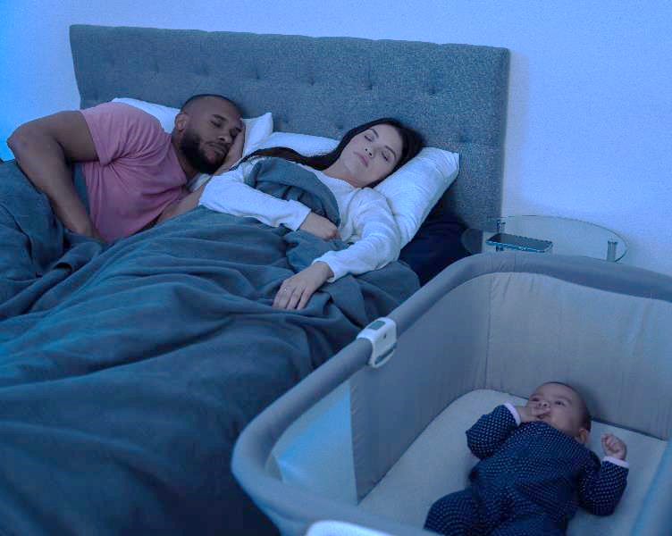
Baby Behavior - Sleep
It is normal for babies to wake up often at night.
Newborns spend more time in light and active sleep which helps them wake more easily to eat, stay warm, and move when needed.
Light sleep helps babies’ brain to grow.
As babies get older, they will sleep for longer stretches of time and spend more time in deep sleep.
Notes:
Baby Behavior- Sleep- It is normal for babies to wake up often at night. Waking is protective and signals a need, so there are many reasons young babies don't (and shouldn't) sleep through the night.​​
Newborn babies spend more time in light and active sleep, which helps them to wake more easily.
In light sleep, newborns dream and this is also a time for brain growth. Just like adults, they are more likely to wake when they are dreaming. ​​
If babies sleep too deeply, they may not be able to wake up if they get too hot or cold or if they need more air.​​
​
It is understandable that new parents might be looking for answers to get more sleep. This is a time of adjustment for the whole family. Because waking frequently at night is normal for newborns sleep training actually goes against their normal development. ​Sharing this information with parents early, will help them to understand that this is normal and to plan for how to get rest.​
​
​
​
Optional:​
What are some things you might suggest to parents and caregivers to support them getting rest?​
​
(Information Source: Texas WIC (breastmilkcounts.com) and Dr. Jane Heinig, UC Davis California)​
​
Image credit: Texas DSHS

Slide 30
Sleep Recommendations Review
Back to sleep
Sleep Surface
Breastfeeding
Room Sharing
Clear Crib
Smoke-free and Vape-free
Avoid Alcohol and Drugs
Pacifiers
Overheating
Regular Baby Checkups
Avoid Monitors and Devices
Tummy Time
Swaddling
Emergencies*
Special Health Conditions*
Sleep Training*
Regular Prenatal Care
*Not recommendations but included with AAP Evidence, 2022.
Notes:
The recommendations in this section come from the American Academy of Pediatrics Policy Statement - Sleep-Related Infant Deaths: Updated 2022 Recommendations for Reducing Infant Deaths in the Sleep Environment.
Like baby behavior, the topics with asterisks include 3 additional situations that can have significant impacts on the adoption or continuation of safe sleep practices.
When you train your community educators it’s important to review the recommendations even if you think you are training a room full of experts.​ The recommendations are provided in order of the evidence to support risk reduction and are aligned with the DSHS Safe Infant Sleep infographic.
The slides include the recommendation, a bolded “why” statement behind the recommendation, and in the notes section, additional context and resources should you need them.
​
Reference:
AAP Technical Report Link: https://publications.aap.org/pediatrics/article/150/1/e2022057991/188305/Evidence-Base-for-2022-Updated-Recommendations-for?autologincheck=redirected

Slide 31

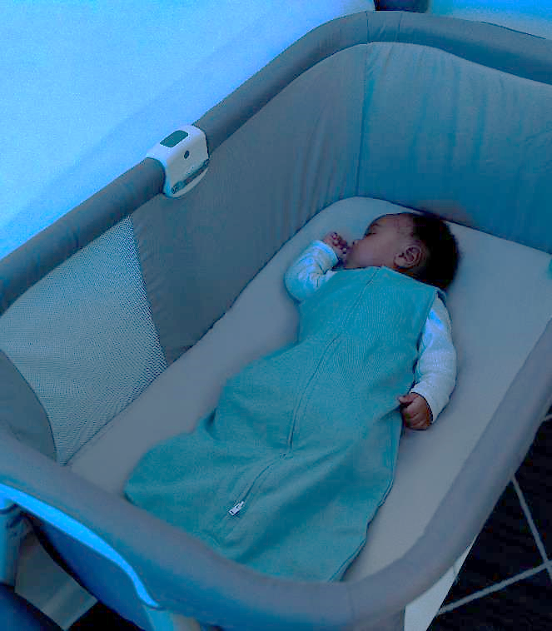
Back to Sleep for Every Sleep
Stomach or side sleeping increases the risk of SIDS death.
Back sleeping is safest for infants.
Babies should be placed on their backs to sleep for every sleep, including naps.
Babies who are placed to sleep on their tummies have a much higher risk of unexpected death, especially if they usually sleep on their backs.
Notes:
WHY- stomach or side sleeping increases the risk of SIDS death​
Back sleeping is safest for infants and should be used for every sleep, including naps.​
Babies who are placed to sleep on their tummies have a much higher risk of unexpected death, especially if they usually sleep on their backs.​
Parents should share this information with everyone who cares for the baby.​
​
Parents and caregivers are often concerned about what position to place an infant to sleep once their babies can roll over. Babies generally learn to roll over between 4 and 6 months of age. The AAP reports that there is not data to support when it is safe to place babies on their stomachs to sleep. If they roll over on their own, they can stay in the position they roll into. Once babies can roll over, keeping the sleep environment free of all other items is even more important so that they do not roll over onto them during sleep.​
​
​
Additional context (if needed):​
Why is sleep position related to infant death?​
Sleeping on the stomach increases the baby’s risk of re-breathing the same air that is under the baby’s face.​
Sleeping on the stomach increases the risk of the baby getting overheated.​
In young babies, 2 to 3 months, sleeping on the stomach changes how the nervous system controls the cardiovascular system.​
Source for information – AAP Recommendations and NCEMCH and NAPPSS Building on Campaigns with Conversations Training)
​
Image credit: Texas DSHS

Slide 32

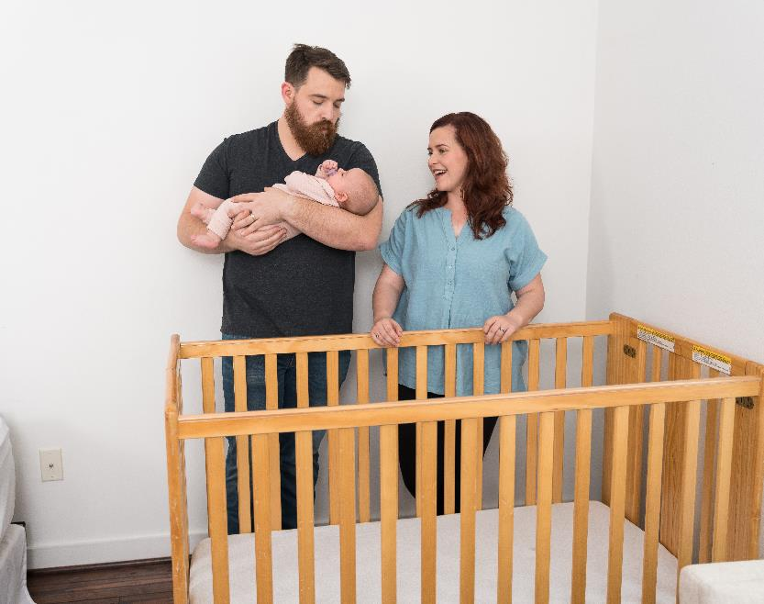
Sleep Surface
Soft surfaces — like couches, sofas, memory foam, or fluffy blankets- can cause your baby's breathing to get cut off.
Make sure sleep surface is firm, flat, and level (not at an angle) and covered only with a fitted sheet.
Parents can sign up for recall alerts on the CPSC site to ensure their crib has not been recalled at www.cpsc.gov/SafeSleep ​.
Notes:
Soft objects, bedding, and other items in the sleep environment can become a barrier to baby’s breathing and lead to death.
Use a safety approved* sleep surface that is firm, flat, and level (not inclined) and covered only with a fitted sheet.​
Take toys, stuffed animals, bumper pads, blankets, and other objects out of the crib.​
Do not use wedges or positioning devices.​
Do not use crib bumpers.​
Baby should have their own sleep surface; babies should not share a sleep space or crib with a twin, other siblings, or pets.​
Do not place near window coverings or cords, do not hang mobiles overhead.​
​
You will hear the term safety-approved during this training. What does this mean? How do parents and caregivers know if their baby’s sleep surface is safe?​
Standards for safety approved sleep surfaces such as cribs, bassinets, portable play areas, and side cars (attachment to an adult bed that provides a separate, but close safe space) have been developed by the U.S. Consumer Product Safety Commission, the agency that tracks accidents and deaths with products and helps keep babies safe from products that can be harmful or cause accidents. Parents can sign up for recall alerts on the CPSC site to ensure their crib has not been recalled.​
www.cpsc.gov/SafeSleep ​
​
​
Additional context (if needed):​
Pillow top mattresses, foam mattresses and other soft surfaces are a problem because the baby’s face can get pushed into them and breathing can be blocked. These items in the baby’s sleep area can increase the risk of sleep related death by five times.​
​
​
(Source for information – AAP Recommendations and NCEMCH and NAPPSS Building on Campaigns with Conversations Training)
Image credit: Texas DSHS

Slide 33


Breastfeed to Reduce the Risk of SIDS
Feeding baby only breast milk for the first six months provides the greatest protection from SIDS.
The longer a baby is exclusively breastfed, the lower the risk of dying from SIDS.
Feeding baby breast milk from the breast or bottle is more protective than not feeding baby breast milk at all.
Notes:
WHY- Feeding baby only breastmilk for the first six months provides the greatest protection from SIDS.​
The protection is dose dependent, meaning the longer a baby is exclusively breastfed, the lower their risk of dying from SIDS.​
​ Providing breastmilk by breast or bottle is more protective than not feeding breastmilk at all.
Breastfeeding is the biological normative way to feed an infant and every other way of feeding should closely mimic breastfeeding, when possible. ​We recognize that not all mothers are able to successfully breastfeed or may choose to provide formula for their infants. It is important to share the recommendation that breastmilk/ breastfeeding offers a protection against SIDS, but equally important to share with mothers using formula, is information on how to safely prepare, store, and feed their baby, paying attention to feeding cues which we’ll talked about earlier and use paced bottle-feeding to mimic the normal pace of breastfeeding.​ Formula resource information is included in the slide notes.
​
​
Additional context (if needed):​
Formula feeding increases a baby's risk of SIDS. This may be because breast milk protects babies from infections and diarrhea and because babies who are breastfed do not sleep as deeply and may more easily arouse themselves if they are not getting enough oxygen. Thus, the advice that parents receive to add formula to the baby’s diet to get the baby to sleep longer is counterproductive—sleeping more deeply and longer may increase risk of death.​
(Source for information – AAP Recommendations and NCEMCH and NAPPSS Building on Campaigns with Conversations Training)​
​
The following information should be provided to parents regarding feeding: ​
For those that are not directly breastfeeding, or are feeding breastmilk by bottle​
safe handling and storage of breastmilk​
safe preparation of the bottle and all feeding implements​
safe preparation of formula​
Paced bottle-feeding​
​
Information Source: CDC- Guidelines and Recommendations: https://www.cdc.gov/breastfeeding/recommendations/index.htm)​
Additional resource: https://texaswiccatalog.specialbee.com/product/breastfeeding-guide-how-to-get-off-to-a-great-start/ ​
​
Image credit: Texas DSHS

Slide 34


Breastfeeding and Safe Sleep: How to Make It Work
Breastfeeding and bedsharing can often be a hard topic to talk about with parents and caregivers.
You can help parents to create a plan and share the following topics:
  Preparing the sleep space.
  Normal hormone-driven sleep during breastfeeding.
  How to respond to drowsiness or falling asleep when feeding.
Notes:
We recognize the intersection of breastfeeding and bed-sharing and how this may create tension for parents when safe sleep recommendations only focus on what “not to do.” ​
​
Using the Let's Talk conversations approach can help identify and reduce potential risks. Share information with parents and caregivers such as:​
Preparing the sleep space before bringing baby into the bed for feeding or comforting​
Help breastfeeding mothers understand that feeling sleepy during breastfeeding is likely to occur, is normal and due to hormones that are released during suckling that cause drowsiness​
Develop a plan to combat falling asleep such as setting an alarm to help keep them awake, asking someone to stay with you while you are breastfeeding/comforting baby in your bed, and others.
​
​
Additional context (if needed):​
The NAPPSS coalition that developed Building on Campaigns through Conversations found that a common concern of community educators was:​
I am not an expert on breastfeeding or safe sleep. How am I supposed to integrate these topics into a conversation?​
These modules will provide you with the knowledge you will need to have conversations with families about both topics. View this training as team sport- you may need to identify others within your Circle of Support with more expertise to guide families through implementing safe sleep and breastfeeding at home with their infants. But you can raise both issues and provide the basic information families need to decide to embrace them. If they raise technical questions, then you can rely on other experts and connect them to those resources. But for the family, these two issues are the biggest challenges they face when they get a new baby home—they are not separate at all—and to effectively support families, we need to break down the silos!​
​
(Source for information – AAP Recommendations and NCEMCH and NAPPSS Building on Campaigns with Conversations Training)​
​
Image credit: Texas DSHS

Slide 35
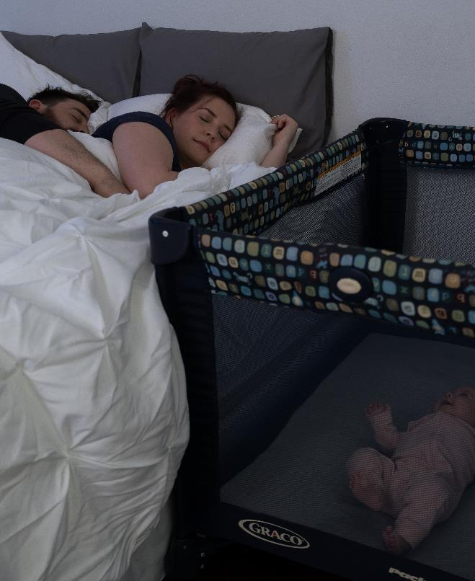
Share Your Room With Baby
Keeping baby close by allows parents to watch and respond to their baby’s needs right away.
Room-share for at least the first six months and ideally the first year.
Before bringing baby into a bed, remove all soft bedding, toys, and pillows.
If a parent or caregiver falls asleep with baby in the bed, place the baby back on a separate safety-approved sleep surface as soon as they wake.
Notes:
WHY- keeping baby close allows parents to watch and respond to their baby’s needs right away. ​There is evidence that sleeping in the parents’ room, on a separate sleep surface, reduces the risk of SIDS by as much as 50%.​
Room-share for at least the first six months and ideally the first year.​
When bringing the baby into an adult bed for feeding or comforting, remove all soft bedding, toys, and pillows.​
If a parent or caregiver falls asleep while feeding or comforting, as soon as they wake, place the baby back on a separate safety-approved sleep surface.
​
​
Additional context (if needed):​
Placing the crib close to the parents’ bed allows the parents to see and respond to their baby, monitor their baby's needs and can make feeding and comforting easier. Babies who room-share with parents have more small awakenings and this may keep them from sleeping too deeply in a way that increases the risk of sleep-related death. Finally, room sharing supports continued breastfeeding and its protective effects and positive health benefits.​
Avoid placing your baby to sleep on a couch, armchair, or sitting device like a swing, baby seat, or car safety seat (except when in a car).​
​
​Information Source: AAP Recommendations and NCEMCH and NAPPSS Building on Campaigns with Conversations Training)​
​
Image credit: Texas DSHS

Slide 36

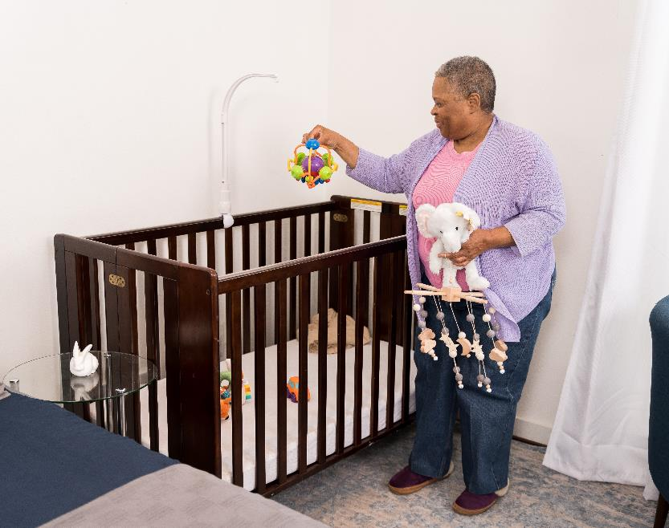
Clear Crib
Soft objects, bedding, and other items in the sleep environment can become a barrier to baby’s breathing and lead to death.
Remove all items out of crib.
Only put one baby per crib; babies should not share a sleep space with a twin, other siblings, or pets.
Notes:
Soft objects, bedding, and other items in the sleep environment can become a barrier to baby’s breathing and lead to death.
Use a safety approved* sleep surface that is firm, flat, and level (not inclined) and covered only with a fitted sheet.​
Take toys, stuffed animals, bumper pads, blankets, and other objects out of the crib.​
Do not use wedges or positioning devices.​
Do not use crib bumpers.​
Baby should have their own sleep surface; babies should not share a sleep space or crib with a twin, other siblings, or pets.​
Do not place near window coverings or cords, do not hang mobiles overhead.​
​
You will hear the term safety-approved during this training. What does this mean? How do parents and caregivers know if their baby’s sleep surface is safe?​
Standards for safety approved sleep surfaces such as cribs, bassinets, portable play areas, and side cars (attachment to an adult bed that provides a separate, but close safe space) have been developed by the U.S. Consumer Product Safety Commission, the agency that tracks accidents and deaths with products and helps keep babies safe from products that can be harmful or cause accidents. Parents can sign up for recall alerts on the CPSC site to ensure their crib has not been recalled.​
www.cpsc.gov/SafeSleep ​
​
​
Additional context (if needed):​
Pillow top mattresses, foam mattresses and other soft surfaces are a problem because the baby’s face can get pushed into them and breathing can be blocked. These items in the baby’s sleep area can increase the risk of sleep related death by five times.​
​
​
(Source for information – AAP Recommendations and NCEMCH and NAPPSS Building on Campaigns with Conversations Training)
Image credit: Texas DSHS

Slide 37

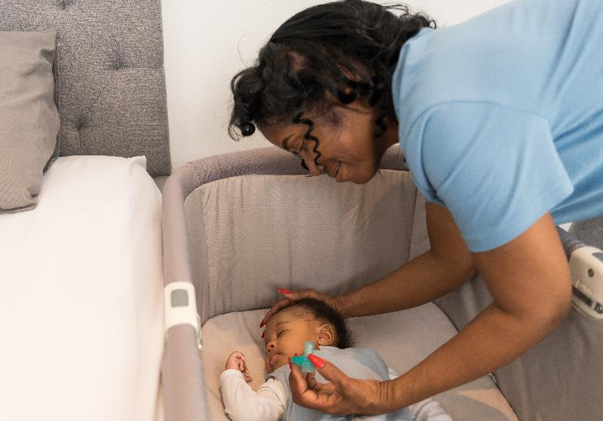
Offering a Pacifier at Nap Time and Bedtime to Reduce the Risk of SIDS
Suckling, either during breastfeeding or when using a pacifier during sleep, may help keep baby from sleeping too deeply.
Use a pacifier that is free of toys or cords.
Never attach a pacifier to baby’s clothes to avoid choking, strangulation, or suffocation.
If pacifier falls out of baby’s mouth during sleep, there is no need to put it back.
Notes:
WHY- Suckling, either during breastfeeding or when using a pacifier during sleep, may help keep baby from sleeping too deeply
Share safe pacifier use with parents and caregivers which includes:
Using a pacifier that is fee of toys, cords
Never attaching a pacifier to baby's clothes to avoid choking, strangulation, or suffocation.​
If the pacifier falls out of your baby’s mouth during sleep, you don’t need to put it back.​
Additionally,
Finger or thumb sucking does not reduce SIDS risk.
For breastfeeding infants, pacifiers can be introduced once breastfeeding is going well. This is determined by:
Baby is calm and satisfied after feeding
There is no pain for mom when baby breastfeeds
Baby is gaining weight and growing well
​
Source for information – AAP Recommendations, NCEMCH and NAPPSS Building on Campaigns with Conversations Training, and Academy of Breastfeeding Medicine- Clinical Protocol #3- Supplementary Feedings in the Healthy Term Breastfed Neonate, Revised 2017
​
Image Credit- Texas DSHS

Slide 38


Stay Smoke-Free and
Vape-Free
Sharing a bed with adult smokers or vape users increases the chances of death.
Smoking during pregnancy increases baby’s risk of SIDS.
Smoke in baby’s environment after birth may also increase a baby’s risk of dying from SIDS.
Sharing a bed with someone who smokes, uses alcohol, or drugs increases the risk of SIDS.
Notes:
WHY-
A baby’s exposure to smoke during pregnancy and after birth increases their risk of dying from SIDS
To keep baby healthy, encourage parents and all caregivers to keep a smoke- and vape-free environment​
It is important to share the ways in which smoke can be transferred to baby:
Firsthand- direct use of tobacco and e-cigarettes
Secondhand- the environment around baby
Thirdhand- smoke on the clothes and other objects like blankets and furniture
​
Additional context (if needed):​
It may be helpful to share some of the dangers of alcohol and drugs with parents and caregivers:​
They are more likely to roll over onto your baby during sleep if they drink, use drugs, or take medication that makes them sleepy while sharing a bed with their baby. ​​
Sharing a bed with their baby is also riskier if they or anyone else uses alcohol or drugs and are also a smoker.​​
The best thing they can do for their health and baby's health is to quit using alcohol, drugs, and smoking.​​
Ask their doctor for help.​
​
The chemicals given off from smokers (even if they are not smoking directly near the baby) impact the functioning of the baby’s nervous system and can have negative effect on the baby’s ability to wake up if she is not getting enough oxygen. Also, these chemicals increase the baby’s risk for respiratory and other infections that are associated with higher risk of sleep related death and are of course, not good for the overall health of the infant and other children in the household.​
​
​Source for information – AAP Recommendations and NCEMCH and NAPPSS Building on Campaigns with Conversations Training
​
Image Credit- iStock photo purchased for unlimited use by DSHS Tobacco Prevention and Control (used with permission).​

Slide 39


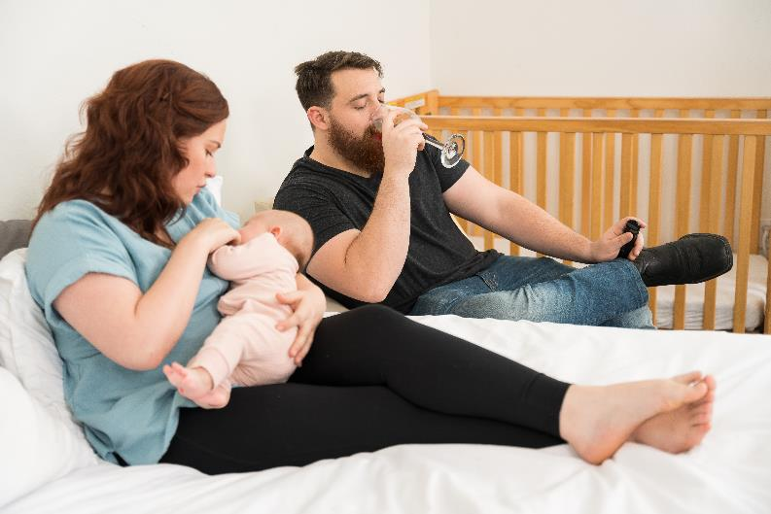
Avoid Alcohol, Marijuana, Opioids, and Illicit Drugs Use During Pregnancy and After Birth
Babies exposed to alcohol and drugs during pregnancy and after birth may have a harder time waking up when they need help.
Sharing a bed with baby is riskier if parents or caregivers smoke or use drugs or alcohol.
Parents are more likely to roll over onto their baby while under the influence.
Notes:
WHY-
Babies exposed to alcohol and drugs during pregnancy and after birth may have a harder time waking up when they need help.
It is important to avoid alcohol and drugs while pregnant and after birth. Using alcohol or drugs impairs a parent’s judgment in general, however, there appears to be a particular risk when bed sharing—the parent is not as easily roused by and attuned to cues of distress from the baby. This concern applies to prescription or over the counter medications that are sedating—cause drowsiness or sleepiness—not just illegal drugs.​
​Share the dangers of using alcohol and drugs with parents and caregivers:​
They are more likely to roll over onto baby during sleep if they drink, use drugs, or take medication that makes them sleepy while sharing a bed with their baby. ​​
Sharing a bed with their baby is also riskier if they or anyone else uses alcohol or drugs and are also a smoker.​​
The best thing they can do for their health and baby's health is to quit using alcohol, drugs, and smoking.​​
Ask their doctor for help with quitting.​
Check if any medicine parents are taking causes them to be sleepy.
​
(Source for information – AAP Recommendations and NCEMCH and NAPPSS Building on Campaigns with Conversations Training)​
​
Image Credit- Texas DSHS

Slide 40

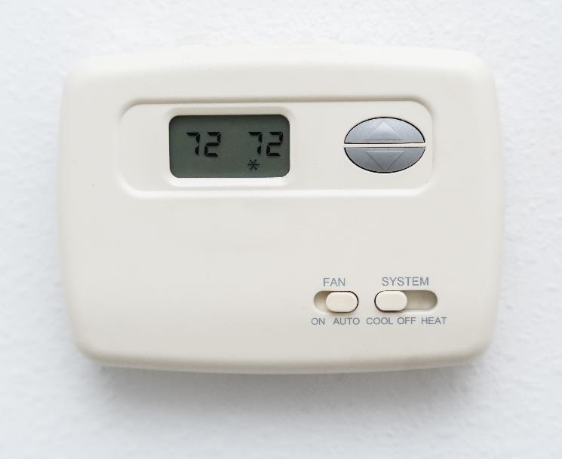
Keep Baby From Getting Too Hot
If baby gets too hot, they may have trouble waking up and getting oxygen.​
Keep the room temperature where baby is sleeping comfortable enough for a lightly clothed adult.​
Use a lightweight sleep sack or footed sleeper instead of a blanket.​
When indoors, keep your baby's head free of hats or other coverings.
A sweaty or damp baby is too hot.
Notes:
WHY- If baby gets too hot, the baby may have trouble waking up and getting oxygen.​​
Keep the room temperature where baby is sleeping comfortable enough for a lightly clothed adult.​​
Use a lightweight sleep sack or footed sleeper instead of a blanket.​​
When indoors, keep your baby's head free of hats or other coverings. A sweaty or damp baby is too hot.​
As a general rule, if the room temperature is comfortable for you, it’s most likely comfortable for your baby too!​
​​
Additional context (if needed):​
Overheating​
Blankets and other soft items in the crib increases your baby's risk from being unable to roll over and away or move that item out of their way. Unlike adults and older children, a baby can’t roll over or move the item out of the way​ This may block their airway, and they could suffocate. Also, hats and other soft items can slide off and block the airway, too. ​
As a general rule, if the room temperature is comfortable for you, it’s most likely comfortable for your baby too!​
To keep your baby warm, use a sleep sack or footed- sleep clothing. You can also dress your baby in layers that can be removed if their face becomes too red or you notice they are sweating.​
​
​
Information Source: AAP Recommendations and NCEMCH and NAPPSS Building on Campaigns with Conversations Training)​
​
Image credit: Texas DSHS

Slide 41


Find a Doctor As Soon As You Know You Are Pregnant and Get Regular Medical Care During Pregnancy
Doctors share updates on important health and safety topics for mom and baby.
Regular health care checks each month until birth can help mom and baby stay healthy.
Research shows that prenatal care can help prevent babies from dying in their sleep.
Image source: Texas WIC Program
Notes:
WHY-
Doctors share updates on important health and safety topics for mom and baby.
​
​To have the healthiest pregnancy, visit your doctor as soon as you know you are pregnant:
Once a month for weeks ten through 28
Twice a month for weeks 28 through 36
Weekly for weeks 36 to birth
The doctor may recommend more visits if needed. Encourage mothers to discuss schedule and any questions they have with their doctor.
​
(Source for information – AAP Recommendations and NCEMCH and NAPPSS Building on Campaigns with Conversations Training)​
​
Image Credit- Texas WIC Program

Slide 42

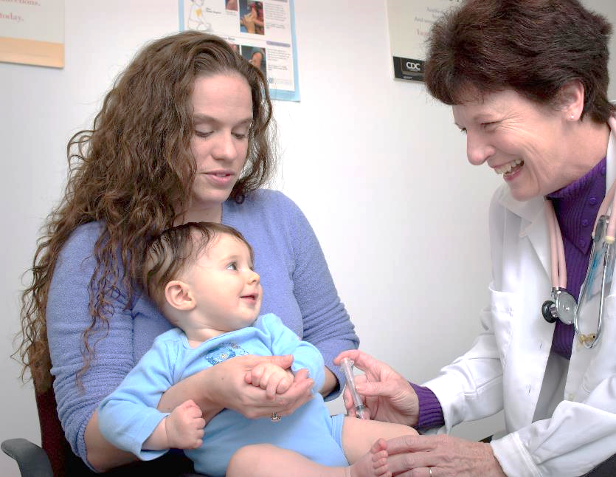
Follow Your Doctor or Clinic’s Advice on Shots, Checkups, and Other Health Concerns for Baby
Vaccines help babies stay healthy, which may protect them from SIDS.
Doctors have the most up-to-date advice on how to keep baby safe and healthy.
Regular visits help make sure your baby is growing and developing well.
Image source: Centers for Disease Control and Prevention
Notes:
WHY- Vaccines help babies stay healthy, which may protect them from SIDS.
​
​Most babies are recommended to see the doctor at:
3-5 days old
1, 2, 3 months old
6, 9, 12 months old
The doctor may recommend more visits if needed. Encourage parents to discuss schedule with their baby’s doctor.
​
(Source for information – AAP Recommendations and NCEMCH and NAPPSS Building on Campaigns with Conversations Training)​
​
Image Credit- Centers for Disease Control and Prevention (CDC)

Slide 43

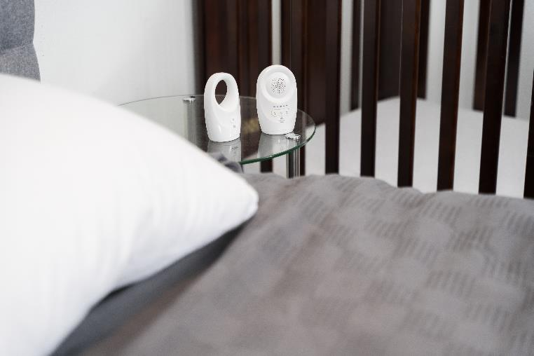
Avoid Using Monitors or Devices as Your Main Way to Reduce the Risk of SIDS
Choosing to use a monitor or device at home doesn’t replace following all safe sleep guidance.
No product can prevent SIDS.
If using a monitor or other device for reasons other than to detect SIDS, follow all safe sleep practices.
For questions, encourage parents to talk with baby’s doctor.
Notes:
WHY- Choosing to use a monitor or device at home doesn’t replace following all safe sleep guidance
No product can prevent SIDS, so encourage parents and caregivers to avoid products and devices that claim to “prevent” SIDS and sleep-related death and this can give a false sense of safety. Encourage them to continue to follow all safe sleep recommendations.
​
Source for information – AAP Recommendations, NCEMCH and NAPPSS Building on Campaigns with Conversations Training​
Image Credit- Texas DSHS

Slide 44


What Does Tummy Time Have To Do With Safe Infant Sleep?
Tummy time strengthens muscles that support a baby’s head and may prevent flat spots.​
Tummy time helps babies develop arm, shoulder, and neck strength.
Supervised tummy time each day helps a baby's brain grow by learning and playing.​
Encourage parents to share information on tummy time with the baby's caregivers.
Notes:
Why- Tummy time strengthens muscles that support a baby’s head and may prevent flat spots.
The American Academy of Pediatrics (AAP) recommends 30 minutes a day of tummy time, but this can be broken into several short sessions, especially if baby doesn’t like tummy time at first. ​Tummy time can start a few days after birth, for short periods of time, a few times a day. Parents and caregivers can increase this time as your baby gets stronger.​ Fathers and other support partners can do tummy time directly on their chest.
Even if a baby cries, encourage parents and caregivers to keep trying every day.​
(Source for information – AAP Recommendations and NCEMCH and NAPPSS Building on Campaigns with Conversations Training)
Image credit: Texas DSHS

Slide 45

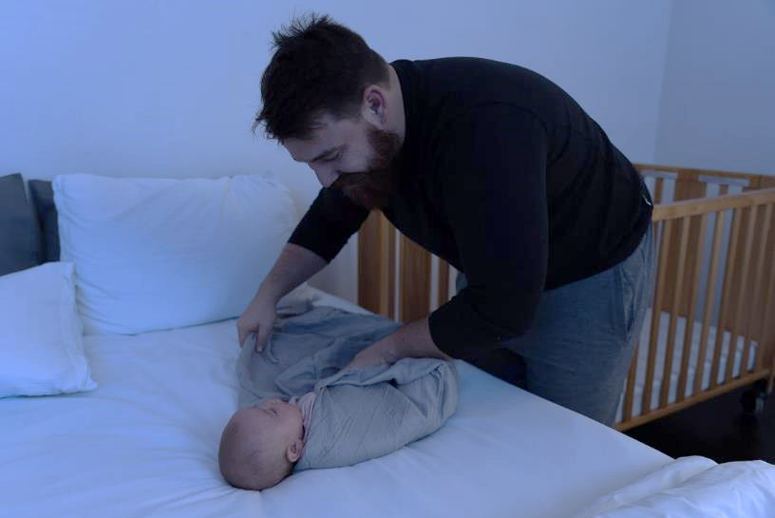
Avoid Swaddling Once Baby Starts to Roll Over
If baby is placed on the stomach or rolls onto their stomach while swaddled, the risk of death is higher.
Keep in mind that swaddling does not reduce risk of SIDS.
Share swaddle recommendations for parents and caregivers to follow.
Notes:
WHY- If baby is placed on the stomach or rolls onto their stomach while swaddles, the risk of death is higher
Swaddle recommendations include:
Make sure the swaddle is wrapped snugly so that the blanket isn't loosened during sleep. ​
Do not swaddle so tightly that your baby cannot move their hips.​
If your baby is placed on the stomach or rolls onto his or her stomach while swaddled, the risk of death is higher.​
Do not use weighted blankets, clothing, or objects within swaddles. ​
Avoid swaddling once baby starts to roll over (two-three months of age).​
Check your baby for signs of overheating.
​
Source for information – AAP Recommendations, NCEMCH and NAPPSS Building on Campaigns with Conversations Training​
Image Credit- Texas DSHS

Slide 46


Have a safe sleep plan in case you must leave your home during an emergency.​
Natural disasters, like tornadoes, hurricanes, floods, or fires, can happen quickly and be scary. Have a plan to keep your baby sleeping safely.
​Make sure baby's sleep space has a firm, flat, and level sleep surface covered by a well-fitted sheet.
Follow safe sleep guidelines as closely as possible to reduce risk.
Notes:
Educators can practice responsive conversations about emergencies by asking open-ended questions like, “Do you have a plan for you and your baby if you experience an emergency event?” or “What concerns do you have about keeping your baby safe if there is an emergency like a tornado or hurricane?”
Take these steps to keep your baby safe during an emergency
Place baby on his or her back to sleep including naps and at night. ​
Keep baby in your room, close by, but not in your bed.​
Make sure baby's sleep space has a firm, flat, and level sleep surface covered by a well-fitted sheet.​
You may need to use a temporary sleep surface, like in the picture. This should be replaced with a Consumer Product Safety Commission-approved* surface as soon as you can.​
Temporary (or Emergency) sleep surfaces can include a box, basket, or dresser drawer.
A common question that may be asked is, “Are baby-sized cardboard or other boxes safe to use in an emergency?”
In an emergency, you may use a temporary sleep surface for your baby that is firm, flat, and level, such as a box, basket, or dresser drawer. The surface should not include a covering or lid and should include thin, firm padding that fits well in the space.​
​
Any space not designed for infants should be temporary and replaced with a CPSC-approved crib, bassinet, or play yard as soon as one is available.
​Source for information – AAP Recommendations, NCEMCH and NAPPSS Building on Campaigns with Conversations Training​
Image Credit- Texas DSHS

Slide 47

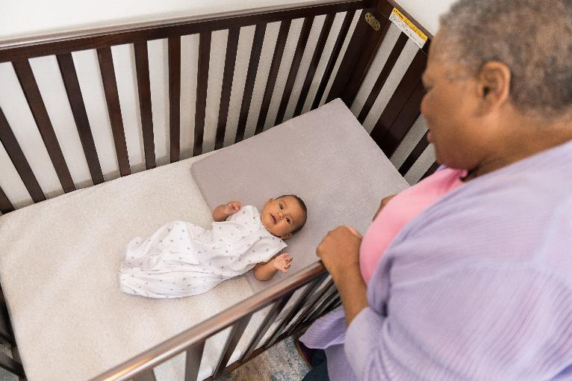
Babies Who Are Born Early or Who Have Special Health Conditions May Be at a Higher Risk for SIDS
Making a safe sleep plan before you leave the hospital can help keep your baby safe.
If your baby was in the Neonatal Intensive Care Unit (NICU):
Ask the hospital staff to review how to prepare your baby for safe sleep at home.​
The plan can include how to change your baby’s sleep position from their side to back.​
Remember, your baby is well enough to go home, so you don’t have to recreate a NICU environment at home.​
Notes:
Educators can practice responsive conversations by asking open-ended questions like, “How are you feeling about your baby coming home from the hospital?” and “Have you made any plans for safe sleep when your baby comes home from the hospital?”
If your baby was in the Neonatal Intensive Care Unit (NICU):
Ask the hospital staff to review how to prepare your baby for safe sleep at home.​
The plan can include how to change your baby’s sleep position from their side to back.​
If your baby goes home with oxygen, feeding tubes, breathing tubes, or any monitors, make sure cords or tubes do not coil or bunch up into the area where your baby is sleeping.​
If you swaddle your baby, make space for the cords to come out from the bottom of the swaddle, keeping them away from your baby’s hands and face.​
All other equipment should be next to, but not in, your baby’s sleep area.
Common questions from parents and caregivers are:
“Should I use a wedge to raise my baby’s position like they did in the hospital?”
If your baby was placed in a non-level position while in the hospital, part of your safe sleep transition to home should include how to move away from using devices that prevent your baby from laying flat including wedges, blanket rolls, or other products. ​​Talk with your baby's doctor about how to keep your baby safely sleeping when at home.
“I’m concerned that my baby got used to sleeping on his tummy in the NICU. What can I do to help keep him calm?” ​
The risk of SIDS for preemie babies or babies with special health conditions can be even higher if they are placed to sleep on their stomachs. ​
Be sure to follow your hospital care team’s transition plan and place your baby to sleep on his back. Skin-to-skin contact can help calm your baby, help with breastfeeding, and help keep your baby warm. ​Make sure that someone is around to watch both you and your baby when holding him skin-to-skin to ensure you do not fall asleep.​
Note for presenter: The 2022 AAP recommendations includes the following top tier recommendation: “It is essential that physicians, nonphysician clinicians, hospital staff, and child care providers endorse and model safe infant sleep guidelines from the beginning of pregnancy.”

Slide 48


Sleep Training: What is it? ​
Is it worth it?
The term "sleep training" is often used to mean any information that parents use to get their baby to sleep longer at night.
Putting infants to sleep in a separate room for sleep training may be linked to an increased risk of SIDS.​
Sleep training babies younger than six months can result in: ​
poor nutrition as it may limit the number of times your baby may eat​
separation from mother, which can impact the success of breastfeeding
Notes:
WHY- Many sleep-training programs and methods can be found online, but not all follow safe sleep guidelines.​
Newborn babies spend more time in light sleep, which helps them wake when they need to and may protect them from SIDS.​ Training babies to sleep longer goes against their normal development.
Information to consider:​
The term "sleep training" is often used to mean any information that parents use to get the baby to sleep longer at night.​
Putting infants to sleep in a separate room for sleep training may be linked to an increased risk of SIDS.​
Sleep training babies younger than six months can result in: ​
poor nutrition as it may limit the number of times your baby may eat​
separation from mother, which can impact the success of breastfeeding
​
Source for information – AAP Recommendations, NCEMCH and NAPPSS Building on Campaigns with Conversations Training​
Image Credit- Texas DSHS

Slide 49
Quiz Time!
Myth vs. fact statement
Check your knowledge
Find out what we don’t know
Notes:
Let’s check our knowledge on facts and myth statements related to safe sleep and sudden unexpected infant death (SUID).
Activity instructions: I’m going to read a statement that you may hear from a parent or caregiver, and I want you to say if it is a FACT or a MYTH
Points to Cover:
There are many myths about safe sleep and sudden unexpected infant death (SUID).
This section will clarify true and false statements about safe sleep practices and the unexpected death of an infant.
Participants can follow along with their Myth or Fact handout.
As you play the game together and a myth is identified, ask the class if they have heard this before? Encourage participants to share personal examples if they feel comfortable.

Slide 50
Myth or Fact
Question 1
If a baby is placed on his back to sleep instead of his stomach, he will be more likely to choke.

Slide 51

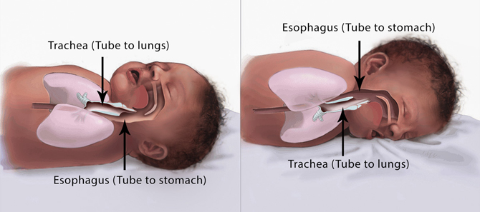
Myth
Healthy babies tend to swallow or cough up fluids best when they are lying on their backs.
They also have a gag reflex to help prevent choking while lying on their backs.
Notes:
Healthy babies tend to swallow or cough up fluids best when they are lying on their backs. They also have a gag reflex to help prevent choking while lying on their backs.
Placing a baby in the back to sleep (supine sleep position) on a firm, flat, non-inclined surface does not increase the risk of choking and aspiration in infants and is recommended for every sleep, even for infants with gastroesophageal reflux "reflux".
Parents and caregivers continue to be concerned that an infant will choke or aspirate while supine.^{149–157} Parents often misconstrue coughing or gagging, which is evidence of a normal protective gag reflex, for choking or aspiration. Multiple studies in different countries have not demonstrated an increased incidence of aspiration since the change to supine sleeping.^{172–174} Parents and caregivers are often concerned about aspiration when the infant has been diagnosed with gastroesophageal reflux (GER). The AAP concurs with the North American Society for Pediatric Gastroenterology and Nutrition that “…no position other than supine position is recommended for infants because of the risk of sudden infant death syndrome (SIDS).”¹⁷⁵ Further, “the working group recommends not to use positional therapy (ie, head elevation, lateral and prone positioning) to treat symptoms of GERD (gastroesophageal reflux disease) in sleeping infants.”¹⁷⁵
Reference:
Rachel Y. Moon, Rebecca F. Carlin, Ivan Hand, THE TASK FORCE ON SUDDEN INFANT DEATH SYNDROME and THE COMMITTEE ON FETUS AND NEWBORN; Evidence Base for 2022 Updated Recommendations for a Safe Infant Sleeping Environment to Reduce the Risk of Sleep-Related Infant Deaths. Pediatrics July 2022; 150 (1): e2022057991. 10.1542/peds.2022-057991
Image Credit: Image courtesy of the Safe to Sleep® campaign, for educational purposes only; Eunice Kennedy Shriver National Institute of Child Health and Human Development, http://www.nichd.nih.gov/sids; Safe to Sleep® is a registered trademark of the U.S. Department of Health and Human Services.

Slide 52
Myth or Fact
Question 2
There are steps parents can take to reduce a baby’s risk of sleep-related death.

Slide 53
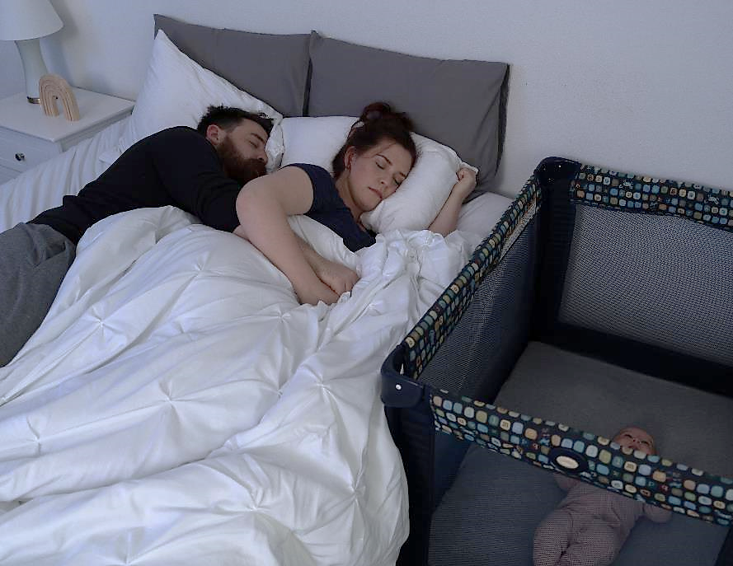
Fact
There are steps parents and caregivers can take to reduce their baby's risk of sleep-related death.
Notes:
We will cover all the 2022 AAP safe sleep recommendations for you to share with parents and infant caregivers to help reduce their infant’s risk of sleep-related death.
Reference:
Moon RY, Carlin RF, Hand I; AAP Task Force on Sudden Infant Death Syndrome; AAP Committee on Fetus and Newborn. Sleep-Related Infant Deaths: Updated 2022 Recommendations for Reducing Infant Deaths in the Sleep Environment. Pediatrics. 2022;150(1):e2022057990
Image credit: Texas DSHS

Slide 54
Myth or Fact
Question 3
Immunizations can cause SIDS or the unexpected death of an infant.

Slide 55

Myth
There is no evidence that immunizations cause SIDS or the unexpected death of an infant.
Notes:
The 2022 American Academy of Pediatrics (AAP) report on evidence continues to show no causal relationship between immunizations and SIDS and suggests that vaccination may have a protective effect against SIDS. The AAP published a technical report to support the recommendations included in the Let’s Talk- Safe Infant Sleep training and toolkit.
AAP Technical Report Link: https://publications.aap.org/pediatrics/article/150/1/e2022057991/188305/Evidence-Base-for-2022-Updated-Recommendations-for?autologincheck=redirected
Reference:
Moon RY, Carlin RF, Hand I; AAP Task Force on Sudden Infant Death Syndrome; AAP Committee on Fetus and Newborn. Sleep-Related Infant Deaths: Updated 2022 Recommendations for Reducing Infant Deaths in the Sleep Environment. Pediatrics. 2022;150(1):e2022057990
Image source: Photo by CDC on Unsplash

Slide 56
Question 4
Myth or Fact
It takes time for a baby to learn to sleep soundly on his or her back.

Slide 57
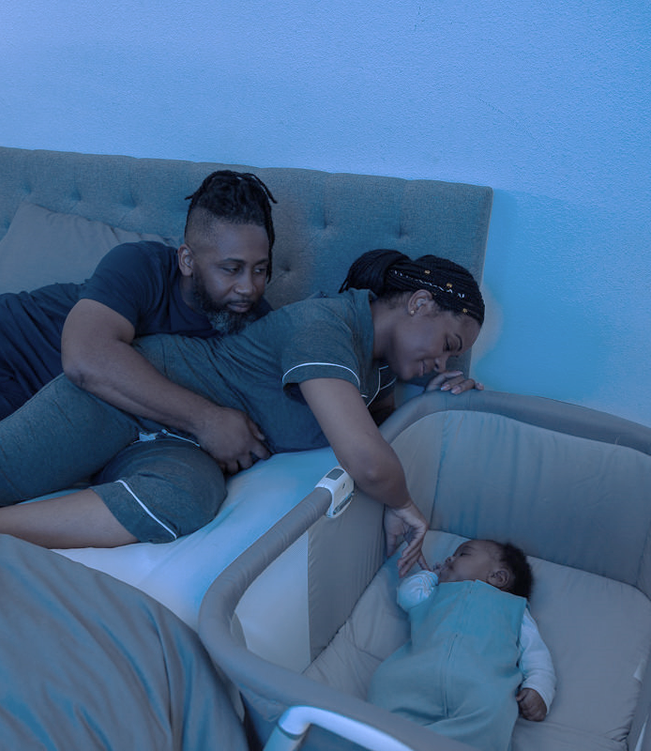
Fact
Sleeping soundly on the back is learned and parents shouldn’t give up.
If baby wakes during the night, remember that lighter sleep protects the baby against unexpected death.
Notes:
Sleeping soundly on the back is learned and parents shouldn’t give up. If baby wakes during the night, remember that lighter sleep and waking more often helps protects them against SIDS.
One reason often cited by parents for not using the supine sleep position is the perception that the infant is uncomfortable or does not sleep well.^{149–157} However, an infant who wakes frequently is typical and should not be perceived as a poor sleeper. Physiologic studies demonstrate that infants are less likely to arouse when they are sleeping in the prone position.^{158–166} The ability to arouse from sleep is an important protective physiologic response to stressors during sleep,^{167–171} and the infant’s ability to sleep for sustained periods may not be physiologically advantageous.
Reference:
Moon RY, Carlin RF, Hand I; AAP Task Force on Sudden Infant Death Syndrome; AAP Committee on Fetus and Newborn. Sleep-Related Infant Deaths: Updated 2022 Recommendations for Reducing Infant Deaths in the Sleep Environment. Pediatrics. 2022;150(1):e2022057990
Image credit: Texas DSHS

Slide 58
Question 5
Putting a baby on his or her back will lead to a flat head.
Myth or Fact

Slide 59
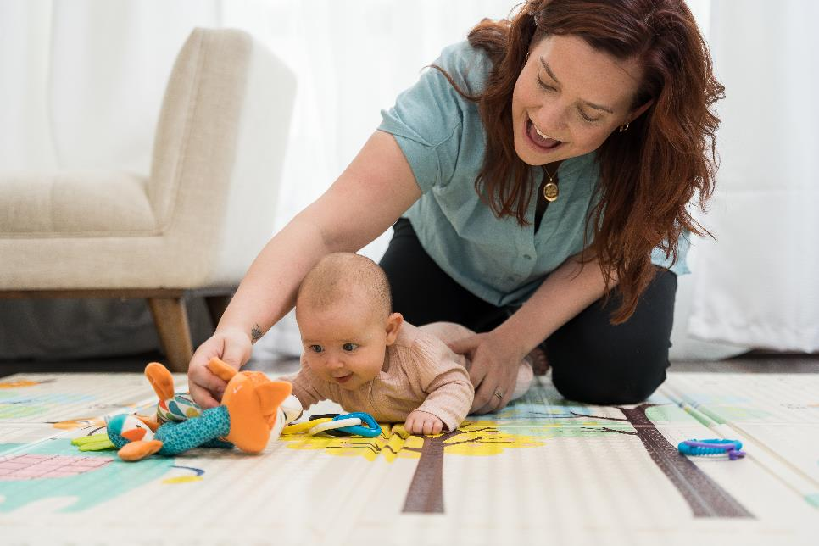
Myth
Putting baby to sleep on his or her back does not lead to a flat head.
However, if a baby is always left on his or her back, for example, in the car seat, in a swing chair, or in a stroller, it could lead to a flattening of the head.
Therefore, tummy time is important!
Notes:
Putting a baby to sleep on their back does not lead to a flat head. If a baby is always left on his or her back while sleeping in a car seat swing chair, or a stroller, it could lead to flattening of their head. To prevent this, it is important to add supervised tummy time every day!
Parents and caregivers should provide their baby with tummy time 2-3 times a day for short periods beginning soon after hospital discharge, increasing incrementally to at least 15 to 30 minutes total daily by 7 weeks of age. This should happen when the baby is awake, and always be supervised so they can watch the baby closely.
Reference:
Moon RY, Carlin RF, Hand I; AAP Task Force on Sudden Infant Death Syndrome; AAP Committee on Fetus and Newborn. Sleep-Related Infant Deaths: Updated 2022 Recommendations for Reducing Infant Deaths in the Sleep Environment. Pediatrics. 2022;150(1):e2022057990
PREFER THIS IMAGE: (Photo by Getty Images)***can contractor purchase?
Image credit: Texas DSHS

Slide 60
Question 6
Myth or Fact
Smoking anywhere near a baby can increase the risk of sudden unexpected infant death.

Slide 61

Fact
Smoke from any type of cigar or cigarette, including e-cigarettes or “vapes,” contains many ingredients that are harmful to adults and young children.
Notes:
Smoke from any type of cigar or cigarette, including from e-cigarettes or “vapes” contains many ingredients that are harmful to adults and young children.
Avoid smoke and nicotine exposure during pregnancy and after birth. Encourage parents and infant caregivers to set strict rules for smoke-free environments including homes and cars and to eliminate tobacco smoke from all places where children and other nonsmokers spend time.
It is important to share the ways in which smoke can be transferred to baby:
Firsthand- direct use of tobacco and e-cigarettes
Secondhand- the environment around baby
Thirdhand- smoke on the clothes and other objects like blankets and furniture
Reference:
Moon RY, Carlin RF, Hand I; AAP Task Force on Sudden Infant Death Syndrome; AAP Committee on Fetus and Newborn. Sleep-Related Infant Deaths: Updated 2022 Recommendations for Reducing Infant Deaths in the Sleep Environment. Pediatrics. 2022;150(1):e2022057990
Image credit: Texas DSHS

Slide 62
Question 7
Myth or Fact
Babies do not die in cribs.

Slide 63

Myth
Just because a baby is in a crib does not mean the crib is a safe sleep environment.
There are things that can be done to make sure a baby’s crib is safe.
Notes:
Just because a baby is in a crib does not mean it is a safe sleep environment. There are things that parents and caregivers can do to make sure their baby’s crib and other sleep surfaces are safe.
Use a firm, flat, non-inclined sleep surface (eg, tightly fitting mattress in a safety-approved crib) covered by a fitted sheet with no other bedding or soft objects to reduce the risk of suffocation or wedging or entrapment.
Moon RY, Carlin RF, Hand I; AAP Task Force on Sudden Infant Death Syndrome; AAP Committee on Fetus and Newborn. Sleep-Related Infant Deaths: Updated 2022 Recommendations for Reducing Infant Deaths in the Sleep Environment. Pediatrics. 2022;150(1):e2022057990
Image credit: Texas DSHS

Slide 64
Question 8
Myth or Fact
Parents and caregivers can use a medical device or monitor to prevent a baby from dying unexpectedly in his or her crib.

Slide 65
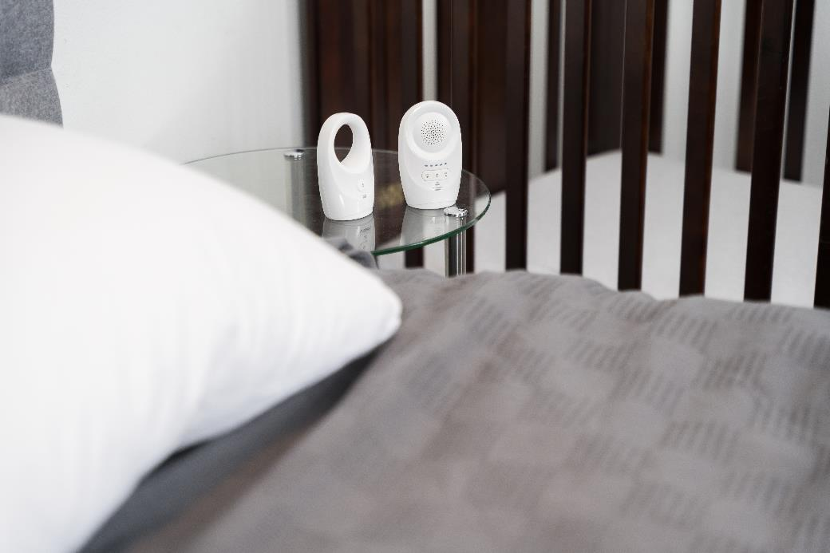
Myth
Monitors and devices should not be used as a caregiver’s main way to prevent SIDS or sleep-related infant death. This can lead to a false sense of comfort.
Many devices go against safe sleep guidance.
Devices often claim to “prevent” SIDS, but no device has been proven to prevent SIDS.
Notes:
Monitors and devices should not be used as a caregiver’s main way to prevent SIDS or sleep-related infant death. This can lead to a false sense of comfort.
Many devices go against safe sleep guidance
Devices that claim to “prevent” SIDS, but no device has been proven to prevent SIDS
Moon RY, Carlin RF, Hand I; AAP Task Force on Sudden Infant Death Syndrome; AAP Committee on Fetus and Newborn. Sleep-Related Infant Deaths: Updated 2022 Recommendations for Reducing Infant Deaths in the Sleep Environment. Pediatrics. 2022;150(1):e2022057990
Image credit: Texas DSHS

Slide 66
Question 9
Babies can nap in car seats, swings, and other places if sleeping in a product that has not been recalled.
Myth or Fact

Slide 67
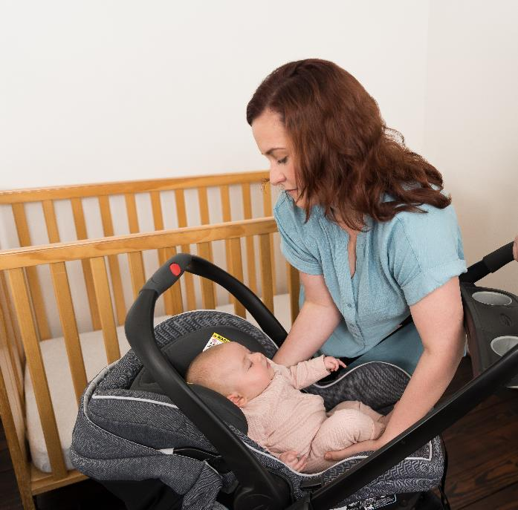
Myth
Sitting devices, such as car seats, strollers, swings, infant carriers, and infant slings, are not recommended for routine sleep in the hospital or at home, particularly for infants younger than four months old.
When infants fall asleep in a sitting device, remove the baby from the product and move the baby to a crib or other appropriate flat surface as soon as is safe and practical.
Car seats and similar products are not stable when placed on a crib mattress or other elevated surfaces.
The Consumer Product Safety Commission sets safety standards for infant sleep surfaces such as a mattress, and sleep spaces like a crib. cpsc.gov/SafeSleep
Notes:
Sitting devices, such as car seats, strollers, swings, infant carriers, and infant slings are not recommended for routine sleep in the hospital or at home, particularly for infants
younger than 4 months.
If your baby falls asleep in a car seat, stroller, swing, carrier, or sling, move the baby to a firm and level safety-approved*sleep surface as soon as possible.
Car seats and similar products are not stable when placed on a crib mattress or other elevated surfaces.
*The Consumer Product Safety Commission (CPSC) sets safety standards for infant sleep surfaces such as a mattress, and sleep spaces like a crib.
www.cpsc.gov/SafeSleep
Moon RY, Carlin RF, Hand I; AAP Task Force on Sudden Infant Death Syndrome; AAP Committee on Fetus and Newborn. Sleep-Related Infant Deaths: Updated 2022 Recommendations for Reducing Infant Deaths in the Sleep Environment. Pediatrics. 2022;150(1):e2022057990
Image credit: Texas DSHS

Slide 68
Question 1
X
WRONG
Return to question 1

Slide 69
Question 2
X
WRONG
Return to question 2

Slide 70
Question 3
X
WRONG
Return to question 3

Slide 71
Question 4
X
WRONG
Return to question 4

Slide 72
Question 5
X
WRONG
Return to question 5

Slide 73
Question 6
X
WRONG
Return to question 6

Slide 74
Question 7
X
WRONG
Return to question 7

Slide 75
Question 8
X
WRONG
Return to question 8

Slide 76
Question 9
X
WRONG
Return to question 9

Slide 77
Break

Slide 78
Let’s Talk-
Safe Infant Sleep
Helping Your Community
Notes:
You may be asking yourself; how can I help?
We are going to explore the Let’s Talk- Safe Infant Sleep toolkit designed to support communities implement the Let’s Talk approach for supporting parents and caregivers with safe sleep.
Image credit: Texas DSHS

Slide 79
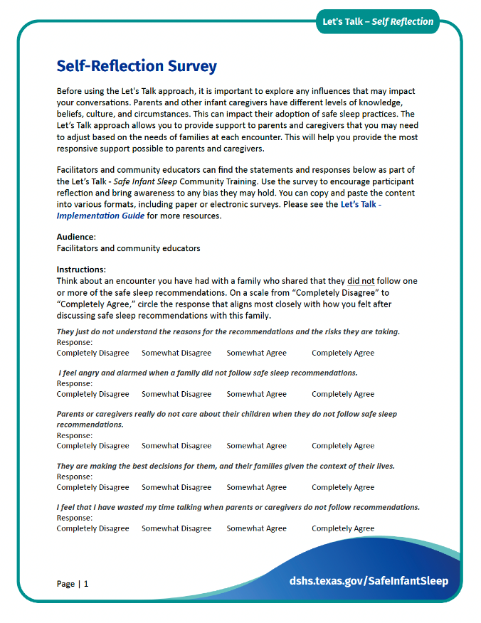
How Do You Feel? (1 of 2)
Take the Self-Reflection Survey
Add your own QR Code or other instructions
Example image of survey.
Notes:
REVIEW THIS SCRIPT
Parents and other infant caregivers vary in their knowledge, beliefs, culture, and circumstances, all of which can greatly impact their adoption of safe sleep practices. The Let’s Talk approach allows you to offer personalized support that can be different based on the needs of families at each encounter.
Before working with parents and caregivers, it is important to understand any bias that we may have that could impact the information we provide. Often bias is hidden, meaning we don’t know it’s there, and is the unique lens we use to view the world. We will now take a quick anonymous poll to help build our understanding. You may have had experiences where the statements in the poll have come to mind. Again, this poll is anonymous and all feelings you may share are valid.
(Give participants a few minutes to scan the QR code)
Share poll results reviewing each statement asking participants if they feel comfortable and would like to share an example.
It is important to work to make sure that all families get the information and support they need. There are several approaches, but self-reflection is a key first step.
Take a moment to ask yourself—
Do my thoughts and feelings:
Impact the amount of time I spend with patients?
Influence how I communicate with patients and their families?
Hamper my capacity to feel and express empathy toward my patients?
Affect the types of information and recommendations I offer?
Affect my expectations about whether families can succeed in carrying out their plans for feeding and sleeping their babies?
Be aware of biases during conversations. For example, do you automatically assume the family will accept or adopt your recommendations? Do you think they understand what you're saying?
Source:
Bronheim, S. (2017). Building on campaigns with conversations: An individualized approach to helping families embrace safe sleep and breastfeeding. Washington, DC: National Center for Education in Maternal and Child Health.

Slide 80
How Do You Feel? (2 of 2)
Self-Reflection Activity:
Take a moment to ask yourself - Do my thoughts and feelings:
  Impact the amount of time I spend with parents or caregivers?
  Influence how I communicate with parents and their families?
  Hamper my capacity to feel and express empathy toward parents or caregivers?
  Affect the types of information and recommendations I offer?
  Alter my expectations about whether families can succeed in carrying out their plans for feeding and sleeping their babies?
Notes:
Parents and other infant caregivers vary in their knowledge, beliefs, culture, and circumstances, all of which can greatly impact their adoption of safe sleep practices. The Let’s Talk approach allows you to offer personalized support that can be different based on the needs of families at each encounter.
Before working with parents and caregivers, it is important to understand any bias that we may have that could impact the information we provide. Often bias is hidden, meaning we don’t know it’s there, and is the unique lens we use to view the world. We all have bias, so it is important to know what we bring to the learning table. We will now take a quick anonymous poll to help build our understanding. You may have had experiences where the statements in the poll have come to mind. Again, this poll is anonymous and all feelings you may share are valid.
(Give participants a few minutes to scan the QR code)
Share poll results reviewing each statement asking participants if they feel comfortable and would like to share an example.
How do we deal with our own hidden biases? It is important to work to make sure that all families get the information and support they need. There are several approaches, but self-reflection is a key first step.
Take a moment to ask yourself—
Do my biases:
Impact the amount of time I spend with patients?
Influence how I communicate with patients and their families?
Hamper my capacity to feel and express empathy toward my patients?
Affect the types of information and recommendations I offer?
Affect my expectations about whether families can succeed in carrying out their plans for feeding and sleeping their babies?
Be aware of biases during conversations. For example, do you automatically assume the family will accept or adopt your recommendations? Do you think they understand what you're saying?
Source:
Bronheim, S. (2017). Building on campaigns with conversations: An individualized approach to helping families embrace safe sleep and breastfeeding. Washington, DC: National Center for Education in Maternal and Child Health.

Slide 81
How Can I Add This Information to Safe Infant Sleep Messaging or Training I Am Using?
Use the Let’s Talk - Safe Infant Sleep toolkit resources to support your current training.
  Expand your current narrative.
  Share accurate information through responsive conversations.
  Listen to their needs and meet caregivers and families where they are.
  Assist to develop a plan with resources to overcome stated barriers.
Notes:
To truly impact health disparities, parents need to experience consistent messaging across their community and Circle of Support. Multiple times from multiple sources.
DSHS recognizes that there are various safe infant sleep messages, resources and trainings available- and you may be using those right now. We encourage you to incorporate a conversations approach with any safe infant sleep messaging you are currently using. We are following the national safe to sleep campaign lead which expands on the simpler message of A-B-C. We recognize that each parent or caregiver can have unique needs that we can collectively support with helps them meet more of the safe infant sleep recommended practices.
To truly impact the health disparities, we know exist our efforts can be only the simple teaching parents and caregivers like A-B-C.
(Source for information – AAP Recommendations and NCEMCH and NAPPSS Building on Campaigns with Conversations Training)

Slide 82
What Can We Do as Community Educators?
Lead responsive conversations.
  Listen effectively.
  Make accurate observations.
  Help parents and caregivers identify barriers to adopting safe infant sleep practices while respecting and supporting their cultural and lived experiences.
  Connect parents and caregivers with resources and reference materials to help them plan for safe sleep.
Notes:
Safe infant sleep is a national and state public health priority. The topic of safe infant sleep is complex and nuanced, adding importance to consistent messaging that goes beyond campaign slogans. Providing information on risk reduction strategies alone will not improve outcomes. Conversations that include real solutions tailored to meet the needs of parents and everyone caring for infants offers a comprehensive approach to saving infant lives.
In our work we can work together to share common messages in a way that supports parents and caregivers. This includes when we lead discussions. We should listen carefully, make accurate observations, and help parents identify barriers they may have to adopting safe infant sleep practices. We cannot oversimply the message- each parent or caregiver can have unique needs that we can collectively support with helps them meet more of the safe infant sleep recommended practices.
To truly impact health disparities, we know our efforts need to move beyond the simple A-B-C or do 1-2-3 teaching of recommendations to parents and caregivers
We encourage all participants to dive deeper into the conversations-based approach using the web-based modules developed by NAPPSS. The Let’s Talk Community Training is adapted from their work and is an introduction to the approach and the toolkit developed by DSHS to support community work.
(Source for information NCEMCH and NAPPSS Building on Campaigns with Conversations Training)

Slide 83
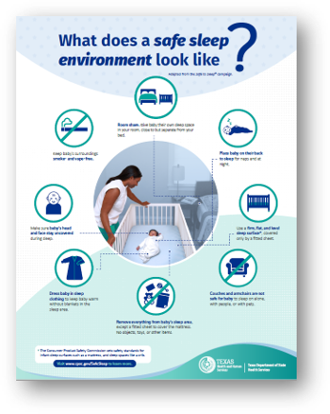
Use the Let’s Talk Toolkit
Printable Materials
Parent handouts
  Safe Sleep Environment Infographic
  Safe Sleep Environment Checklist
Discussion Guides
Caregiver Plan
Community Resource Template
Circle of Support
Example image of handout.
Notes:
Ask participants to locate the Safe Infant Sleep Infographic handout pictured on the slide.
The resources developed within the toolkit were designed with low reading levels and graphics to support parent and caregiver uptake of information. They are meant to support the Let’s Talk approach to supporting parents and caregivers adoption of safe infant sleep practices. The online files include instructions for use and individual files are referenced throughout the Community Training Implementation Guide.
Let’s review some of the key files and how they can be used in the Let’s Talk approach.

Slide 84

What Are the Challenges?
Time
Setting
Knowledge
Culture
Notes:
Many training participants may express barriers to the Let’s Talk approach. As a facilitator it important to provide a safe supportive place for community educators to share and support each other with solutions.
Ask participants what challenges they expect when using the Let’s Talk approach. Guide discussion through the themes of time, setting, knowledge, and culture.
Below is an example of barriers educators may experience from the NAPPSS Building on Campaigns through Conversations modules.
TIME:
“Wow, there are a lot of parts to this conversation. Who has that much time?”
Remember that you may be one of several people talking with families. This approach depends on a broad system of users comprised of people and programs that touch families. Look at the matrix of the parts and think about which ones fit your role with the family. It’s essential that we all work to make sure that before the baby is born, at the birth, and afterward, the conversation is started, a plan is made, and the conversation continues to tweak the plan and make sure it is working for the family and is a plan they will share with other infant caregivers.
“Explaining each recommendation seems very time-consuming. I don’t have that much time to communicate these important recommendations.”
Since research has reported that families are not likely to buy into the recommendations without some understanding of why they are made, not sharing this information is wasting valuable time. You don’t, however, have to go through each and every reason—since the Conversations Approach is a two-way process, you can ask families if they have any questions about why a recommendation is given and deal with that one or more. Also, there are two important themes that you can reference and relate to each recommendation: 1. Making sure the baby gets enough oxygen (keeping the baby’s airways open (nothing covering the face, not cut off by the position of the chin on chest) and keeping the baby from rebreathing the carbon dioxide when face down; 2. Making sure the baby does not sleep so deeply that he/she doesn’t wake up if oxygen levels are getting too low. Breastfeeding, of course, has additional benefits.
“I really don’t have much time with families. How can I add even more information to my interactions?”
You can really cover this information very quickly. It is most important to let parents know that others may expect the baby to sleep through the night very soon, but that is not typical, and that feeding extra probably won’t help. Let them know how little babies can eat at one time. You can then ask them how they plan to get support for themselves when they get home. If they have developed a plan before the baby is born, remind them to use it. If they have not, connect them with someone who can help them think through their support system. You do not have to work that out with them in your short time with them. Suggesting a plan is just as important as giving the recommendations for safe sleep and breastfeeding, because without some help when they are sleep deprived, they may not follow through on implementing safe infant sleep practices.
SETTING:
“I provide information in groups settings—workshops or classes in settings such as WIC centers or Head Start sites, etc. How does the Conversations Approach apply to those types of situations?”
The Conversations Approach works extremely well in group settings. While some caregivers may be hesitant to share their refusal or reluctance to implementing recommended behaviors, a group conversation may allow others in the group to voice concerns that may be shared across several members or embolden other group members to speak. In addition, the group can help brainstorm ways of meeting challenges, share past successes, and create a network of support for addressing unanticipated challenges in the future.
“I have to document my teaching about safe sleep and/or breastfeeding. How can I use this approach?”
You can still document your interaction. It will just be done as a two-way communication, where you anticipate and elicit questions and concerns and help with problem solving. Part of your interaction may be connecting families with ongoing support for their decisions about how to feed and sleep their babies.
KNOWLEDGE or SKILL:
“I am not sure I can know all of this information. It seems like too much to keep in mind when I talk with families.”
First, there are a number of common concerns—sleep for parents being the main one. So being prepared to talk about those issues is important and will become familiar. Secondly, within your community or among the families you serve, there also may be some recurring issues that will allow you to become well acquainted with the information. Finally, there are a set of “cheat sheets” for this module—see the Handouts in the left navigation bar.
“I am not an expert about breastfeeding or I am not an expert on safe sleep. How am I supposed to integrate these topics into a conversation?”
These modules will provide you with the knowledge you will need to have conversations with families about both topics. As already noted, the Conversations Approach is a team sport and you may need to identify others with more expertise to guide families through implementing safe sleep and breastfeeding at home with their infants. But you can raise both issues and provide the basic information families need to decide to embrace them. If they raise technical questions, then you can rely on other experts and connect them to those resources. But for the family, these two issues are the biggest challenges they face when they get a new baby home—they are not separate at all—and to effectively support families, we need to break down the silos!
“I am not comfortable with sharing information about reducing risks when bed sharing. Aren’t we giving families permission to bed share?”
In the Conversations Approach it is important to recognize that we do not give families permission, because they don’t need our permission. They will make their own decisions. We lend our expert knowledge and ability to support families in making informed decisions. We are not authority figures who tell them what to do and expect compliance. It may feel uncomfortable at first to let go of the role of authority, but in reality it hasn’t worked particularly well. Hopefully, creating open dialogue and recognizing that families may make choices not totally in compliance with the recommendations is more in keeping with current thinking about behavior change and public health promotion.
CULTURE:
“Because of their culture and traditions, some families don’t agree with all of the recommendations. Should I really share all of them with all families?”
If you think about this process as information sharing, not telling people what to do, it changes the perspective. Ethically, we need to share what we know with all families. It is how we share it—these recommendations are the starting point for a conversation and as you will learn in later modules, we then must be prepared to welcome and engage with them about their concerns, reluctance or rejection of particular recommendations.
“I understand that bias is a problem, but aren’t some stereotypes common because they are true?”
Your experiences and those of others may have led you to expect certain responses from families and individuals from specific groups. In addition, every day we are exposed to news and others’ opinions that worm their way into our unconscious views of people from various groups. This is especially true if those people are not “like us.” The problem with not acknowledging your assumptions based on stereotypes is twofold. First, not every person or family from any group is like all the others. If you assume they are, you have short-circuited the purpose of the Conversations Approach—to individualize it to each person or family. Second, if you have not used an individualized approach with people from a given group in the past, you now have an opportunity to learn about their concerns and resistance and do a better job of giving them information about sleeping and feeding their babies. So use what you have learned in the past, but question the assumptions it might make you have.
“What happens if families still do not accept or want to adopt the recommendations after I have shared additional information?”
Families will always make their own decisions, and you will be successful if those decisions are made with good information that you share. If families do not want to embrace one or more safe sleep or breastfeeding recommendations, you can focus on those they do endorse and provide information about reducing risks or supporting benefits. For example, you can make sure families who plan to bed-share have a plan for removing problematic items in the bed. Or, you can support families that decide that breastfeeding will not work when mother goes back to her job, by helping them develop a plan to breastfeed as long as possible to get early benefits of antibodies for the newborn. Some families may decide to reject the recommendations altogether. Then you still have an important role: Helping the family plan for the supports they will need to implement their choices (See Module 6).
From NICHQ:
“I work with a lot of immigrant families and co-sleeping is a cultural practice for many of them. How do we remain culturally sensitive and still convey information regarding safe sleep?”
It’s important to find the time to have an interactive conversation with parents, families and caregivers. During these conversations, we ask open ended questions about their plans and circumstances and acknowledge where families are in terms of their beliefs and plans. This provides an opportunity to share the evidence that we know, then discuss risk reduction for behaviors families are willing to adopt.
When we do this, we can support their understanding, provide an opportunity to discuss the advice or expectations coming from their family, and uncover questions they have around practices they may not be familiar with or are uncomfortable with. Using a strength based approach, we can identify the caregivers’ practices and behaviors that will reduce the greatest risks.
Image credit: Texas DSHS

Slide 85
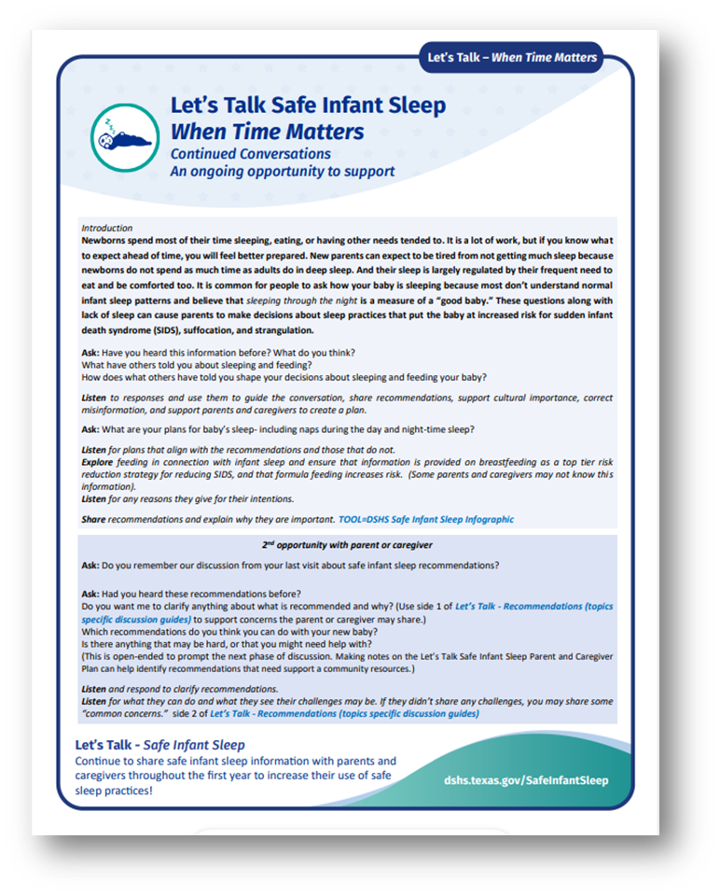
Breaking Down Barriers for Families
Recognize the unique needs of each parent or caregiver.
Use active listening skills to explore challenges.
Connect families to resources to meet their needs.
Adopt a risk-reduction mindset.
Use the Let’s Talk - Recommendation Discussion Guides to share safe sleep recommendations with parents and caregivers and to support their questions.
Example image of resource.
Notes:
Ask participants to locate the Let’s Talk- When Time Matters handout pictured on the slide.
Ask participants: How often do you get to spend with parents supporting their education and needs? Raise your hands
Once
A few times
Multiple times
Ask participants: How long do you get to spend with parents supporting their education and needs? Raise your hands
5-10 minutes
15-30 minutes
An hour or more
Whether a community educator has 5-10 minutes, 30-plus minutes, or multiple opportunities to share safe infant sleep recommendations, this time can be used effectively to support parents and caregivers. The Let’s Talk – When Time Matters provides a breakdown for community trainees to implement part, or all, of the Let’s Talk approach based on their setting
Remember the attendees of your training can often be viewed as experts by caregivers who interact with them. As we prepare to implement a conversational approach to supporting caregivers, we first need to flip that perception through open and honest conversations. We go beyond expert to collaborator, supporter, and an encourager to identify and accommodate a family’s cultural and social factors that contribute to accepting and implementing recommendations.
The information we share should be accurate and may be in a short, medium, or long format discussion.
Asking open-ended questions, actively listening to responses, and reflecting on the caregiver’s barriers is important to helping them build a plan to implement some (or all) recommendations for safe infant sleep and breastfeeding. Often this will include referral to additional sources of support. In the online toolkit, community partners will find a template to build a resource list, a Let’s Talk Conversation Guide, as well as a Caregiver’s Plan for Safe Infant Sleep and Feeding to use when working with families.
Reference:
Bronheim, S. (2017). Building on campaigns with conversations: An individualized approach to helping families embrace safe sleep and breastfeeding. Washington, DC: National Center for Education in Maternal and Child Health.

Slide 86

Why Help Parents and Caregivers Plan?
Planning for the known or unknown can support safe sleep for babies:
While traveling.
When displaced from the home (e.g. during an emergency or natural disaster).
When someone other than you will be caring for your baby (e.g. family member or child care provider).
Notes:
Planning for the known or unknown can support safe sleep for babies.
While traveling
When displaced from the home (e.g. during an emergency or natural disaster)
When someone other than you will be caring for your baby (e.g. family member or child care provider)
Examples of non-usual care providers: day care provider, family member, babysitter or friend
Babies who are used to sleeping on their back are at greater risk of unexpected death when placed on their tummies to sleep.
Image credit: Texas DSHS

Slide 87
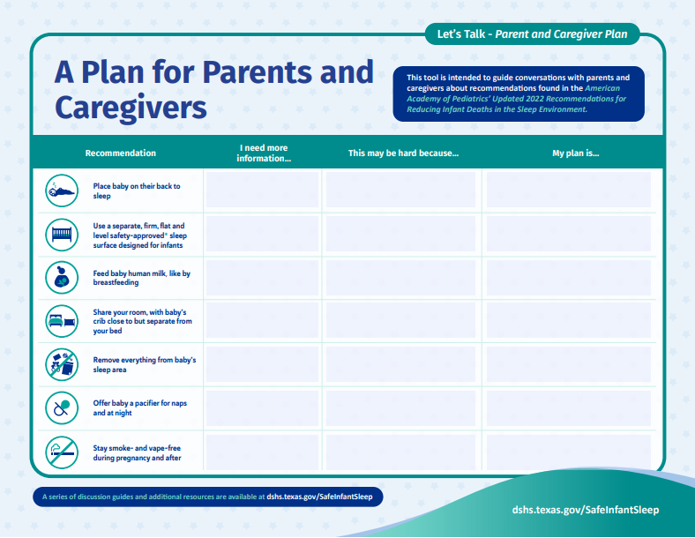
Creating a Safe Sleep Action Plan
Where will my baby sleep at home?
Where will my baby sleep when staying with other caregivers (grandparents, aunts, uncles, babysitters, etc.)?
Where will I feed my baby at night?
Where will my baby sleep in an emergency?
Example image of resource.
Notes:
Ask participants to locate the Let’s Talk- Plan for Parents and Caregiver handout pictured on the slide.
This handout is designed to be used with parents and caregivers to prompt your conversations supporting safe infant sleep recommendations. It can be paired with the DSHS Safe Sleep Environment infographic, the Let’s Talk – Recommendations (topic specific discussion guides), and with the Let’s Talk – When Time Matters. Using the first empty column parents or caregivers can note recommendations they may need more information of support to understand and adopt.
The middle column can be used to record any barriers the parent or caregiver identifies. When a parent or caregiver presents a challenge, it is important to listen and provide resources and additional support (see Let’s Talk – Circle of Support) You may also use the Let’s Talk – Community Resources (template) to add local resources the parent or caregiver may be referred to for additional community support.
The final column encourages parents and caregivers to build a plan for safe infant sleep. It is especially important to encourage them to share the plan with all the baby’s caregivers (grandparents, other family members, child care center staff, and others). This can increase the likelihood that safe infant sleep practices will be adopted every night, every nap, every feeding, every time.
REMEMBER: It’s okay if you don’t know an answer!
If a parent asks about something you aren’t familiar with regarding one of the recommendations, let the parent know you will find out more information and follow up with them. To find additional information, contact your community training facilitator, or the DSHS Infant Health team at InfantHealth@dshs.texas.gov
Additional resources from NAPPSS Building on Campaign through Conversations:
1. Families may not want to create a plan. Do I have to push this issue?
Of course, families have a choice and creating a full plan may not be something they choose. Having the discussion with them, however, is still very important and helpful. It can help them begin to anticipate what they need to do to prepare for their baby and help them think about what supports they have or may need. This thought process alone gives families a chance to make sure they can follow through with their plans for sleeping and feeding their babies.
2. A written plan may not work for everyone. Families with limited or no literacy or with disabilities that impact reading written material won’t benefit from one.
There are a number of ways that you can make accommodations to the process for families who might not benefit from a written plan. For example, large numbers of people have smart phones. You could video or audio record a summary of the plan for the family for future reference. If the family has identified particular supports they want to use, you could help them put contact information into speed dial that could be voice activated. Finally, you might determine if there is someone in that family’s support system who could help them review the written plan over time—that could be part of the plan!
Reference:
Bronheim, S. (2017). Building on campaigns with conversations: An individualized approach to helping families embrace safe sleep and breastfeeding. Washington, DC: National Center for Education in Maternal and Child Health.

Slide 88
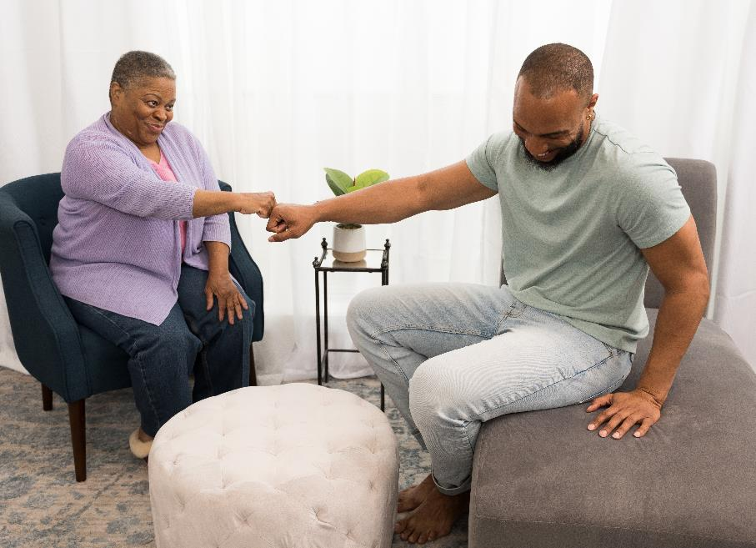
Let’s Practice
Help caregivers form an action plan to support safe sleep practices.
Pick Topics from the Memory Game (partner activity)
Practice with a Partner
Performance
Notes:
Each conversation with a new parent or caregiver creates a unique opportunity to provide support and encouragement.
What are some examples of people or roles who act as starters, deepeners, or those who provide ongoing conversations?
The NAPPSS developed Building on Campaigns through Conversations modules offers information and dives deeper into these roles and helps you as a facilitator determine how to support your audience.
The conversation purpose and methods are all based on asking open-ended questions and actively listening to families and caregivers so that they can select the best behaviors that they can routinely practice and provide safer infant sleep environments.
Resource: https://www.ncemch.org/learning/building/
Image credit: Texas DSHS
(Add questions - Paul)

Slide 89
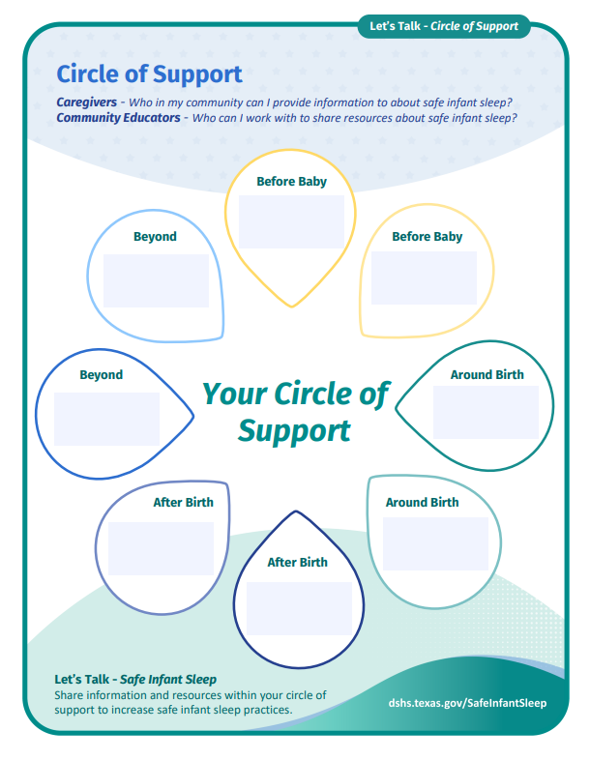
Who Can Continue the Conversation?
Multiple sources. Multiple times.
To increase the chance of parents and caregivers using safe infant sleep recommendations.
Example image of resource.
Notes:
Ask participants to locate the Let’s Talk- Circle of Support handout pictured on the slide.
One of the most common concerns that supporters express is their lack of time or their limited role in having discussions and sharing recommendations for safe infant sleep and breastfeeding. We know that caregivers are more likely to accept and adopt recommendations for safe infant sleep and breastfeeding. Where do you fit into a caregiver’s system of support? Who else in your community can start, continue, and deepen the open and honest discussions around safe sleep and breastfeeding?
Offer a stretch and snack break activity-
Ask participants to work together without using their voice/words to form their community circle of support.
Keeping this slide on screen as a reference participants can self identify if they fit into the circle “before birth”, “at birth”, “after birth” or “beyond”.
Once the participant group has formed a circle reinforce the opportunity to collaborate and share the same message to parents and caregivers.
This community can even look for gaps where they need to add to the circle.
Reiterate that this tool is included in the online toolkit as a handout and includes recommendations to use both in trainings and with parents and caregivers.
Encouraging both community educators and parents to identify and engage their circle of support can create a collective impact for individuals and communities to reduce the rates of sleep related death.
Reference:
Bronheim, S. (2017). Building on campaigns with conversations: An individualized approach to helping families embrace safe sleep and breastfeeding. Washington, DC: National Center for Education in Maternal and Child Health.

Slide 90
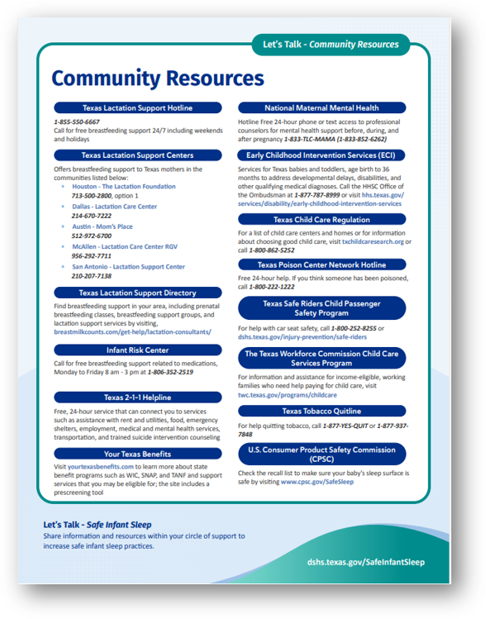
What Resources Can I Share in Conversations?
Customizable Community Resource Template
Side one lists national and state resources to support safe infant sleep practices.
Side two provides a space for you to add community resources and your contact information.
Example image of resource.
Notes:
Ask participants to locate the Let’s Talk- Community Resources handout pictured on the slide.
One of the most common concerns that supporters express is their lack of time or their limited role in having discussions and sharing recommendations for safe infant sleep and breastfeeding. We know that caregivers are more likely to accept and adopt recommendations for safe infant sleep and breastfeeding. Where do you fit into a caregiver’s system of support? Who else in your community can start, continue, and deepen the open and honest discussions around safe sleep and breastfeeding?
Offer a stretch and snack break activity-
Ask participants to work together without using their voice/words to form their community circle of support.
Keeping this slide on screen as a reference participants can self identify if they fit into the circle “before birth”, “at birth”, “after birth” or “beyond”.
Once the participant group has formed a circle reinforce the opportunity to collaborate and share the same message to parents and caregivers.
This community can even look for gaps where they need to add to the circle.
Reiterate that this tool is included in the online toolkit as a handout and includes recommendations to use both in trainings and with parents and caregivers.
Encouraging both community educators and parents to identify and engage their circle of support can create a collective impact for individuals and communities to reduce the rates of sleep related death.
Reference:
Bronheim, S. (2017). Building on campaigns with conversations: An individualized approach to helping families embrace safe sleep and breastfeeding. Washington, DC: National Center for Education in Maternal and Child Health.

Slide 91
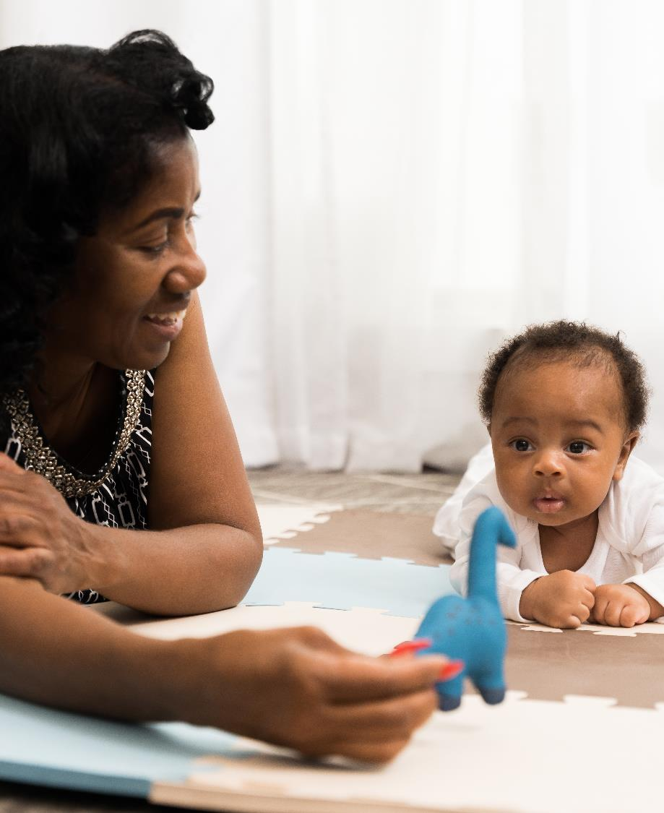
Training Your Community
Goals, Planning, and Follow-Up Support
Notes:
Image credit: Texas DSHS

Slide 92
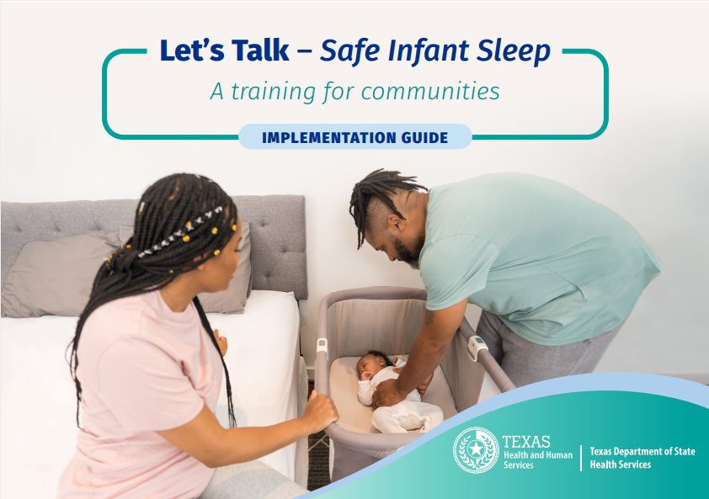
Host a Community Training
Use the Let’s Talk approach to develop a plan with families that focuses on their needs, beliefs, and lived experiences. Help families find resources in your community and create realistic goals.
Implementation Guide
Resources
Handouts
Presentations
Example of Implementation Guide. Click on image to go to the website.
Notes:
Point out to participants that we are going to walk through some of the components of the Let’s Talk- Safe Infant Sleep toolkit and practice the approach together during the rest of the training.
With your self-reflection in mind, we are going to walk through the tools available to help you implement the Let’s Talk approach in your community. Later we will practice using these tools!
Let’s Talk – Safe Infant Sleep takes what you know about safe infant sleep practices and moves your work to a model of action. The new approach focuses on an open and honest dialogue between the community trainer and families and caregivers. This training updates and replaces the previous DSHS-developed “Safe Sleep for Babies, a Community Training”.
Like the previous training, there are activities and handouts designed to support specific audiences including:
Facilitator and community educator tools and materials (distinguished by a blue page border)
Parent and caregiver resources and materials (distinguished by a teal border or background)
Handouts and other tools are hyperlinked and referenced to additional state and national resources.
This training supports a shift in the role of safe infant sleep educators from “experts or authorities” to “partners” who can help families identify and break down stated barriers to the adoption of safe infant sleep practices.

Slide 93
Activities That Support the Let’s Talk Approach
Let’s Talk Approach
Let’s Talk – Safe Infant Sleep Community Training
Let’s Talk – Safe Infant Sleep
Clear the Crib Awareness Activity
Let’s Talk – Safe Infant Sleep
Parent and Caregiver Class
Notes:
When you adopt the Let’s Talk Approach you aim to use responsive conversations with parents and caregivers to break down barriers that prevent safe infant sleep practices. After attending the Let’s Talk - Safe Infant Sleep Community Training safe sleep champions can work within their organizations to plan activities that adopt the Let’s Talk Approach. Champions can adapt the Community Training for their organizations and their staff or volunteers who support parent and caregivers. Organizations that engage in community events can adapt the Let’s Talk – Clear the Crib activity and/or the Let’s Talk – Safe Infant Sleep Parent and Caregiver class.
Developing goals for your organization and its activities is important first step to adopting the Let’s Talk Approach.

Slide 94
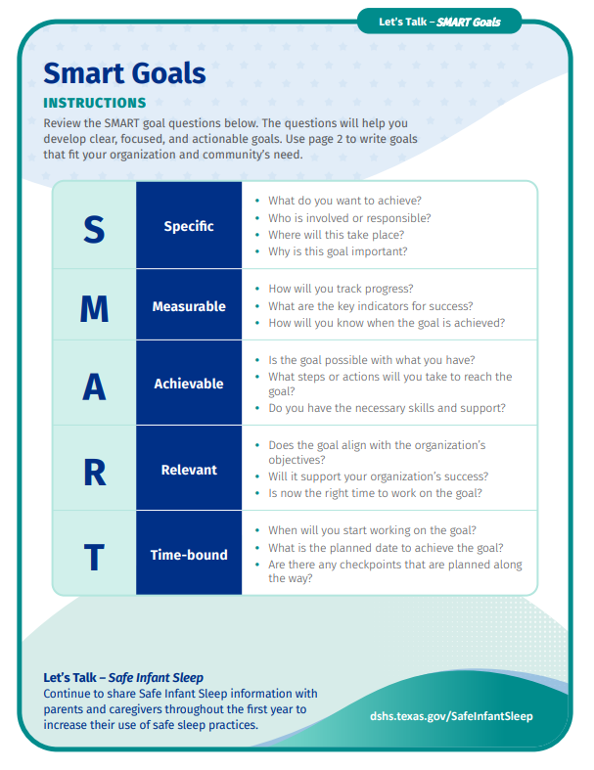
Set Goals to Measure Success
Consider the goals you want to reach with your community.
Do you want to improve their knowledge, adoption of recommendations, or the reach of your program?
Each community and organization should develop a set of SMARTIE objectives they hope to achieve.
Example image of resource.
Notes:
Ask participants to locate the Let’s Talk- SMART goals handout pictured on the slide.
Setting Goals to Measure Success
Pre- and post- tests measure knowledge of both training participants as well as parents or caregivers that are engaged in your training program.
How will you measure success of your Let’s Talk training?
Examples may include:
Number (or minutes) of interactions a parent of caregiver has with their circle of support using the Let’s Talk approach.
Number of organizations or staff trained in the Let’s Talk approach.
Percent of participants that were highly satisfied with their training.
Percent of parents or caregivers that adopted additional recommendations after receiving support through a Let’s Talk approach
Ask the class if they have ever written a SMART goal? Ask participants if they would be willing to share examples?
Share a prepared SMART goal or if time permits work with the class to develop one SMART goal example. Encourage participants to write down the goal as an example to take back to their organization.

Slide 95
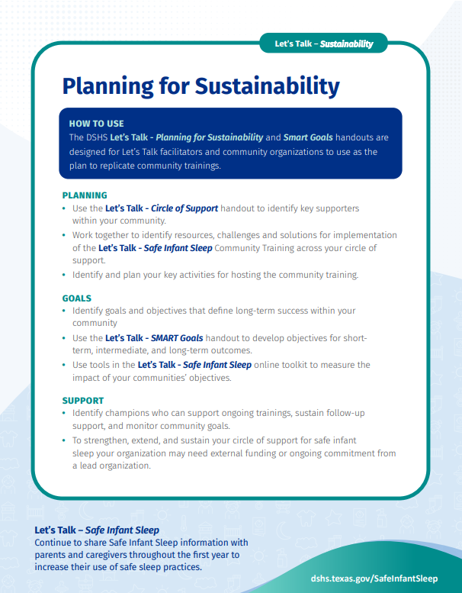
Key Planning Activities
Anticipate how to achieve long-term success.
Consider necessary adaptions to the Let’s Talk training to meet your community’s current needs.
Identify key partners for the Circle of Support within your community.
Provide the training in a safe, non-judgmental space that is sensitive to the diversity among the mothers and families you serve.
Example image of resource.
Notes:
Ask participants to locate the Let’s Talk- Sustainability handout pictured on the slide.
Planning and Logistics
Planning starts with gathering key supporters in your community that work or offer services to families and caregivers. Planning should include safe infant sleep community champions to help identify challenges and solutions for implementing and sustaining the Let’s Talk training within your community.
Key planning activities:
Anticipate how to achieve long-term success
Consider necessary adaptions to the Let’s Talk training to meet your community’s current needs
Identify key partners for the Circle of Support within your community
Follow-up with educators to identify additional training needs
Provide the training in a safe, non-judgmental space that is sensitive to the diversity among the families you serve
Review page two of the handout with the participants and encourage them to take notes on initial planning ideas that they can share with their organizations.

Slide 96
Follow-Up Support
Monitoring and responding to the needs of your training participants and your community strengthens your community's Circle of Support.
Participant Surveys
Follow-up Surveys
Phone or Email Support
Notes:
Monitoring and responding to the needs of your training participants and your community strengthens your community's Circle of Support.
As part of this pilot, we plan to use:
Pre and Post Training Surveys
For facilitators use in Community Training class:
Let’s Talk – Community Training Pre-Test
To identify the baseline knowledge of participants as well as interest or needs prior to the start of training.
Let’s Talk – Self-Assessment Survey
For use after completing the review of safe infant sleep recommendations portion of training with participants. Facilitators can provide a paper or electronic version of the survey and ask participants to complete before taking a break (let them know that surveys are anonymous). Facilitators
can then share the compiled results and lead the group in discussion and self-reflection.
Let’s Talk – Community Training Pre-test
To identify the knowledge gained after the participants’ completion of the training as well as additional needs and follow-up contact information.
Let’s Talk – Community Training Participation Survey
To measure training objectives and goals while gathering feedback for future improvements.
Phone or Email Support: when replicating the Let’s Talk Community Training, we hope that organizations offer phone or email support to the training participants (community educators) who may have questions.

Slide 97
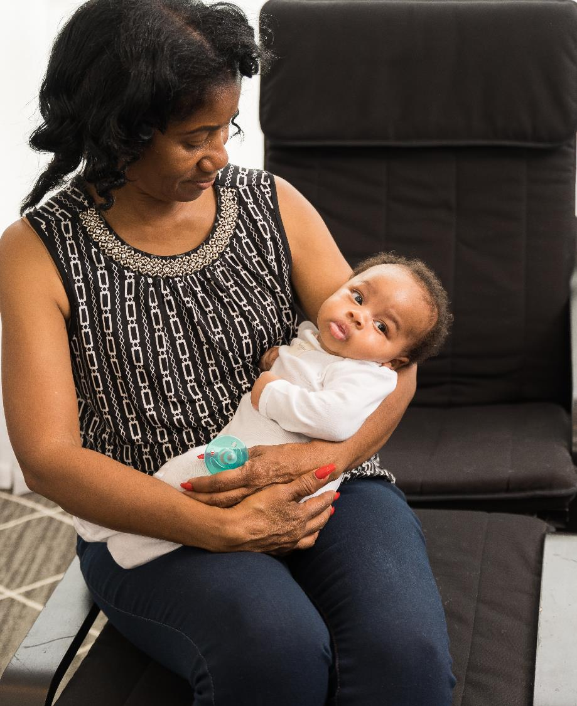
Closing

Slide 98
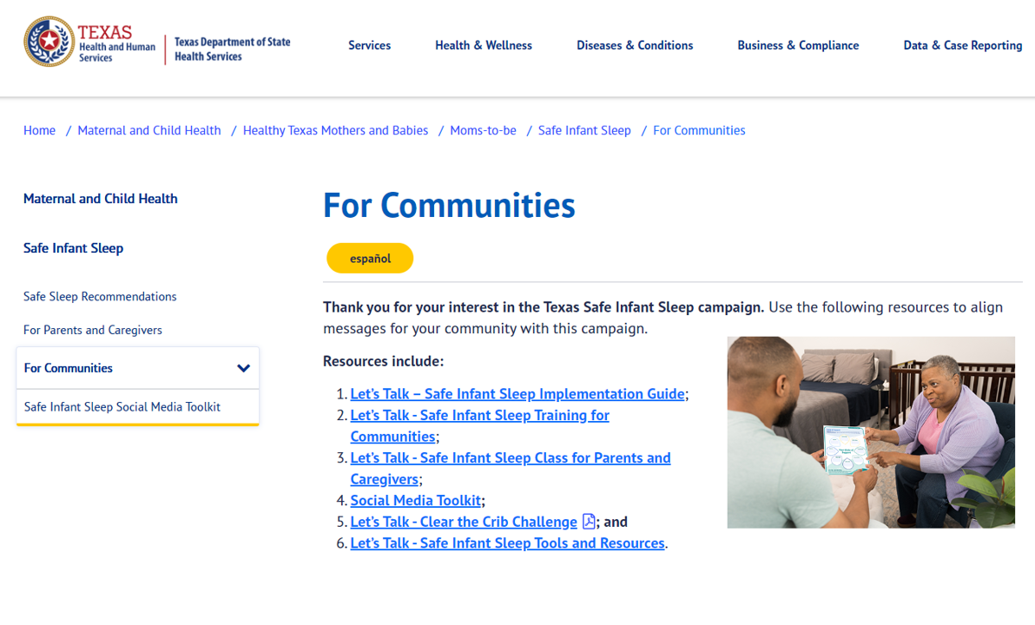
Closing
Questions
Resources Available for Download or Electronic Use
Community Training Post-Test
Follow-Up Survey
Example of image of Let’s Talk-Safe infant Sleep toolkit location. Click on image to go to the website.
Notes:
Ask participants to locate the Let’s Talk- Community Resource template handout pictured on the slide.
This resource has space to customize resources specific to the communities you serve.
We would like to provide a few minutes at the end of this training you to network and identify organizations or resources that you can add to the template.
Ask participants what questions they might have today?
Pass out or share a QR code for the Let’s Talk Community Training Post-Test.
Remind participants that they will receive follow up survey about their training experience.

Slide 99
Safe Infant Sleep Website
Every caregiver can plan for safe infant sleep.
Every night. Every nap. Every feeding. Every time.
DSHS Safe Infant Sleep Website:
dshs.Texas.gov/SafeInfantSleep
dshs.texas.gov/SuenoInfantilSeguro
Notes:
Please share our state Safe Infant Sleep webpage with parents, caregivers and your Circle of Support community partners to support their learning more about safe infant sleep recommendations. Current information is based on adaptations of the national Safe to Sleep ® campaign materials (like the safe sleep environment PDF mentioned in the previous slide), but more resources and information are being developed as we speak and made available on this site throughout the year.
As our tagline indicates, this information is not just for parents. We encourage you to bookmark our site and share with everyone who cares for an infant, so they can better understand the importance of practicing safe infant sleep.
Information on the DSHS Safe Infant Sleep website is adapted from: The Eunice Kennedy Shriver National Institute of Child Health and Human Development Safe to Sleep campaign: https://safetosleep.nichd.nih.gov/

Slide 100
Safe Infant Sleep Data Resources
DSHS Infant Health Practices Dashboards:
healthdata.dshs.texas.gov/dashboards/maternal-and-child-health/infant-health/
CDC SUID Data Resource:
cdc.gov/sids/data.htm
Notes:
Please share our state Safe Infant Sleep webpage with parents, caregivers and your Circle of Support community partners to support their learning more about safe infant sleep recommendations. Current information is based on adaptations of the national Safe to Sleep ® campaign materials (like the safe sleep environment PDF mentioned in the previous slide), but more resources and information are being developed as we speak and made available on this site throughout the year.
As our tagline indicates, this information is not just for parents. We encourage you to bookmark our site and share with everyone who cares for an infant, so they can better understand the importance of practicing safe infant sleep.
Information on the DSHS Safe Infant Sleep website is adapted from: The Eunice Kennedy Shriver National Institute of Child Health and Human Development Safe to Sleep campaign: https://safetosleep.nichd.nih.gov/

Slide 101
References
Images courtesy of:
  DSHS Maternal Child Health Unit Safe Infant Sleep campaign;
  iStock photo purchased for unlimited use by DSHS Tobacco Prevention and Control;
  Safe to Sleep® campaign, for educational purposes only; Eunice Kennedy Shriver National Institute of Child Health and Human Development, nichd.nih.gov/sids; and
  United States Breastfeeding Committee.
  Link to collective Let’s Talk Safe Infant Sleep Toolkit:
  dshs.texas.gov/maternal-child-health/healthy-texas-mothers-babies/moms-to-be/safe-infant-sleep/communities
Notes:
References for the full Let’s Talk- Safe Infant Sleep Toolkit including this training are located on dshs.texas.gov/SafeInfantSleep

Slide 102
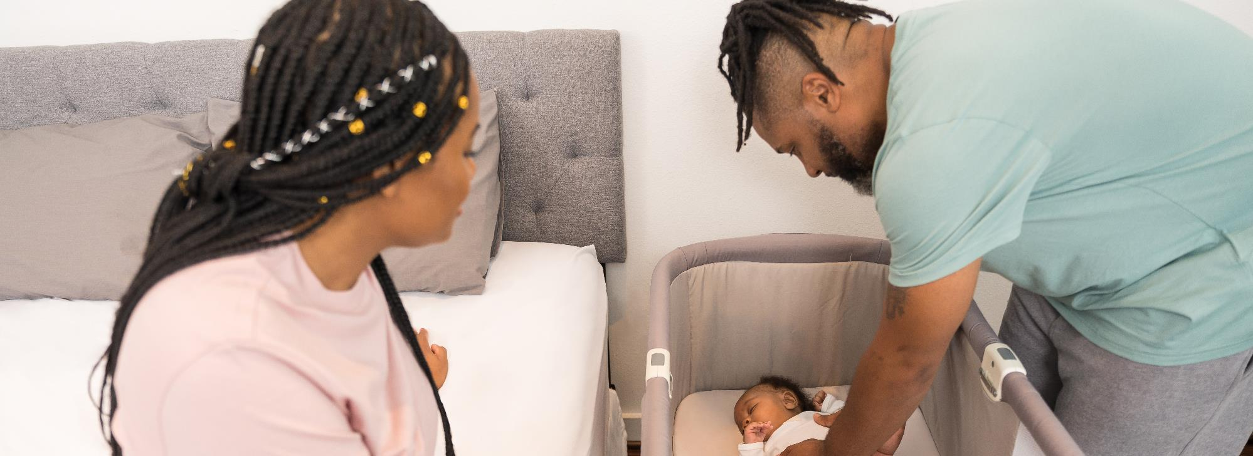
Thank You
InfantHealth@dshs.texas.gov
Notes:
Image credit: Texas DSHS

Slide 103
Let’s Talk - Safe Infant Sleep
Add instructions and/or QR code to complete the Community Training Post-Test or optional What I Learned Today activity.
Notes:
The notes contained within this presentation are meant as suggested facilitator language and contain additional resources to support the facilitator and audience attending the Let’s Talk- Safe Infant Sleep Community Training
Image credit: Texas DSHS

