Slide 1
Consumer Safety
FOOD & DRUG COMPLIANCE

Slide 2
MANUFACTURED FOODS COMPLIANCE 2023 CALENDAR YEAR END REPORT

Slide 3
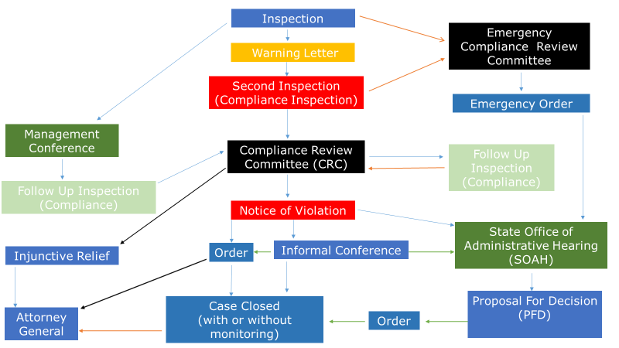
Food & Drug Compliance Flowchart

Slide 4
Cases referred to Compliance
Twenty-eight (28) cases were referred in total:
Ten (10) cases were triaged through Compliance Review Committee (CRC)
Eighteen (18) cases were license only cases that required no Compliance Review Committee (CRC)
CRC | 10
License Only | 18
Total | 28

Slide 5
Outcomes
After triage at CRC:
Twenty-five (25) Notice of Violation (NOV) letters were cleared to be issued
Three (3) cases were referred to the Attorney General
Two (2) cases (from 2022) were returned to program

Slide 6
Informal Conference (IC)
Five (5) cases were heard at an IC:
Four (4) cases were settled after the IC
One (1) case was referred to the State Office of Administrative Hearings

Slide 7
State Office of Administrative Hearings (SOAH)
Compliance referred 4 cases to SOAH, either at the request of the Respondent or at Department request.
All Respondents were offered the opportunity to have their case(s) presented before an Administrative Law Judge.
SOAH REFERRAL | 4

Slide 8
Orders & Agreements Processed
14 Agreed Orders/ Acceptance Orders (AO)
An Agreed Order is issued after an informal conference, to document and memorialize the settlement agreement reached between a Respondent and the Department.
An Acceptance Order is issued when a Respondent accepts the proposed disciplinary action in the Department’s Notice.
16 Attorney General (AG) Referrals
16 cases were referred to the AG for further administrative and/or judicial remedies on Respondents who failed to and/or refuse to comply with a final order.

Slide 9
Cases Closed With or Without Monitoring
Cases that have a finalized Order or an Agreement are either:
Closed with monitoring
Terms and conditions to be met are still pending
Closed without monitoring
All terms and conditions are met

Slide 10
Cases Closed With or Without Monitoring Continued
20 cases were closed with monitoring
16 cases were closed without monitoring

Slide 12
Ongoing trends

Slide 13
For more information regarding Compliance Consumer Safety policies and protocols, please click on the link below:
Consumer_Safety_Unit_Procedure_Manual_122123.pdf

Slide 14
Thank You and Happy New Year!

