Slide 1
HAI / MDROs
ELC break out session
Jessica Ross, CIC
Thi Dang, MPH, CIC
Bobbiejean Garcia, MPH, CIC
Sandi Henley, RN, CIC

Slide 2

Objectives
Explanation of HAI teams
  Addition of HAI regional Epidemiologists
HAI / MDRO Overview
NBS education
  Updates
  Issues
Specific case studies
Q & A

Slide 3
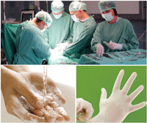
DSHS – Healthcare Safety Group
HAI Audit team
  Look at CAUTI, CLABSI, SSI in acute care hospitals and ASC
  Case reporting and TxHSN user maintenance
  Pull reports from the CDC National Healthcare Safety Network (NHSN)
  Conduct on site visits for first time high standardized infection ratio (SIR)
Preventable adverse event (PAE)
  Case reporting
HAI Investigation team
  Team of certified Infection Preventionist (CIC)
  Work with the audit team and also conduct site visits
  Infection Prevention and Control consultations\
  Outbreak investigations
Notes:
NHSN – data base that enables HCF to collect and report HAI data. Also provides facilities, states, regions, and the nation with data needed to identify problem areas, measure progress of prevention efforts, and ultimately eliminate HAIs.
CIC what does it mean: competence in actual practices of infection prevention and control and healthcare epidemiology, supports future knowledge and skills
Where is the best place to start? Your LHD!
The LHD should know who at the facility should receive health alerts/public health information to keep the facility staff aware of emerging situations.
Facilities should have internal communication protocols so that all relevant staff receive public health information.
The facility should know who to contact at the LHD and when and how to contact them.
The LHD (or regional or IDCU back-up) can provide assistance in the following ways:
Answer questions about travel or other risk factors.
Determine if a condition is of public health concern and what actions should be taken.
Advise and assist on prophylaxis, contact tracing and other risk reduction measures in the hospital and in the community.

Slide 4
HAI Epidemiologist
Covers a multitude of Infectious Diseases and situations
Bloodborne Pathogens
Meningitis
Influenza
Emergency preparedness
Multidrug-resistant organisms (MDROs)
  MRSA, CDIFF, VISA/ VRSA
  More emerging and urgent threats: CRE, MDR-Acinetobacter (MDR-A)
High consequence diseases
  Measles
  Ebola or other VHF

Slide 5
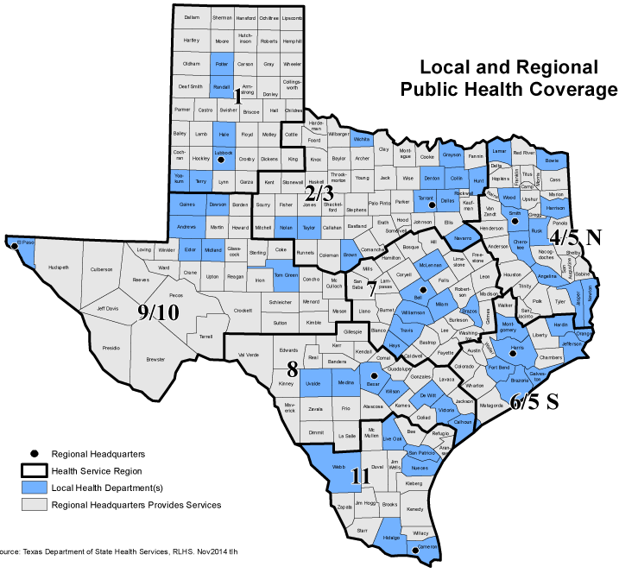
HAI Investigation Team
Jessica Ross
HSR 1
Thi Dang
HSR 2/3
Interim, Thi Dang
HSR 4/5 N
Jessica Ross
HSR 9/10
Sandi Henley
HSR 7
Jessica Ross
HSR 8
Bobbiejean Garcia
HSR 6/5 S
Melba Zambrano
HSR 11
Notes:
Talk about RACs and how there will be some over lap

Slide 6
HAI Investigation Team
Jessica Ross, CIC
  Central office but covers HSR 1, 9/10, and 8
  Phone: 512-776-6356, cell: 512-956-1029
Bobbiejean Garcia, MPH, CIC
  HSR 6/5 S Regional HAI Epi
  Phone: 713-767-3404
Melba Zambrano, RN, CIC
  HSR 11 Regional HAI Epi
  Phone: pending start date of March 16th, 2016
Thi Dang, MPH, CIC
  HSR 2/3 Regional HAI Epi
  Interim for 4/5 N, job interviews conducted, pending
  Phone: 214-632-3480
Sandi Henley, RN, CIC
  HSR 7 Regional HAI Epi
  Phone: 254-750-9387

Slide 7
The HAI Problem
United States
722,000 infections/year
75,000 deaths/year
$25-$33B in healthcare costs
Texas
130K-160K infections/year
8K-9K deaths/year
Costs to patient & family, HCW, etc.
Notes:
The US numbers are based off of 2011 data:
- These numbers are down from the 2007 estimates for 1.2 million infections
References:
Magill, S., Edwards, J., Bamberg, W., Beldavs, Z., Dumyati, G., Kainer, M., . . . Fridkin, S. (2014). Multistate point-prevalence survey of health care-associated infections. N Engl J Med, 1198-208.
The Centers for Disease Control and Prevention. (2009, December 29). Template Document for Texas Healthcare-Associated Infections (HAI) Plan. Retrieved from http://www.cdc.gov/HAI/pdfs/stateplans/tx.pdf

Slide 8
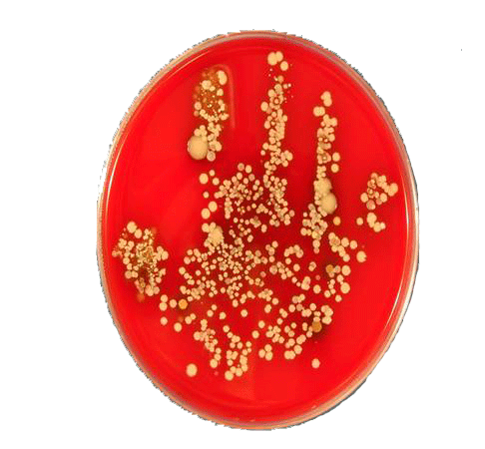
5 Reasons for HAI Reporting
Improve healthcare quality by reducing HAI
Establish standards for comparability of data
Consumer’s right to know
Patient Empowerment
Help to identify facility needs for DSHS support
Notes:
8
In the last few years there has been a strong push for patient empowerment in healthcare.
Most wide-spread, hand hygiene campaigns : Speak up and It’s OK to Ask, which encourage patients to ask their HCWs to clean their hands before providing care.
We are trying to build on the principles of transparency and consumer choice to create incentives and motivate healthcare organizations and providers to provide better, more efficient care.
There have been recent news stories about:
patient suffered some complications following surgery and it emphasized the need for healthcare consumers to have as much information as possible to make informed decisions about their own well being.
Working to establish greater consistency and compatibility of HAI data through developing standardized definitions and measures for HAIs.
Will help DSHS identify educational needs – areas where more education or focused education needs to occur around the state.

Slide 9
2014 Annual Report
Health Care-Associated Infections

Slide 10
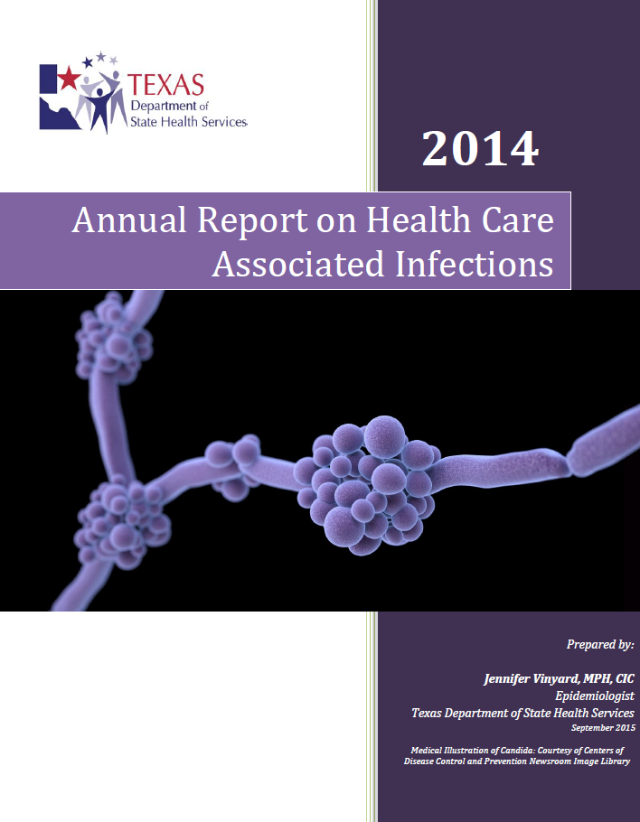
www.haitexas.org
Click “Annual Report”

Slide 11
Who reported? How did we do?
2013 Data
2014 Data
Facility Type | Number | Percent of Facility Type Reporting HAI
General Hospital | 285 | 75.4
Surgical Hospital | 36 | 9.5
Ambulatory Surgery Center | 24 | 6.3
Critical Access Hospital | 16 | 4.2
Children’s Hospitals | 12 | 3.2
Orthopedic Hospital | 3 | <1%
Oncology Hospitals | 1 | <1%
Women’s Hospital | 1 | <1%
All Facilities | 378 | 100%
Facility Type | N | Percent of Facility Type Reporting HAI
General Hospital | 293 | 68%
Surgical Hospital | 40 | 9%
Ambulatory Surgery Center | 54 | 13%
Critical Access Hospital | 24 | 6%
Children's Hospital | 14 | 3%
Orthopedic Hospital | 3 | 1%
Oncology Hospital | 1 | <1%
Women's Hospital | 1 | <1%
All Facilities | 430 | 100%
Notes:
2013 info:
847 eligible general hospitals and ASCs
Only 413 were required in 2013
The other 434 did not have ICUs nor perform reportable procedures
Of the 413, 378 reported
The remaining 35 that did not report were contacted to find out why and assist in the process
2014 info:
Only 438 of the 879 eligible general hospitals and ASCs were required to report HAIs to Texas in 2014.
The other facilities did not have ICUs nor did they perform any of the Texas reportable procedures; therefore, they did not have anything to report.
430 facilities reported HAI data to Texas (via NHSN).

Slide 12
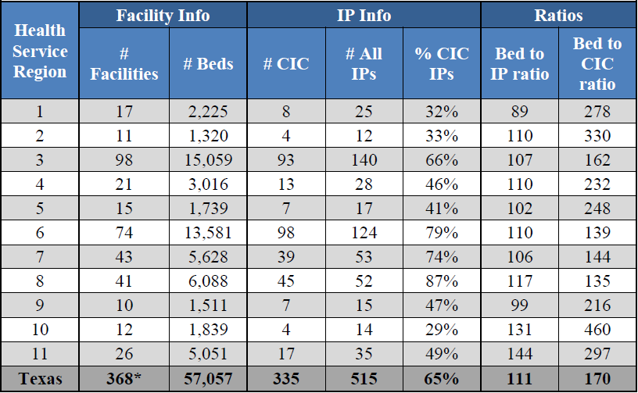
Summary of Texas
Infection Preventionist
Notes:
*10 facilities did not provide bed size or IP information and, therefore, were not included in this analysis.
On average and for each of the HSRs, the CDC recommended 100 beds per 0.8 – 1.0 (FTE) IPs is not met in all regions except region 1.

Slide 13
Future Plans & Ideas for HAIs

Slide 14
Combating HAIs
CLABSI Validation protocol began in 2016 with assessment audits
  New auditor hired
Expand CLABSI/CAUTI/SSI
Notes:
The CDC has a validation protocol that would change our current practice. We have started the steps necessary to meet the requirements to be able to perform this level of validation.
Expand reporting to outside of the ICU’s to include Medical and Surgical wards
Expand CLABSI/ CAUTI/ SSI: discuss new process for 2016 with letter sent to facilities, etc.

Slide 15
Preventable Adverse Events (PAE)
Started public reporting of PAEs January 2015
3 Tier phase-in implementation of different kinds of adverse events
PAE Users enter data into TxHSN
More information
  Website: www.paetexas.org
Questions
  Email: paetexas@dshs.state.tx.us
Notes:
If they haven’t received that information they need to email paetexas@dshs.state.tx.us
Lots of information on www.paetexas.org

Slide 16
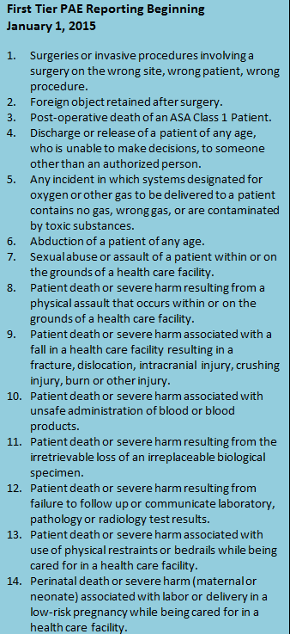
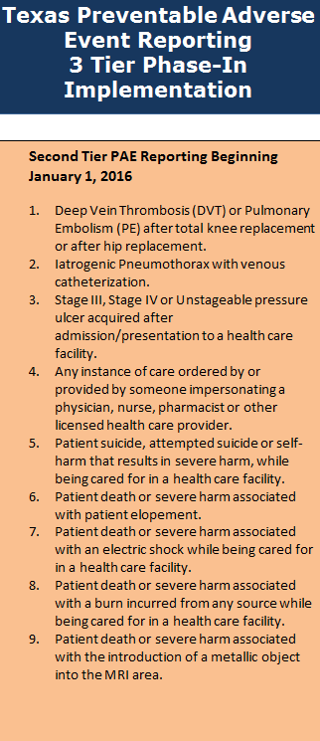
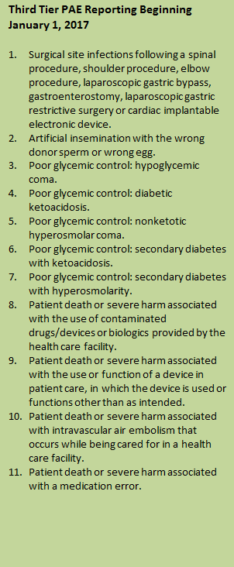
Notes:
Total PAE’s for 2015: 476 preliminary data
Top two PAE’s:
Falls with fracture
Forgien object retained

Slide 17
HAI/MDRO Reporting

Slide 22
ECCG (Epi Case Criteria Guide)
CRE
Confirmed: A Klebsiella species or E.coli from any body site/ source that is laboratory confirmed.
CRE confirmed
Klebsiella species and E. coli that are resistant to any carbapenem, including meropenem, imipenem, doripenem, or Ertapenem,
OR
Production of a carbapenemase (i.e. KPC, NDM, VIM, IMP, OXA-48) demonstrated by a recognized test (i.e. polymerase chain reaction, metallo-β-lactamase test, modified Hodge test, Carba NP).
Note: There is no requirement to submit isolates to the DSHS lab. Please contact a DSHS HAI Epidemiologist or the DSHS lab for additional information on available lab support.
Notes:
New CRE definition:
Only resistant now and not non-susceptible
Inclusion of Ertapenem

Slide 23
ECCG (Epi Case Criteria Guide)
MDR-A
Confirmed: Acinetobacter species from any body site/source that is laboratory confirmed.
MDR-A confirmed
Non-susceptible (i.e., resistant or intermediate) to at least one antibiotic in at least 3 antimicrobial classes of the following 6 antimicrobial classes:
βeta-Lactam (Piperacillin, Piperacillin/Tazobactam)
Aminoglycosides (Amikacin, Gentamicin, Tobramycin)
Carbapenems (Imipenem, Meropenem, Doripenem)
Fluoroquinolones (Ciprofloxacin, Levofloxacin)
Cephalosporins (Cefepime, Ceftazidime)
Sulbactam (Ampicillin/Sulbactam)
Note: There is no requirement to submit isolates to the DSHS lab. Please contact a DSHS HAI Epidemiologist or the DSHS lab for additional information on available lab support.

Slide 24
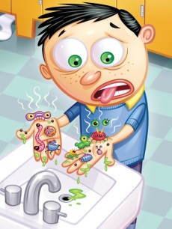
HAI/ MDRO questions
  mdrotexas@dshs.texas.gov

Slide 25
NBS data entry
Jessica Ross, CIC

Slide 26
MDRO Reporting in NBS:
Discussion Points/ Updates
Data Entry Guide
Corrected confusing titles of questions/fields
Limitations of options in drop-down menus
Timeline of healthcare facility stays
Lab report data entry
Associating lab reports with investigations
Program area assignment for lab reports

Slide 27
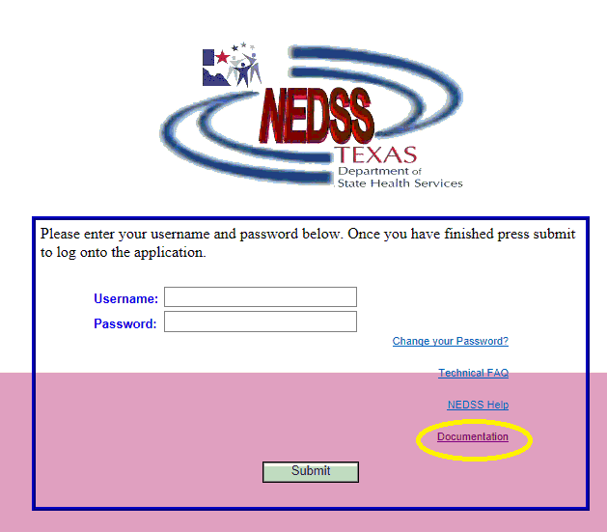
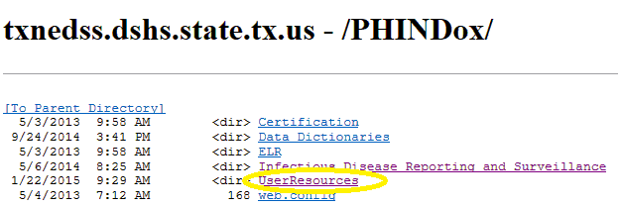

MDROs: Big picture
NBS Investigation + NBS lab report(s)
  As complete as possible, using the…
Data Entry Guide: aka “the DEG”
  Where is it?
Notes:
Overall, a complete report of an MDRO in NBS (aka NEDSS) includes an investigation and at least one lab report. There may be multiple lab reports in certain situations where a patient repeatedly cultures positive for the same MDRO while in the same healthcare facility stay. Having as many of our questions answered as possible is helpful for us to get the right information for possible outbreak investigations, data analysis to reduce MDROs overall in Texas, and on a more immediate scale, to approve the notifications the first time around.
The NBS Data Entry Guide is constantly updated for all of Texas’ reportable conditions, and it is the definitive guide of how to enter investigations and lab reports on NBS, including detailed step-by-step instructions and screenshots of the website itself. The MDRO portion of the DEG will soon be updated to clarify some of the more complex sections, based on the year of feedback from our initial reporting and all of your helpful comments and suggestions. It is worth taking a bit of time to read the MDRO entry portion in its entirety if you are the main MDRO NBS entry/investigator person at your PH department – many of the points of confusion and details we request in our rejection comments will be made much more clearly if you can familiarize yourself with the instructions.
To find the DEG, start on the NBS homepage but do not log in. Go to Documentation at the bottom right corner, leading to a list of folders. Click User Resources, then NBS Data Entry Guide is available in pdf form. Apologies that it is a bit difficult to find.

Slide 28
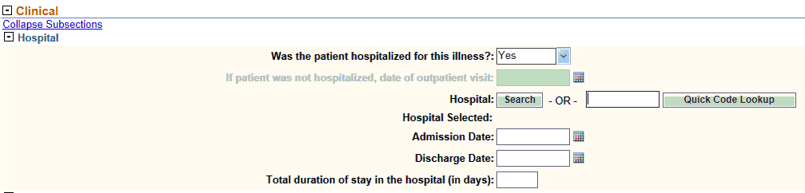
Titles of questions/fields
Was patient hospitalized for this illness?
HCF (healthcare facility) information
Was the patient admitted to a HCF (healthcare facility)?: | No
Was the patient visit due to an outpatient/wound clinic/ER, etc. visit only: | Yes
Outpatient/wound clinic/ER visit date: | 09/14/2015
HCF (healthcare facility): | ABC Hospital ER
Admission Date:
Discharge Date:
Total duration of stay in the hospital (in days):
Updated
Notes:
Within the MDRO Investigation (not the lab report), a few of the questions have stood out as being unclear.
For MDROs, we need to know if the person was admitted to any kind of healthcare facility – this includes long term acute care, nursing homes, acute care hospitals, etc. – during the time that their laboratory specimen was collected. They do not need to be there due to the MDRO;
MDROs do not always cause symptoms or even infection, as a person can be colonized with an organism without being sick from it. The key issue is knowing what healthcare facilities the patient was moving through when they were culture positive for an MDRO, most importantly to implement appropriate control measures and investigate any possible outbreaks. The answer to the question should be “Yes” if they meet the above description, but “No” if they had an outpatient visit to take a laboratory specimen for culture.

Slide 29

Titles of questions/fields
Date of Symptom Onset, Diagnosis Date
Notes:
Diagnosis Date and Date of Symptom Onset are important as they are two of the dates used in NBS data cleanup/analysis procedures to categorize cases by MMWR year.
Diagnosis Date is when the lab reports were finalized, as that is when the case officially meets the epi case criteria by the laboratory definition of MDRO.
Date of Symptom Onset may not be applicable for many MDRO cases; if asymptomatic or not clear from medical record/discussion with IP, leave blank.

Slide 30
MDRO Investigation:
Patient healthcare facility “timeline”
Specimen collection date for the associated lab report should be within this time period (if in a healthcare facility) or on the date of outpatient visit (if outpatient)
Notes:
Where was patient at the time they had a specimen collected for MDRO culture? If in ANY healthcare facility, for any reason – does not have to be MDRO related – answer is Yes. If outpatient, answer is No.
Facility they came from: where did they come from IMMEDIATELY before the admit or outpatient date for the main hospital?
Facility they were discharged to: where did they go to IMMEDIATELY after the discharge or outpatient date for the main hospital?

Slide 31
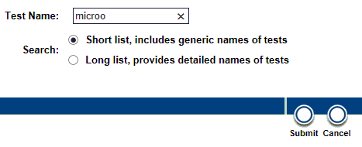

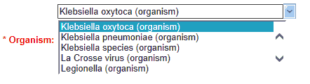
Lab report data entry
Resulted Test
Organism

Slide 32
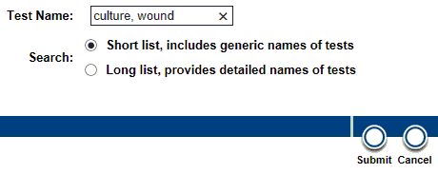
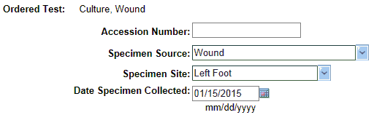
Lab report data entry, continued
Ordered Test (preferred)
Specimen Source (and Site if applicable)
Specimen Collection Date

Slide 33
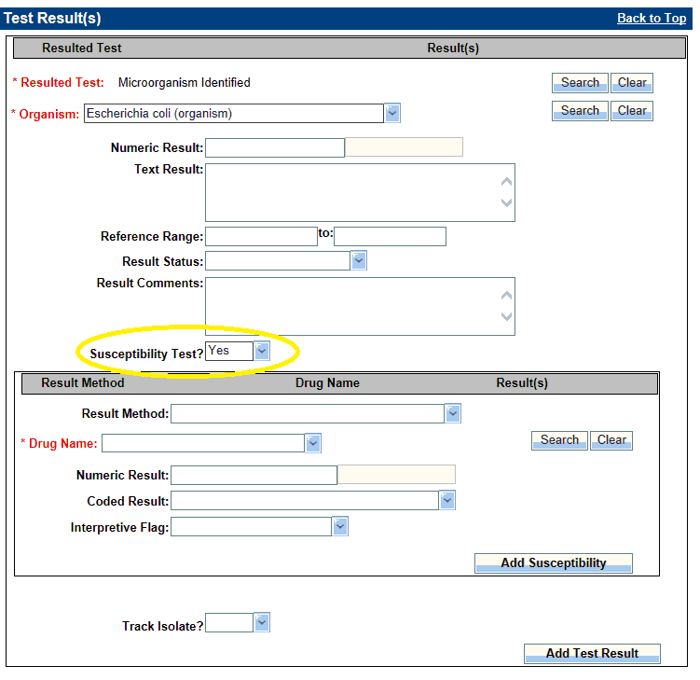
Lab report data entry, continued
Susceptibility Test?
  Yes – box appears
Please enter all susceptibility data, even for antibiotics to which the pathogen was susceptible
  Tracking antibiotic resistance over time

Slide 34
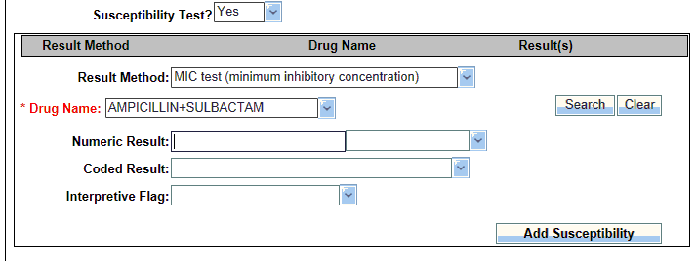
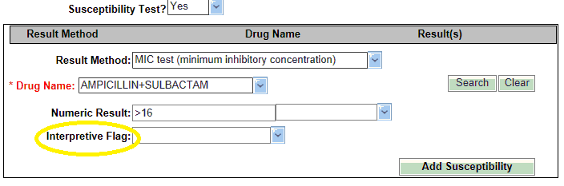
Lab report data entry, continued
Result Method (if available)
Drug Name
→ Ertapenem is now available
Numeric Result
Coded Result
→This box disappears after entering a Numeric Result!
Interpretive Flag
Notes:
Numeric Result: if you enter a numeric result, coded result will disappear
Coded Result
Interpretive Flag: enter susceptibility here

Slide 35
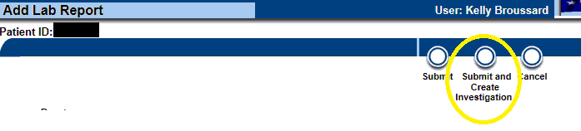
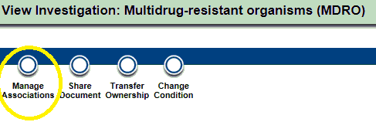
Associating lab reports with investigations
Creating investigation from a lab report does this automatically
If lab report isn’t associated with its investigation, or you need to un-associate unrelated lab reports from an investigation, use Manage Associations button

Slide 36

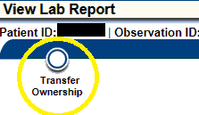
Program Area & Jurisdiction assignment
Program Area:
  Always choose Antibiotic Resistance/MDRO (AR/ MDRO)
  This program area now has statewide view; you can request this from the NEDSS team if you do not already have it.
Jurisdiction: investigation should be done by the jurisdiction where the patient was culture positive.
In the investigation:
Need to change these in the lab report?
In the lab report:
Notes:
Remind them, again, to make the Lab Report entry first so that it’s easier to associate the case

Slide 37
Ebola Readiness Assessments
Using the CDC Assessment Tool
Bobbiejean Garcia, MPH, CIC

Slide 38
Center for Disease Control (CDC) – ELC Grant
Funded states to provide assistance with application of CDC Assessment Tool
Requires revision of the Texas Health Care-associated Infection Prevention Plan
Texas Application: Regional HAI Epidemiologists and contracted infection control support
Notes:
The consultants are being allocated to regional offices to serve as the state infection prevention resource for healthcare facilities and are titled HAI Epidemiologist. There are currently three regions with this resource and expansion into other areas of the State have been requested. Regions awaiting the regional HAI Epidemiologist resource are supported from DSHS Central office in Austin.
As the positions are filled, the HAI Epidemiologist will contact facility infection preventionists to provide contact information. This role will lead the technical assistance team for application of the CDC Assessment Tool and will consult on other infection prevention challenges at any healthcare facility within the region.

Slide 39
Texas HAI Plan
Additions to plan
  Establish working relationship with hospital preparedness partners
  Enhance infection control assessment and response
  Enhance outbreak reporting and response
  Targeted healthcare infection prevention programs
  http://www.cdc.gov/HAI/pdfs/stateplans/tx.pdf
Notes:
As noted on this slide, these are the highlighted additions to our State plan. The current plan can be accessed at the web address listed and the revised plan should be available in early 2016.

Slide 40
Goal of the Hospital Visit
To provide technical assistance to facilities to apply the standards of the CDC assessment tool
Enhance understanding of facility readiness activities and approaches to gap mitigation
Develop repository of knowledge related to high consequence infectious diseases

Slide 41

Team Members
Facility team
  Corporation and C-suite
  Facility Management
  Quality/Safety officer
  Facility Infection Preventionist
DSHS team
  HAI Epidemiologist (Team Lead)
  Second Infection Preventionist
  Laboratory Biosafety Officer
  Hospital Preparedness

Slide 42
Other Common Attendees During the Visits
At the discretion of the facility
  Hospital Preparedness Contractors
  Regional Health Department
  Local Health Department
  Laboratory Response Network Representative

Slide 43
Assessing Texas Hospitals Readiness
Approximately 14 facilities
  Identified to public health for the purpose of patient evaluation and care
  4 of 12 assessments preformed as of Feb 24, 2016
Purpose of designation
  Effective referral process of potentially infected persons for plan of care evaluation
Notes:
75 facilities to 12, 2 treatment centers that can be seen as assessment facilities as well.
These facilities have expressed interest in assistance with application of the CDC Assessment. Once completed, the HAI Epidemiologist will continue to support gap mitigation activities and contribute to the state understanding of readiness for this specific high consequence disease.
Through this partnership, the goal is to develop a network of facilities that are confident in receiving a patient for evaluation of HCID such as Ebola.

Slide 44
CDC Ebola Readiness Assessment Tool
12 Domains of Preparedness
  Emergency Medical Services and Emergency Department Preparedness
  Staffing of Patient Care Team
  Patient Transport within the Facility
  Patient Placement
  PPE with Donning and Doffing Procedures
  Healthcare Personnel Monitoring and Managing Exposures
  Laboratory Safety
  Environmental Infection Control and Equipment Reprocessing
  Management of Waste
  Communications
  Management of the Deceased
  Special Populations
Notes:
Online version of the tool sent to facilities for self-survey prior to the site visit

Slide 45
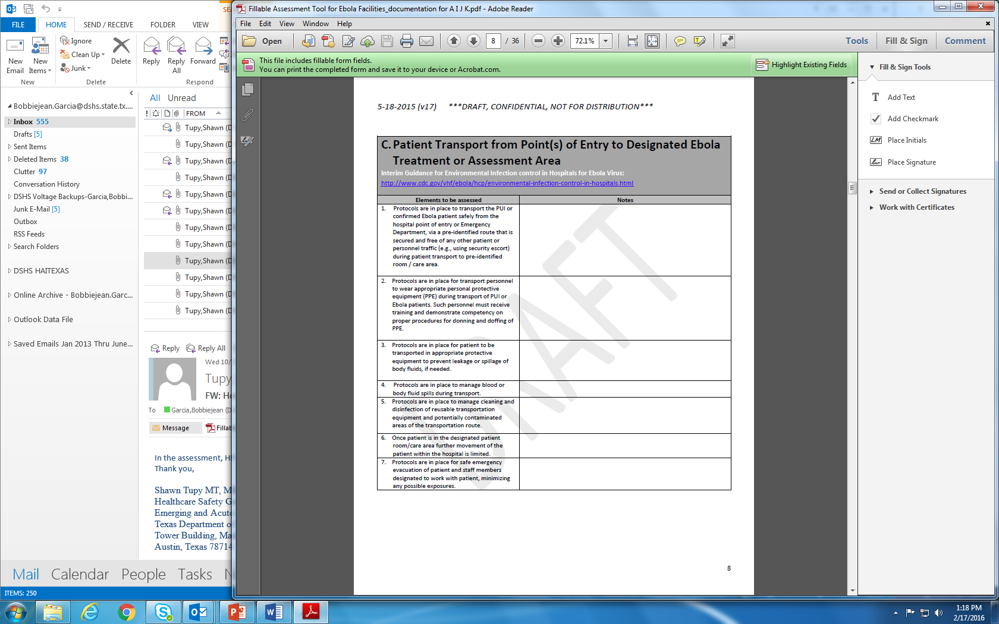
Snippet of Tool
Notes:
111 questions
See draft date at top
Hospitals give pre-assessment on EPI-INFO and team can review prior to visit.

Slide 46
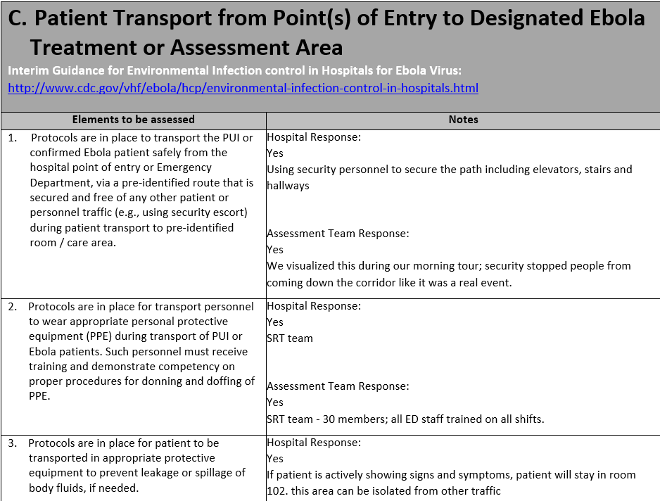
Example of completed Assessment
Notes:
3-6 months later check in and get update on assessment/mitigation

Slide 47
CDC Tool Limitations
Does not assess readiness for all high consequence infectious diseases
  Respiratory
Is not designed for individual patient assessment
Notes:
Is there a common screening form?
Universal screening tool is not feasible and that taking a good patient history is key.
Create a strong relationship with their local health departments.
The LHD (or regional or IDCU back-up) can provide assistance in the following ways:
Answer questions about travel or other risk factors.
Determine if a condition is of public health concern and what actions should be taken.
Advise and assist on prophylaxis, contact tracing and other risk reduction measures in the hospital and in the community.
What type of PPE for what disease?
Resources currently exist that specify what type of PPE is required for various diseases. The CDC has a reference that lists the different types of isolation (standard, contact, airborne, droplet) and the conditions under which they should be implemented by condition: http://www.cdc.gov/hicpac/2007IP/2007ip_appendA.html, as well as transmission-based guidelines like these: http://www.cdc.gov/HAI/settings/outpatient/basic-infection-control-prevention-plan-2011/transmission-based-precautions.html.

Slide 48
DSHS & DADS
Collaborating with the Quality Monitoring Program (QMP)
Bobbiejean Garcia, MPH, CIC

Slide 49
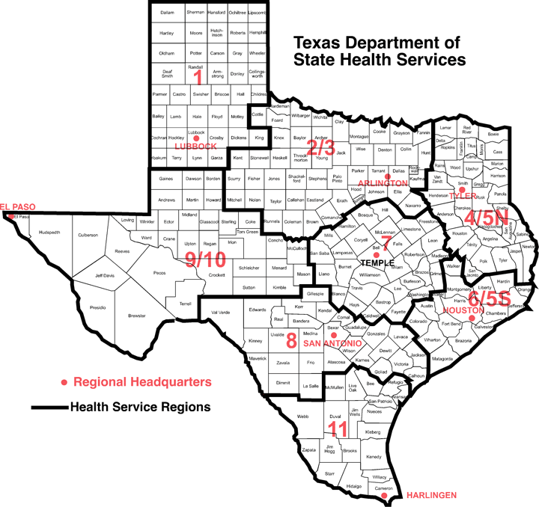
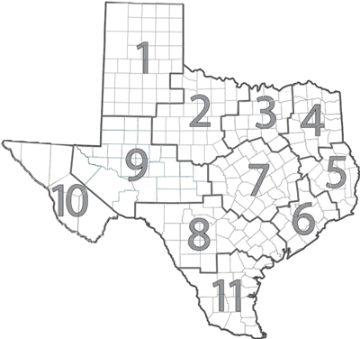
DSHS Regional Map
DADs Regional Map

Slide 50
Infection Prevention Resources
Consultation
  phone, in-person
Education resources
  seminars and printed materials
Working with LHD on clusters/outbreaks and QMP

Slide 51

Video

Slide 52

Overview of Outbreak Settings and Investigations
Jessica Ross, CIC

Slide 53
Why investigate
Investigation of HA outbreaks helps identify preventable causes of infection and unsafe products and practices
  Prevent additional cases
  Improve detections and reporting of outbreaks, clusters or unusual cases
  Establish investigation protocols and train HD staff
  Identify “unusual” practices
  Improve or establish new standards of intervention or control measures
  Assist in communication between state and local partners (e.g., State Survey Agencies, LHDs, licensing boards)
Notes:
Because it is a core public health function to prevent the spread of communicable disease!

Slide 54
Types of Settings that could be Investigated
Hospitals
Long Term Care Facilities (LTCF)
Group homes/assisted living centers
Physician offices
Outpatient treatment centers
Dialysis Centers (ESRD)
State schools
Military bases
Prisons/Jails
Law enforcement training center
Tattoo studios
Nail salons
Tanning studio
ASC

Slide 55
Hospital Investigations
MRSA (several)
Group A strep (GAS or S. pyogenes wound infections)
Burkholderia cepacia
Pseudomonas aeruginosa
Acinetobacter baumannii
Mycobacterium mucogenicum (CLABSI)
Sphingomonas
Ralstonia pickettii
NEC, Legionellosis
Device and product –associated
Transplant and tissue associated
Surgical Site Infections (SSI) MDROs etc.

Slide 56
Product/Device-associated Investigations
Whirlpool
Autoclave
Contaminated dressings (Hydrogel)
Mouthwash (several)
Contact Lens solution (several)
Oxygen Probes
IV flushes (several)
Tanning beds
Arthroscopic shavers
ECMO

Slide 57
Physician Practice
Dermatology practice- (autoclave failure)
Allergy practice (injection safety)
Wound care practice (MDRO)
Wound Care Clinic (pseudomonas)
* Citations, references, and credits – Myriad Pro, 11pt

Slide 58
Report of Unsafe Injection Practices at a Healthcare Facility
And how that relates to public health
Sandi Henley, RN, CIC

Slide 59
The call
From one of your facilities:
  HIV positive nurse found to have been diverting drugs for a six month period in the intensive care and surgical units of a hospitals in your county.
    Nurse admitted to taking drugs (Demerol) and refilled vials with saline using the same needle that she had used to inject herself.
    200 patients admitted in the these units during this time frame.
    However over 1,000 patient received the drug Demerol during this time frame.

Slide 60
Is this a problem for the health department to investigate?

Slide 61
The Call
An infection Preventionist at one of your facilities calls about a cluster of HCV patients.
  She noted that she had to report four patients with HCV during the last 3 months
  All of these patients had surgery at a local outpatient surgery center.
  There are no other commonalities among these patients

Slide 62
Is this a problem for the health department to investigate?

Slide 63
The call
Monday morning you receive a call from one of your hospitals’ Infection Preventionist. The following is a summary of the information provided:
Saturday nurse was identified reusing saline flush prefilled luer lock (no needle) syringes on multiple patients
There is no evidence to support injecting drug use or drug diversion by the nurse
The nurse reports reusing partial syringes on multiple patients for at least 6 months Hired 19 months prior.
Nurse is negative for HCV, HBV and HIV
A saline flush is the method of clearing out intravenous lines (IVs), Central Lines or Arterial Lines of any medicine or other perishable liquids so that they can keep the area of entering clean and sterile. Usually in flushing an intravenous cannula, a 5ml syringe of saline is emptied into the medication port of the cannula's connecting hub after insertion.

Slide 64
Is this a problem for the health department to investigate?

Slide 65
Summary of the problem
44 outbreaks (two or more cases) of viral hepatitis related to healthcare reported to CDC during 2008-2014; of these, 42 (95%) occurred in non-hospital settings.
Hepatitis B (total 23 outbreaks, 175 outbreak-associated cases, >10,700 persons notified for screening):
17 outbreaks occurred in long-term care facilities, with at least 129 outbreak-associated cases of HBV and approximately 1,600 at- risk persons notified for screening
  82% (14/17) of the outbreaks were associated with infection control breaks during assisted monitoring of blood glucose (AMBG)
5 outbreaks occurred in other settings, one each at: a free dental clinic in school gymnasium, an outpatient oncology clinic, a hospital surgery service, and two at pain remediation clinics (one outbreak of HBV and one with both HBV and HCV), with 46 outbreak-associated cases of HBV and > 8,500 persons at-risk persons notified for screening
Hepatitis C (total 22 outbreaks, 239 outbreak-associated cases, >90,400 at-risk persons notified for screening):
9 outbreaks occurred in outpatient facilities (including the above mentioned outbreak of both HBV and HCV), with 87 outbreak-associated cases of HCV and >91,100 persons notified for screening
11 outbreaks occurred in hemodialysis settings, with 79 outbreak-associated cases of HCV and 1,833 persons notified for screening
Two outbreaks occurred because of drug diversion by HCV-infected health care providers, with at least 71 outbreak-associated cases of HCV and >19,000 persons notified for screening

Slide 66
What’s the impact?
Unsafe injection practices and other lapses in basic infection control put patients at risk of infection.
These incidents have occurred in a wide variety of healthcare settings (e.g., hospitals, outpatient clinics, assisted living facilities). Most typically (95%) are in outpatient centers.
When these practices or the resulting infections are discovered, a patient notification process typically ensues.
There has been a steady increase in the number of requests to CDC from state health departments and healthcare facilities for assistance in investigating infections and outbreaks potentially stemming from unsafe injection practices or related breakdowns in safe care.
http://www.cdc.gov/injectionsafety/pntoolkit/index.html

Slide 67
What are some Unsafe Injection Practices?
that have led to patient harm. . . .
Use of a single syringe, with or without the same needle, to administer medication to multiple patients
Reinsertion of a used syringe, with or without the same needle, into a medication vial or solution container (e.g., saline bag) to obtain additional medication for single patient and then using that vial or solution container for subsequent patients
Preparation of medications in close proximity to contaminated supplies or equipment

Slide 68
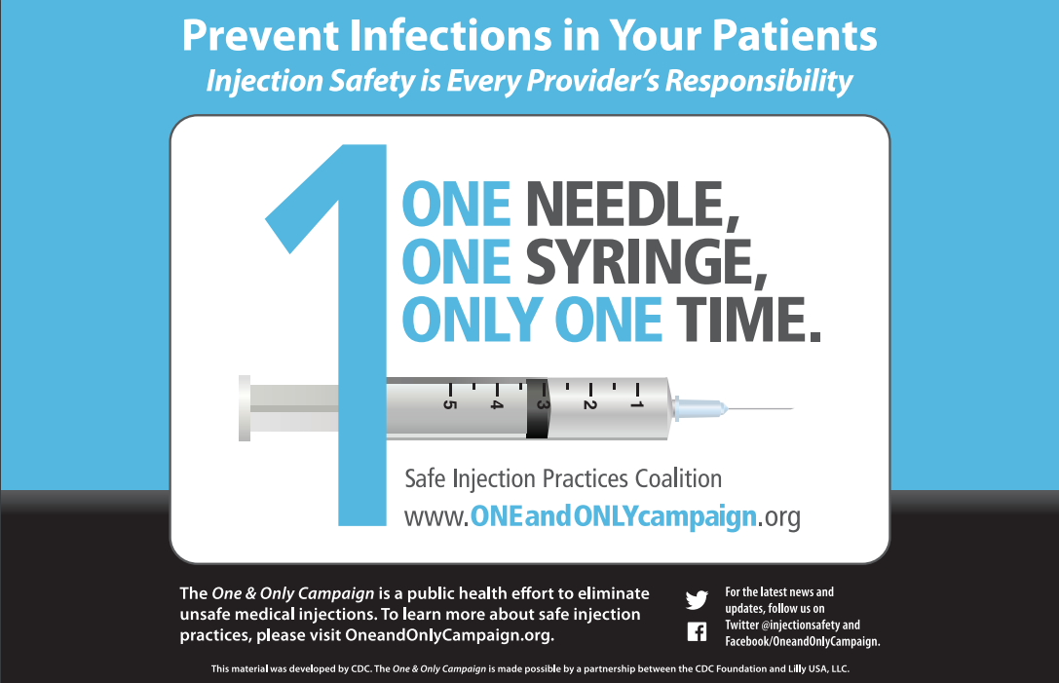

Slide 69
This can be really big!
NEVADA: A 2008 outbreak of hepatitis C at an endoscopy clinic in Nevada occurred because syringes used to access medication vials were reused for multiple patients. The resulting public health notification of approximately 50,000 people was the largest of its kind in United States healthcare. The Southern Nevada Health District estimated total public health costs including investigation, testing, and medical counseling at $16-$21 million. The doctor and two nurses involved in the outbreak face a loss of livelihood and reputation, as well as criminal charges that their malpractice insurance does not cover

Slide 70
The call
Monday morning you receive a call from one of your hospitals’ Infection Preventionist. The following is a summary of the information provided:
Saturday nurse was identified reusing saline flush prefilled luer lock (no needle) syringes on multiple patients
There is no evidence to support injecting drug use or drug diversion by the nurse
The nurse reports reusing partial syringes on multiple patients for at least 6 months Hired 19 months prior.
Nurse is negative for HCV, HBV and HIV
A saline flush is the method of clearing out intravenous lines (IVs), Central Lines or Arterial Lines of any medicine or other perishable liquids so that they can keep the area of entering clean and sterile. Usually in flushing an intravenous cannula, a 5ml syringe of saline is emptied into the medication port of the cannula's connecting hub after insertion.

Slide 71

What questions would you have?

Slide 72
What questions would you have?
How long has she/he engaged in this sort of practice?
Are other engaged in the same or similar practices?
What is the patient population that is impacted?
Can you track which patients she cared for?

Slide 73
What questions would you have?
Do we have to follow-up on ALL of the healthcare encounters?
Do we need to visit the healthcare facility?
At what point can we stop?
Can’t we just wait for the molecular testing?

Slide 74
Initial Activities
The facility is being very proactive pursuing this low risk exposure to the time of hire of the nurse in February 2014 through August 10, 2015
The facility is determining the number of patients who may have had IV exposure the current estimate is approximately 500 adult patients
The facility will determine the addresses of patient exposures and PH will determine jurisdiction
The facility will work with PH on the language used in the patient notification
DSHS recommended letters be sent certified or registered mail
PH is working with The facility on the best process to test the patients
The facility will likely establish a 24/7 call center
Media notification is to be determined

Slide 75
Other information to request
Copy of the policy for flushing a patient’s IV.
Provide information on orientation. Did it include specifics on IV flush policy?
Does the orientation include preceptorship? If so, please interview this person for details on what training was provided related to IV care and flush policy.
Did the nurse float to other units?
Did she worked at other healthcare facilities?

Slide 76
Activities
HD Cross referenced patient list against any known positive (HCV, HBV and HIV)
Assist with providing alternate contact information for patient non-responsive (Accurint)
On going conference calls to determine status and further needs
CDC included on call to provide further guidance and molecular testing of those that were identified as possible new positives

Slide 77

Break
15 minutes
Be back promptly

Slide 78
Surgical Site Infections at a Plastic Surgery Center
Thi Dang, MPH, CIC

Slide 79
Notifiable Surgical Site Infections (SSIs)
There are not any procedures normally performed at Plastic Surgery Centers that are currently reportable to the Health Department in the State of Texas.
Anything reported would fall under the clause “any outbreaks, exotic diseases, and unusual group expressions of disease must be reported”.

Slide 80
Report
The Medical Director for ABC Plastic Surgery Center contacted the health department epidemiologist regarding his concern over an increase in Mycobacterium abscessus infections among patients who had undergone blepharoplasty, abdominoplasty, and/or liposuction.

Slide 81
What information would you want to know?

Slide 82
What information would you want to know?
How many patients were affected?
What is blepharoplasty? What is abdominoplasty?
What were the dates of their procedures?
Were they performed in the same OR?
Who were the surgeons?
What was the succession of the procedures in the OR for each patient?

Slide 83
What information would you want to know?
What is the pre-surgery process? (CHG baths, skin prep, antibiotics)
What skin prep agent was used? Are manufacturer protocols followed?

Slide 84
What information would you want to know?
Has the IP done an observation of the procedure?
Is there adherence to surgical attire? (scrubs, masks, caps/hoods, shoe covers, sterile gloves, gowns, drapes)
Appropriate hand and arm hygiene
Asepsis adherence—sterile field
How is the ventilation, temperature, humidity, and environmental cleanliness of the room?

Slide 85
What information would you want to know?
What are the post-op processes? (i.e., antibiotics, what is used on the patient’s surgical site post op?)
How are the instruments processed?

Slide 86

MDR-A outbreak
Case Study
Jessica Ross, CIC

Slide 87
Background
Residents were associated with an outbreak of MDR-A at a Long term acute care (LTAC) facility in Texas from around late July 2014 through early April 2015.
This facility has an average daily census of 60-65 patients
They are licensed for 72 beds and the facility employs around 256 staff.

Slide 88
MDR-A Outbreak
Notification received from DSHS lab that MDR-A isolates had been sent for PFGE testing.
HAI Epi was not aware of any isolates being sent, further follow up was needed.
Call to the lab who submitted the isolates, noting that the facility where the isolates were cultured was possibly having an outbreak.
Contact was made to the IP at the LTAC with the possible cases and it was noted that they had four cases at that time all from a different patient body source and they were potentially due to a case back in May that was transferred to their facility from a another hospital in another county.
Notes:
At this time in the investigation only 2 isolates were sent for PFGR, they were the same pattern but not enough information to go on at that time

Slide 89
MDR-A Outbreak
Additional isolates starting being submitted for PFGE, all with the same pattern
What would be next steps?
Notes:
Next steps taken:
Conference call with all involved
Site visit by HAI Epi and PH

Slide 90
MDR-A Outbreak
Site visit #1 was conducted with HAI Epi and PH
Infection Control violations were found but nothing of major concern
What would be next steps?

Slide 91
Site visit #1 findings/ recommendations
Monitor and perform quality assurance (QA) rounds for all patients on isolation precautions to ensure staff are donning and doffing personal protective equipment (PPE) appropriately, as breaches were observed during rounding in the intensive care unit (ICU).
If possible cohort MDR-A positive patients if private rooms are not available.
Educate staff on the significance of MDROs and the actions to take when a positive lab is resulted.
Educate patients and their families on the significance of MDRO’s in English and/ or Spanish and the importance of infection prevention measures.
Emphasize the importance of including MDRO status when transferring patients within facility and also if transferring outside facility.
Utilize the CDC Interfacility Transfer Form for interfacility transfers.
Educate environmental services on the importance of routine and terminal cleaning activities for MDRO’s.
Ensure education is also completed for other staff that clean and disinfect equipment, specifically the therapy department.
Consider increasing environmental cleaning activities for patients in MDRO precautions.
Perform QA on environmental service staff after routine and terminal cleaning is completed.
Consider reducing the amount of different disinfectant wipes used in the facility to ensure correct usage among staff, as multiple disinfectant wipes were seen throughout the facility.
Monitor and perform QA rounds on hand hygiene for all units and staff, as breaches were observed during rounding in the ICU.
Review policies on eating and drinking in patient care areas, as drinks were seen in the ICU.
Notes:
Letter sent to facility with recommendations

Slide 92
MDR-A Outbreak
Additional reports and isolates coming in and most all are the same PFGE pattern
LHD becoming overwhelmed with investigations
What would be next steps?
Notes:
Amarillo PH requested assistance from central office HAI Epi.
Possible another site visit
Conference calls

Slide 93
MDR-A Outbreak
LHD requested assistant from DSHS
Site visit # 2 conducted
On going monitoring
What would be next steps?
Notes:
Did other site visits to surrounding facilities that some of the patients went to
More in depth visit to main facility
Facility noted to have made some changes after 1st visit

Slide 94
Site Visit #2 findings/ recommendations
Still seeing PPE issues
EVS department more involved and now cleaning all isolation rooms with bleach x3 days
Look at wound care team more closely
Hand hygiene issues
Environmental cleaning issues noted in ICU

Slide 95
MDR-A Outbreak
Cases starting to taper off since site visit #2
  Continue to monitor cases and events
New information received from LHD and more isolates received for PFGE
  Isolates identified as outbreak stain again
Decided another on site visit was needed and mandatory in-services for hospital staff
What would be next steps?

Slide 96
Site Visit #3 findings/ recommendations
    16 mandatory mini trainings given to staff by DSHS
    Wound VAC’s used at hospital are also used throughout the city and other counties.
    Staff eating/ drinking in patient care areas
    Environmental cleaning issues
    Hand hygiene issues
    PPE issues

Slide 97
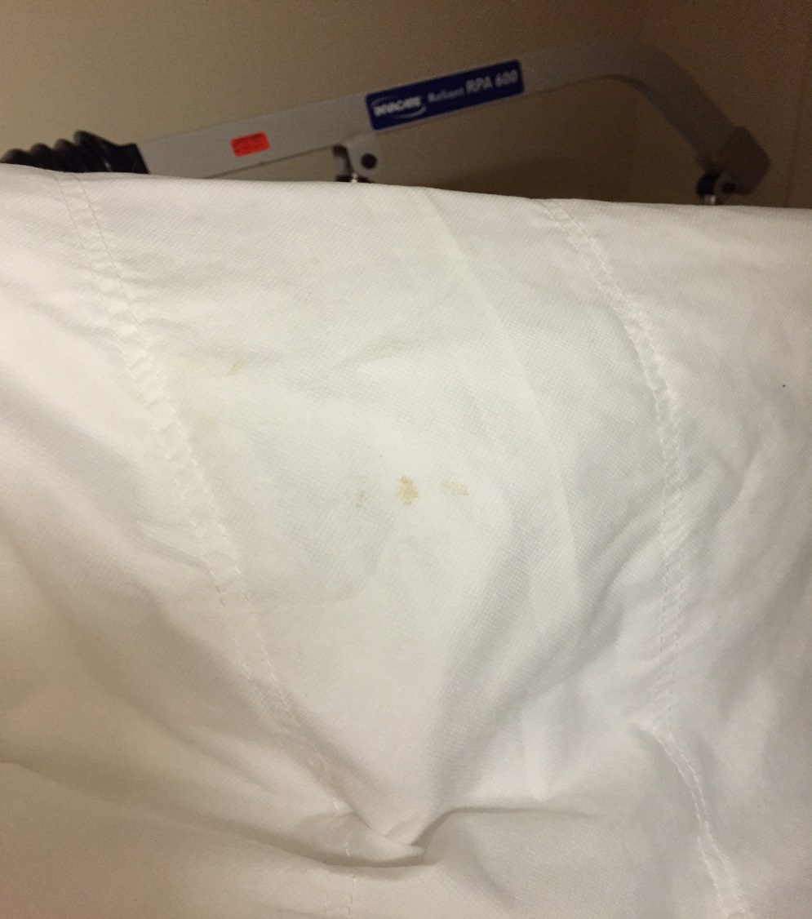
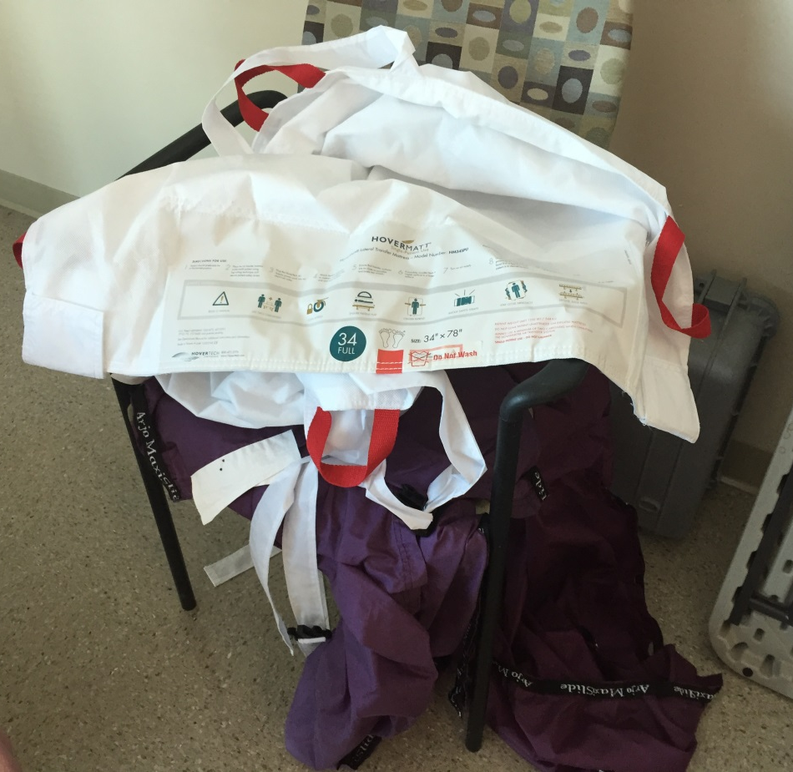
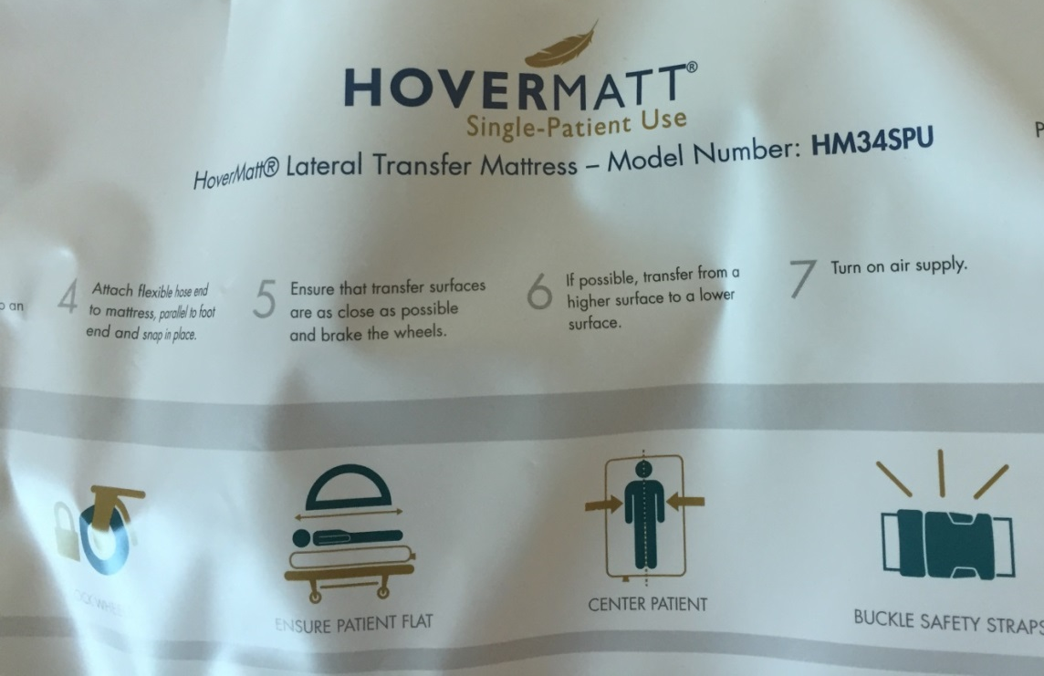
Figure 1
Figure 2
Figure 3
Notes:
F1: Single use disposable sling with fecal matter
F2: showing disposable sling possibly being reused; reusable slings touching the ground and not store appropriately
F3: showing the white slings are single patient use

Slide 98
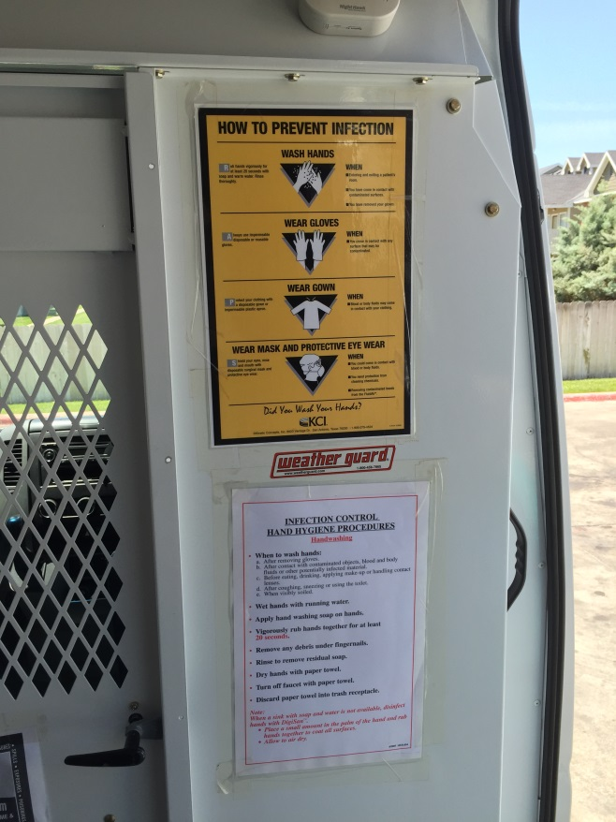
Figure 2
Notes:
F2: PPE signage and hand hygiene signage. Concern about the employee if he/ she is contaminated as the signage states they must wash their hands with soap and water, which is not available in the van, they would have to go inside the building to find this. Also if there is a chemical exposure to the eyes what do they do?

Slide 99
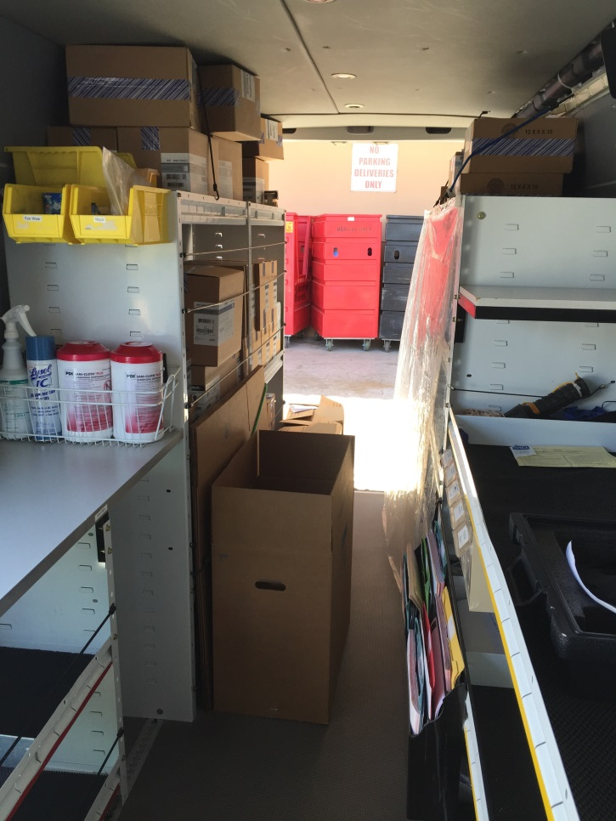
Figure 3
Notes:
F3: inside of van; left front side of the picture is the dirty side; the left back half is new equipment; the right front side is the clean side; then the right back half is disinfected equipment covered and ready to be transferred to the next facility.
This is very close quarters and lots of possibility for cross contamination. Also the ventilation is poor and poses a risk to the employee. Employee stated that all doors are closed to the van when disinfecting equipment. Would recommend not using an aerosolized product in the van.

Slide 100
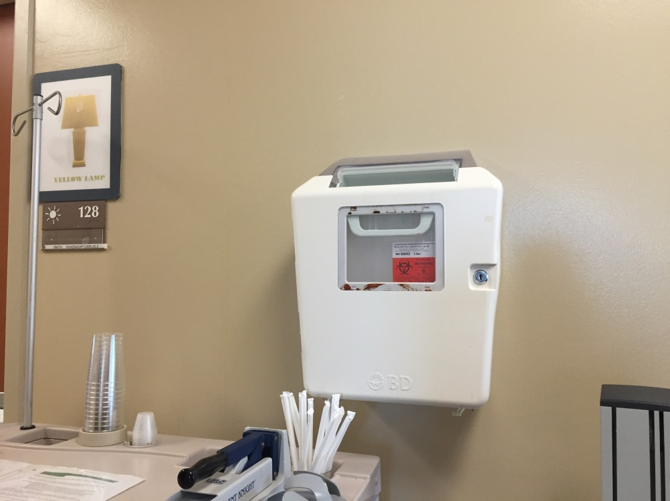
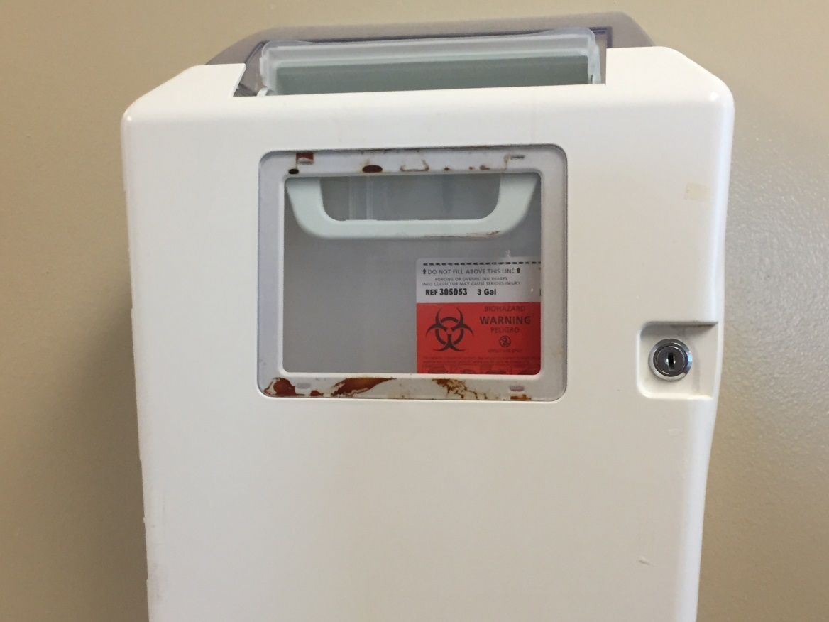
Figure 4
Notes:
F4: bloody sharps container in hallway by room 128, needs to be replaced

Slide 101
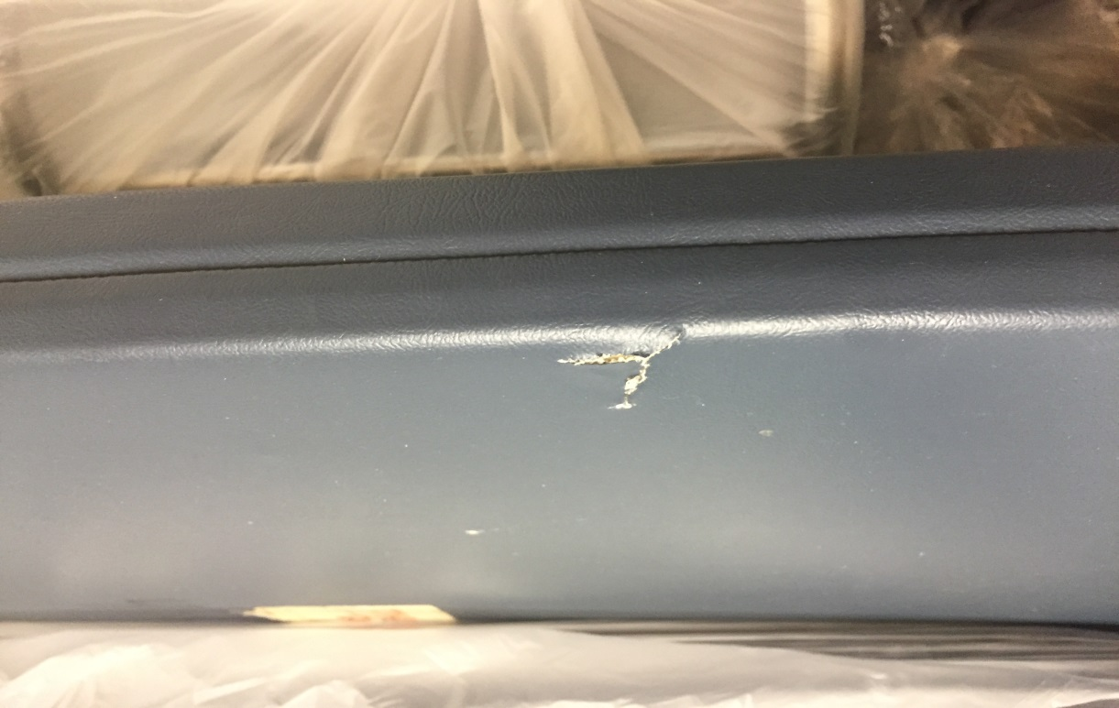
Figure 5
Notes:
Clean Utility Storage Room:
F5: torn mat, stored to be used; any torn or compromised mats should be removed for patient care use and replaced

Slide 102
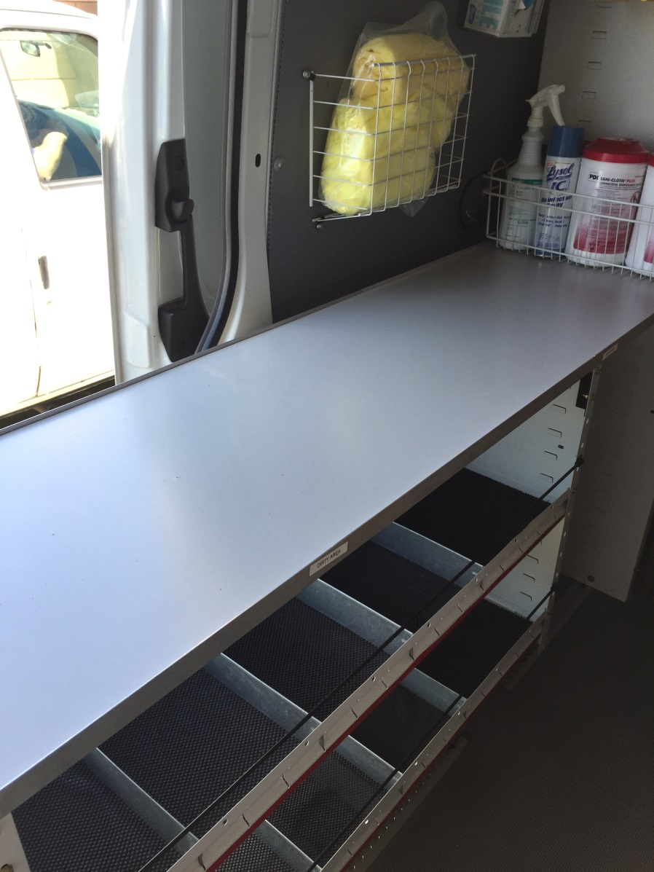
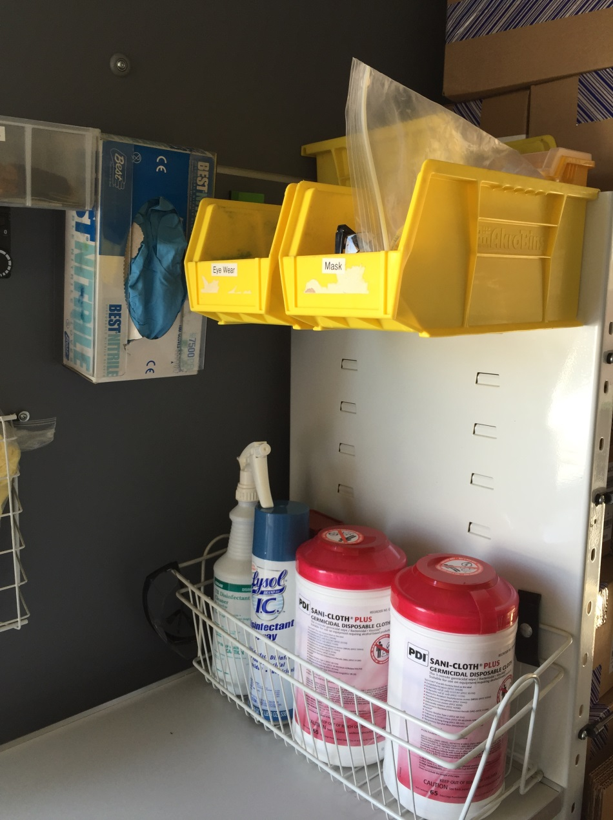
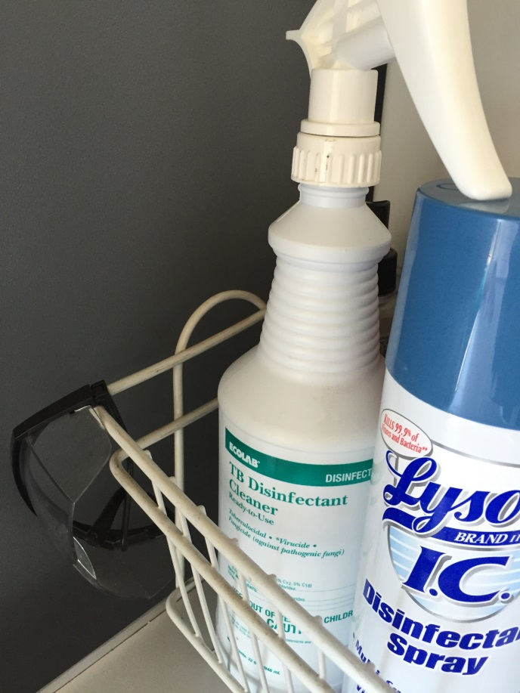
Figure 7
Figure 6
Figure 8
Notes:
F6: the dirty side of the van; noted PPE: yellow gowns, gloves, eye goggles
F7: cleaning products; note the PDI red top wipes state a minimum of 3 minute contact time but the KCI procedure book stated a minimum of 1 minute contact time; they also have Ecolab TB disinfectant and Lysol but it is not clear when the employee’s are to use what product.
F8: note the goggles next to the disinfectant

Slide 103
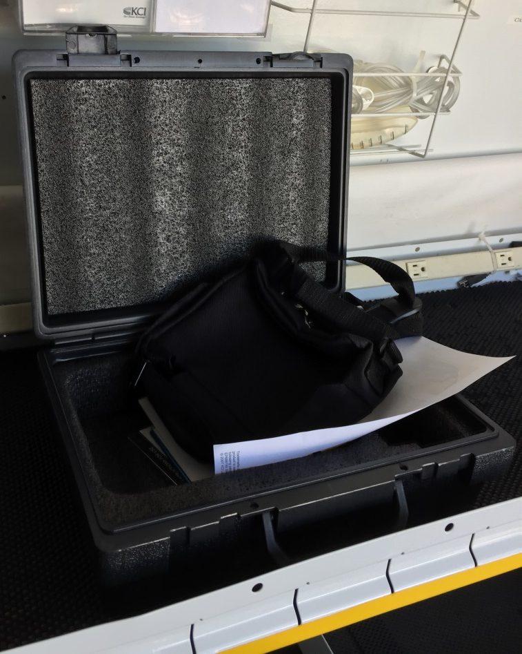
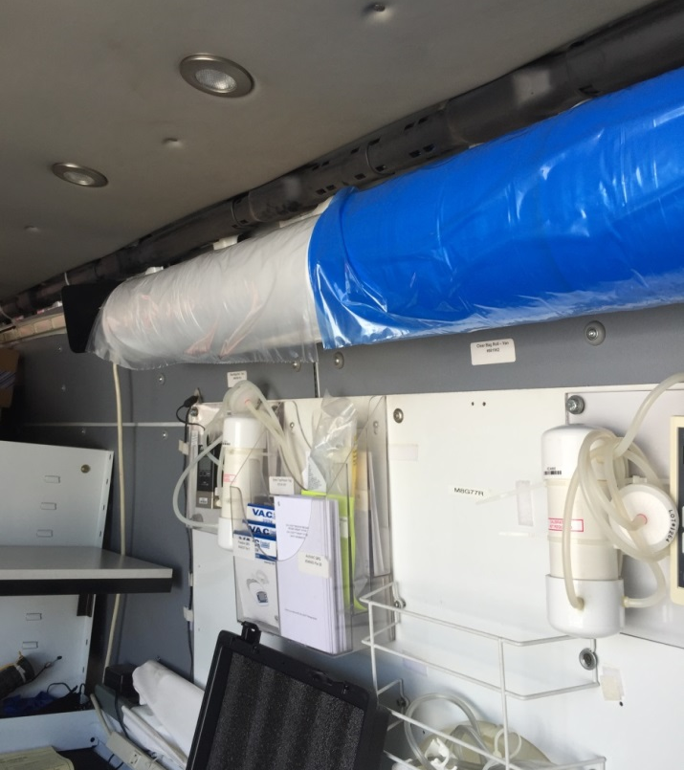
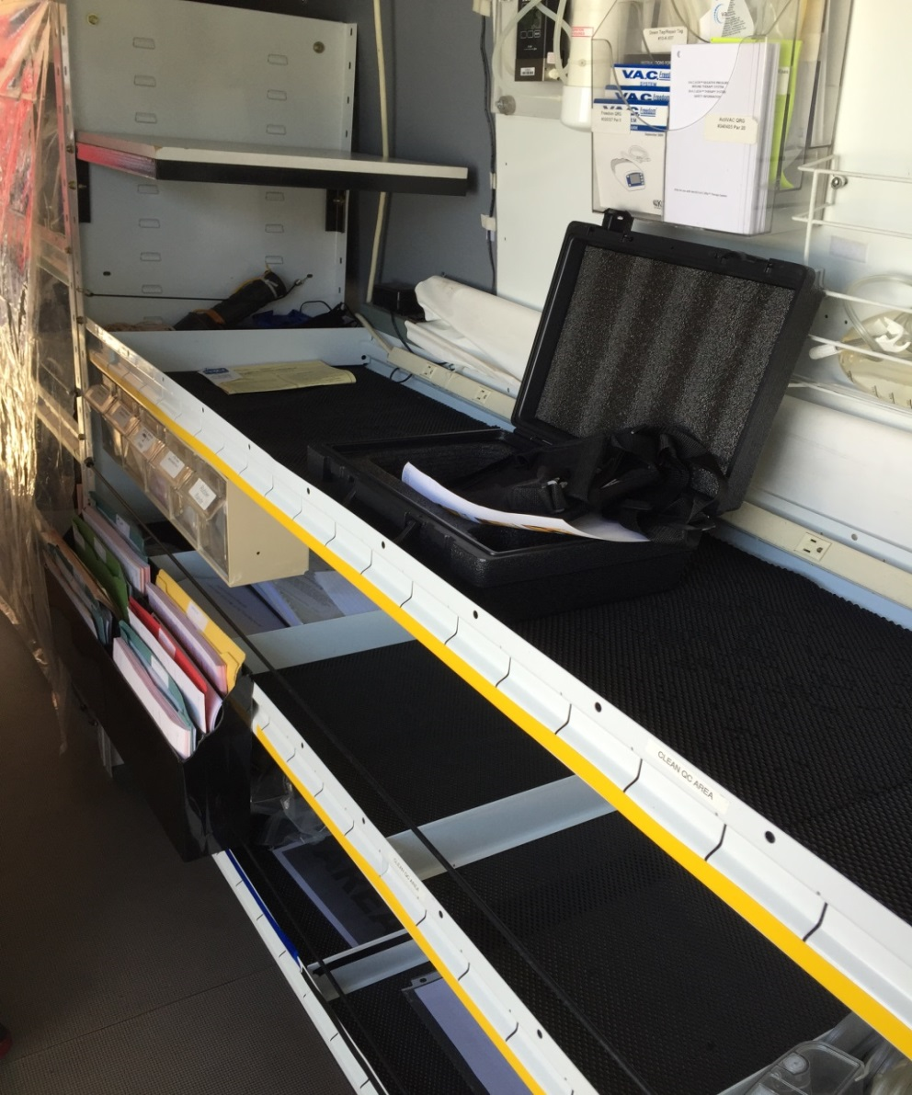
Figure 10
Figure 11
Figure 9
Notes:
F9: new cases that KCI is now delivering the some of the VACs in; note the inside of the case has foam inserts; it was noted that these are just sprayed down with Lysol.
F10: the clean side of the van; where electrical testing is done on the VACs after they are disinfected from the dirty side.
F11: rolls of plastic; clear/ white plastic is used to put the finished VACs inside; the blue plastic is used if a VAC or piece of equipment needs to go back to the warehouse for further testing or needs to be disinfected better.

Slide 104
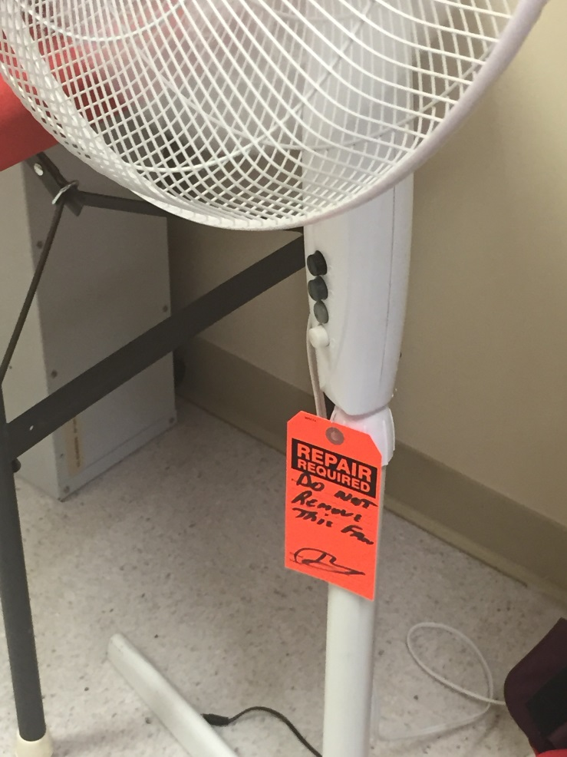
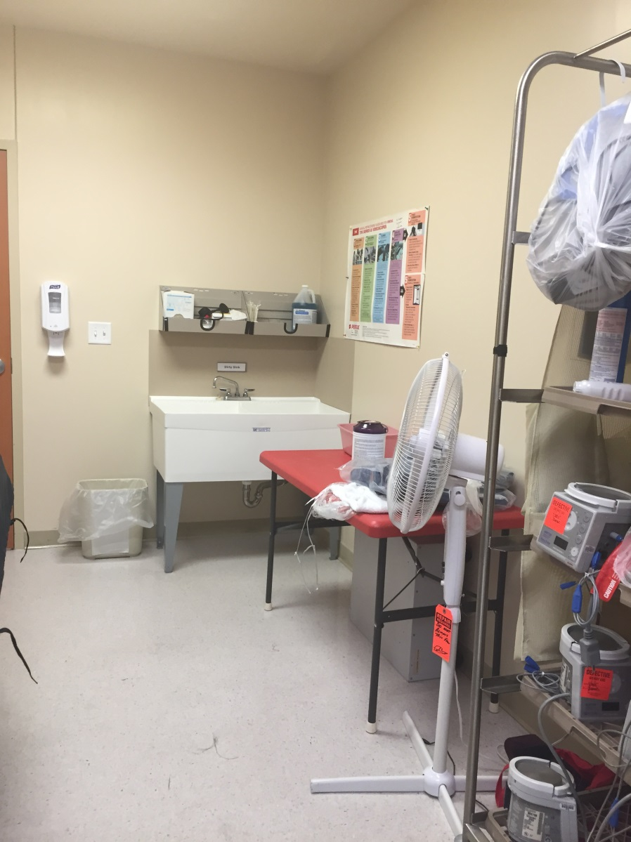
Figure 12
Notes:
Clean/ Soiled Utility Rooms; Soiled side:
F12: soiled utility room where decontamination of equipment is done, including spraying of chemicals; note the fan that is on in the room

Slide 105
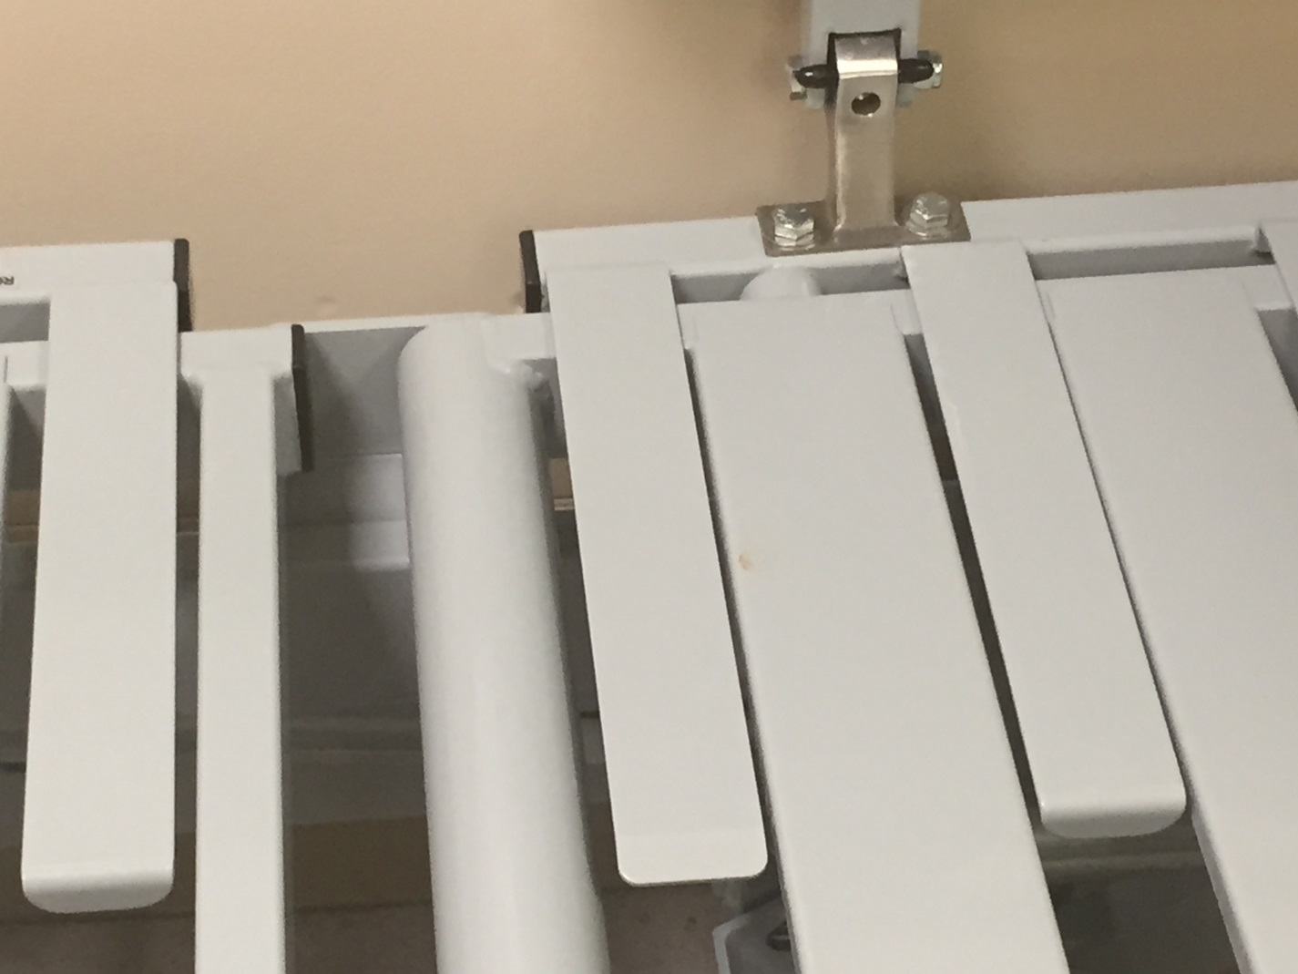
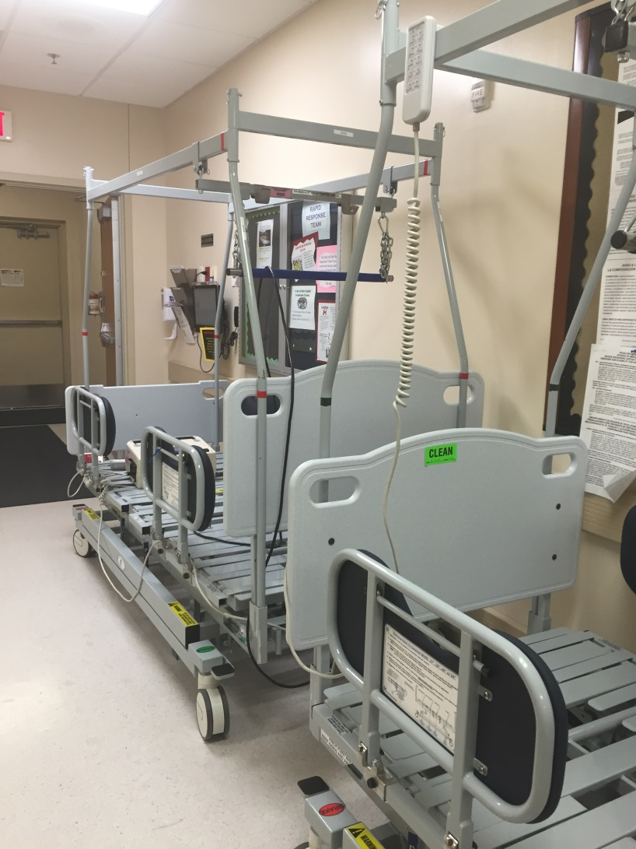
Figure 13
Figure 14
Notes:
F13 & F14: clean and dirty bed in hallway by loading dock
F13: dirty bed, noting blood or fecal matter on bed in hallway
F14: clean bed, as noted by the green sticker stating “clean” and the date

Slide 106
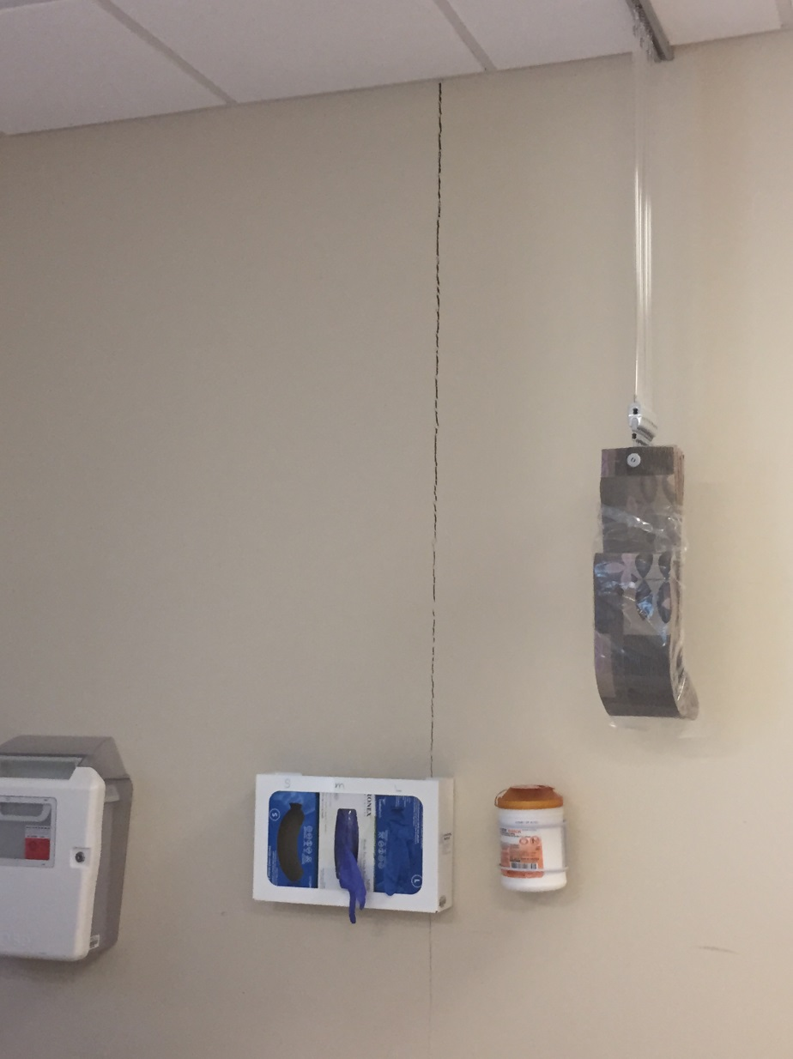
Figure 15
Notes:
Dialysis Unit:
F10: large, deep structural crack in the wall next to a patient treatment bed in the dialysis unit

Slide 107
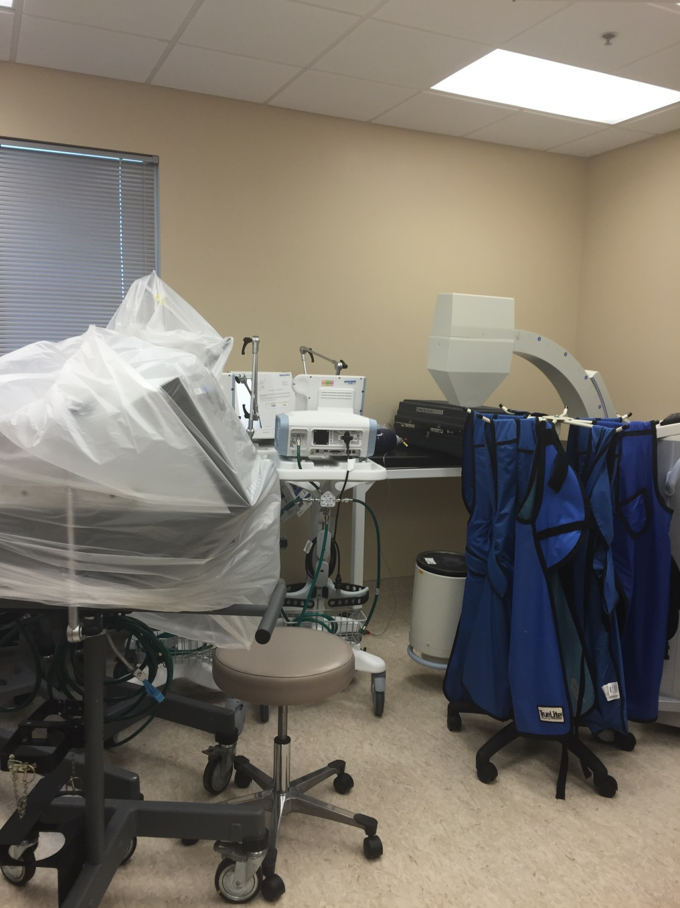
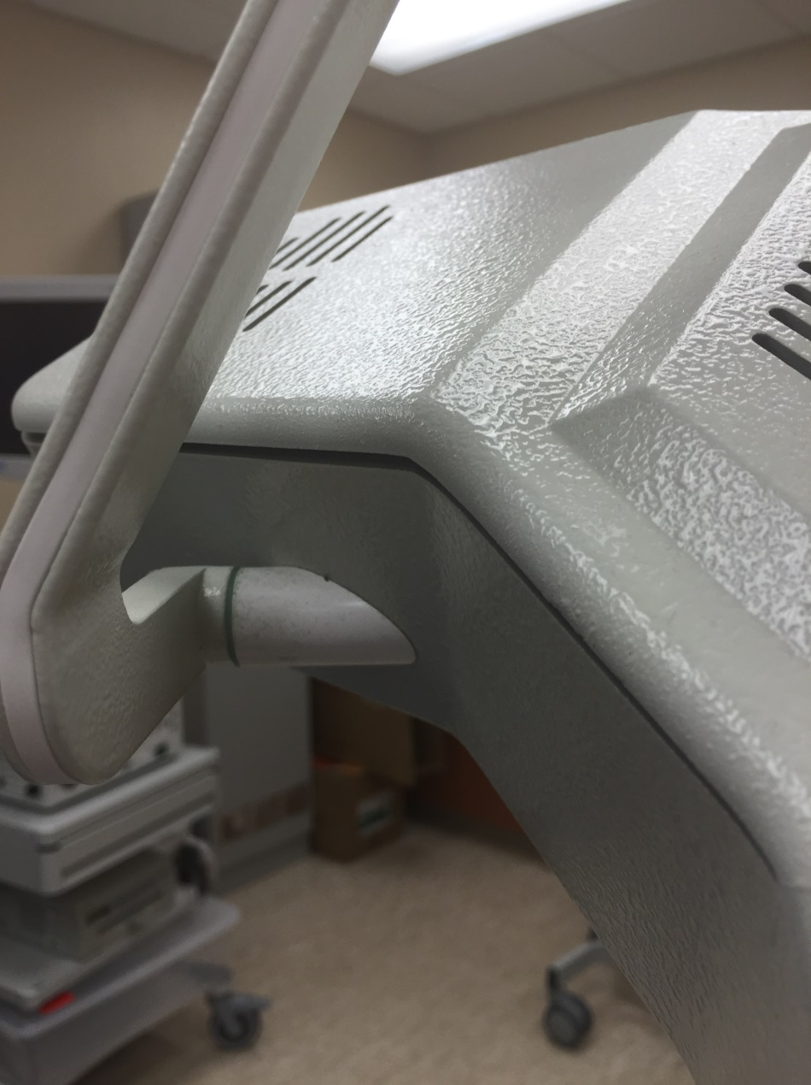
Figure 16
Figure 17
Notes:
Procedure room
F16: very cluttered; lots of ventilators being stored in this room, some covered and some not
F17: boom very dusty on top

Slide 108
MDR-A outbreak
25 cases of MDR-A were identified
18 cases with same molecular pattern
Majority of the cases were cultured from wounds and respiratory tract
Notes:
2014 data for MDR-A in TX also represented mostly wound and sputum sources:
Wounds: 379
Urine: 107
Sputum: 165

Slide 110
Conclusion
To date the results of the investigations and site visits did not identify a single source associated with the outbreak.
Initial exposure was likely due to transmission with in the healthcare facility.
The multitude of infection control violations was the likely cause of continued transmission.

Slide 111
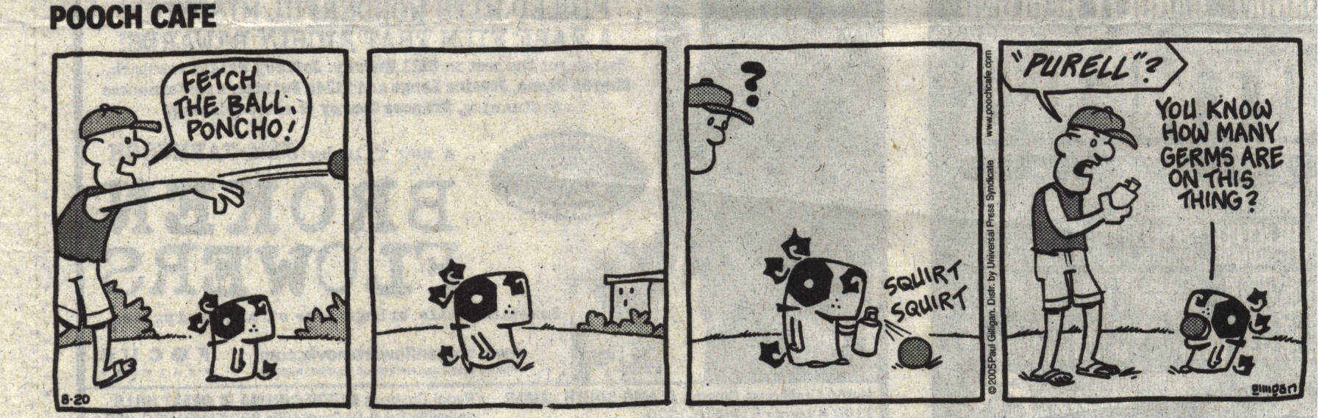
Questions

Slide 112
References
Guideline for Prevention of Surgical Site Infection, 1999 http://www.cdc.gov/hicpac/SSI/005_SSI.html
Brief Report: Nontuberculous Mycobacterial Infections After Cosmetic Surgery --- Santo Domingo, Dominican Republic, 2003—2004
http://www.cdc.gov/mmwr/preview/mmwrhtml/mm5323a4.htm
Rapidly Growing Mycobacterial Infection Following Liposuction and Liposculpture -- Caracas, Venezuela, 1996-1998
http://www.cdc.gov/mmwr/preview/mmwrhtml/00055984.htm

