Slide 1
2014 Notifiable Conditions
ELC Workshop
April 28, 2015
Rachel Wiseman, MPH

Slide 2
All data is provisional as of 4/22/15!
“Same graph as last year,
but now I have an additional dot.”

Slide 3
Top Ten Conditions
Provisional 2014 Case Counts
Salmonellosis | 5,174
Shigellosis | 2,744
Campylobacteriosis | 2,592
Pertussis | 2,577
Varicella | 1,662
Streptococcus pneumoniae, Invasive | 1,562
Invasive Group B Streptococcus | 1,356
MDRO: Multidrug-resistant Organisms | 1,338
STEC | 611
Invasive Group A Streptococcus | 602

Slide 4
Foodborne Condition | 2014 Provisional Case Count
Amebiasis | 189
Botulism infant/wound | 7/1
Campylobacteriosis | 2,592
Cryptosporidiosis | 415
Cyclosporiasis | 199
Acute Hepatitis E | 15
Listeriosis | 19
Salmonellosis | 5,174
STEC (HUS) | 611 (6)
Shigellosis | 2744
Typhoid fever | 17
Vibriosis | 77
Yersiniosis | 26

Slide 5
Suspect Foodborne Cases

Slide 6
2014 Salmonellosis Outbreaks
67 multistate outbreaks (400 cases)
Cucumbers, Nut Butter, Organic Sprouted Chia Powder, Frozen Feeder Rodents, Live Poultry, and Bearded Dragons!
4 Texas only outbreaks
(23 cases)
9 locally investigated
outbreaks (60 cases)

Slide 7
Other Enteric Outbreaks in 2014
Listeriosis
2 multistate outbreaks
Caramel Apples (4 TX cases)
Quesito Casero Cheese (1 TX case)
Shigellosis
4 multistate outbreaks (45 cases)
Azithromycin resistant Shigella
CDC has been investigating decreased antibiotic susceptibility in strains of Shigella sonnei and flexneri in the United States.
41 locally investigated outbreaks (376 cases)
Cyclosporiasis
130 outbreak associated cases
(SPOILER ALERT!) Cilantro

Slide 8
Invasive/Respiratory Conditions | 2014 Provisional Case Count
Amebic Meningitis | 1
Flu-associated Pediatric Mortality | 24
Legionellosis | 254
Meningococcal Disease | 22
Streptococcus pneumoniae, Invasive | 1562
Invasive Group A Streptococcus | 602
Invasive Group B Streptococcus | 1356

Slide 9
Legionellosis in 2014
>50% increase from 2013
Highest case count since reporting began in 1984
35 deaths (and 60 unknown outcomes)
13 outbreaks/clusters identified in 2014
Typically 0-2 per year
NH/LTCF/rehab: 6
Hospital: 3
Outpatient: 1
Hotel: 1
Apt complex: 1
Community: 1

Slide 10
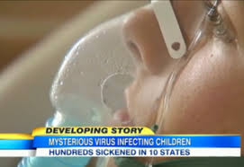
EV-D68
National (8/2014-1/2015)
Texas (7/2014-10/2014)
1,153 confirmed specimens in 49 states and DC
Predominantly in children
Especially those with hx of wheezing/asthma
14 deaths
27 Texas residents positive for EV-D68
Ages: 2 mos-14 years
No cases since 10/17
No deaths
All hospitalized (ICU admit required for testing)

Slide 11
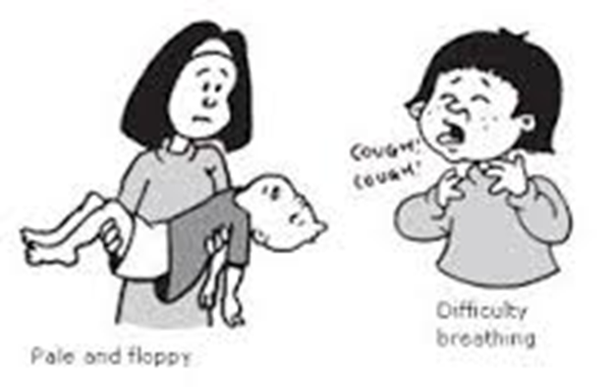
Acute Flaccid Myelitis
National (8/2014-4/2015)
Texas (8/2014-10/2014)
CDC verified 118 children in 34 states
Median age: 7 years
Most reported a fever/ respiratory illness before neurological symptom onset
2 fully recovered
~66% partially recovered
No pathogens identified in 71 CSFs tested
3 meet CDC case definition
Ages: 4, 5 and 11 years
All had fever/respiratory illness concurrent or prior to neurological symptoms
No deaths, partial recovery
2 respiratory specimens were EV-D68+
1 CSF specimen—no pathogens

Slide 12
Vaccine Preventable Conditions | 2014 Provisional Case Count
Invasive HIB | 12
Hepatitis A | 124
Perinatal Hepatitis B Infection | 3
Acute Hepatitis B | 122
Measles | 10
Mumps | 15
Pertussis | 2577
Tetanus | 4
Varicella | 1662

Slide 13
Pertussis Cycles

Slide 14
VPD Deaths
HIB (1)
64 yo, immunocompromised
Pertussis (2)
Vaccinated 14 yo, severe comorbidities
Unvaccinated 6 wk old, Mom vax’ed post-partum
Tetanus (1)
86 yo, unvaccinated, laceration from fall
Varicella (1)
Unvaxed? healthy 47 yo. Case and death unreported (found via Medicaid and death data)

Slide 15
Flu-Mumps and Flu-Measles
12/14: Statewide increase in parotitis reports
All PCR- for mumps; non-mumps outbreak?
CDC: Flu w/ parotitis, known but rare symptom
Tested our mumps rule outs for flu: 9 flu+
2/15: CDC announces flu, now with rash!
Tested all of our measles rule outs for flu: 3 flu B+
Possible causes: antibiotic reaction, febrile rash, caused by flu virus itself?

Slide 16
Zoonotic Conditions, part 1 | 2014 Provisional Case Count
Anaplasma phagocytophilum | 3
Babesiosis | 1
Brucellosis | 15
Chronic Chagas indeterminate/ symptomatic | 15/5
Cysticercosis | 16
St. Louis encephalitis/virus non-neuroinvasive | 1/3
West Nile encephalitis/fever | 253/126
Arbovirus, other | 1
Dengue (hemorrhagic) | 32 (2)

Slide 17
Zoonotic Conditions, part 2 | 2014 Provisional Case Count
Ehrlichiosis, chaffeensis | 12
Hantavirus pulmonary syndrome | 5
Leishmaniasis | 12
Lyme disease | 40
Malaria | 106
Q fever Acute/Chronic | 6/6
Spotted Fever Rickettsiosis | 94
Taeniasis | 1
Trichinosis | 2
Typhus fever-fleaborne, murine | 308

Slide 18
Reported Cases of Flea-borne Typhus in Texas, 2003-2014

Slide 19
Reported Cases of West Nile Virus in Texas, 2003-2014

Slide 20
Malaria Spike due to Ebola Worry?

Slide 21
Miscellaneous Conditions | 2014 Provisional Case Count
Acute Hepatitis C | 47
MDRO: Multidrug-resistant organisms | 1338
VISA: Vancomycin-intermediate Staph aureus | 5
Viral hemorrhagic fever (Ebola!) | 3
Creutzfeldt-Jakob Disease | 26
Novel Coronavirus aka MERS | 0

Slide 22
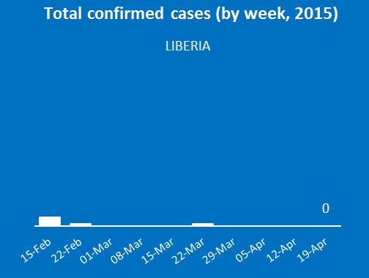
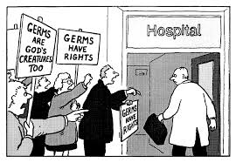
Miscellaneous Presentations
MDRO—off to a bang!
CJD—variant!
MERS—contact tracing practice?
VHF/Ebola—come on, Liberia!

Slide 23
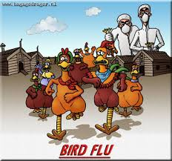
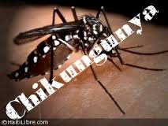
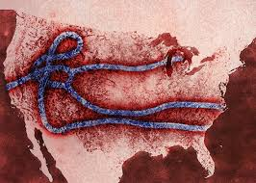
2016 ELC Spoiler Alert

