Slide 1

DSHS
Foodborne Investigation
Guidelines
Epidemiologist Orientation
February 23, 2016
Key Points To Remember

Slide 2

DSHS Foodborne Epi Team
Venessa Cantu, team lead
Greg Leos, Epi II
Irina Cody, Epi I
Raymond Dinnan, PHPS III
Wendy Albers, PHPS II

Slide 3
Resources

Slide 4

Training Course
INVESTIGATING FOODBORNE ILLNESS: A training course for Texas epidemiologists
  Module 1: Foodborne Outbreak Investigations, Step-by-Step
  Module 2: Interviewer Training
  Module 3: Submitting Specimens to the DSHS laboratory
  www.foodborneepitexas.org

Slide 5

CIFOR
CIFOR- Council to Improve Foodborne Outbreak Response
  http://www.cifor.us/
  CIFOR Guidelines For Foodborne Disease Outbreak Response- 2nd edition
  CIFOR Toolkit
Notes:
FOR Guidelines- 2nd edition
describes the overall approach to foodborne disease outbreaks, including preparation, detection, investigation, control and follow-up.
CIFOR Toolkit
intended to further the ability of state and local health departments to understand the contents of the Guidelines, to conduct a self-assessment of their outbreak detection and investigation procedures, and to implement appropriate recommendations from the nine chapters in the Guidelines.

Slide 6
CDC foodborne listserv
The CDC foodborne outbreak listserv is managed by CDC and is used to disseminate multistate (and local) FB outbreak updates, articles and new research on FB topics, and sharing of best practices for foodborne outbreak investigations.
To sign up, please send an email to FOODBORNETEXAS@dshs.state.tx.us and please include your name, position, agency, and email address. Please put “FB listserv subscriber” in the subject of the email.
Notes:
Not in print out.

Slide 7
FOODBORNE CONDITIONS

Slide 8
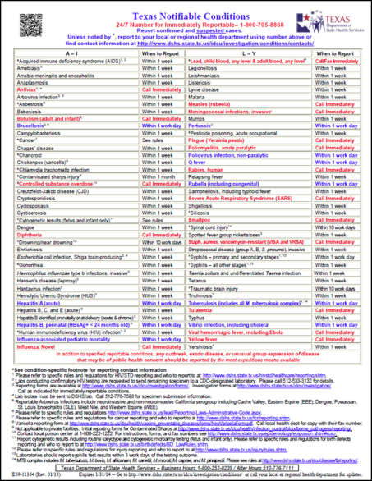
Foodborne Team
Reportable conditions
Botulism (adult and infant)
Vibriosis, including Cholera
Listeriosis
Typhoid Fever
Shiga toxin-producing Escherichia coli (STEC)
Cyclosporiasis
Hepatitis E
Salmonellosis
Shigellosis
Campylobacteriosis
Yersiniosis
Cryptosporidiosis
Amebiasis
Paragonimiasis
Fascioliasis
INVESTIGATION
GUIDELINES
AVAILABLE!!

Slide 9
Foodborne and Waterborne Case Counts in Texas, 2005-2014
Condition | 2005 | 2006 | 2007 | 2008 | 2009 | 2010 | 2011 | 2012 | 2013 | 2014
Amebiasis | 135 | 204 | 434 | 336 | 244 | 200 | 112 | 148 | 183 | 189
Botulism, infant | 1 | 5 | 4 | 8 | 4 | 8 | 4 | 1 | 7 | 7
Botulism, foodborne | 0 | 3 | 0 | 0 | 0 | 0 | 0 | 0 | 4 | 0
Botulism, other | 1 | 0 | 0 | 1 | 0 | 0 | 0 | 0 | 0 | 0
Botulism, wound | 0 | 1 | 0 | 1 | 0 | 0 | 1 | 1 | 2 | 1
Campylobacteriosis | 816 | 1075 | 1690 | 1441 | 1617 | 2001 | 1741 | 2390 | 2640 | 2589
Cholera | 0 | 0 | 1 | 1 | 2 | 2 | 1 | 1 | 0 | 0
Cryptosporidiosis | 115 | 273 | 233 | 3342 | 419 | 359 | 504 | 302 | 412 | 416
Cyclosporiasis | 1 | 1 | 2 | 6 | 10 | 9 | 14 | 44 | 351 | 200
Hemolytic uremic synd,postdiarrheal | 12 | 16 | 11 | 12 | 6 | 19 | 22 | 13 | 20 | 6
Listeriosis | 39 | 41 | 64 | 37 | 27 | 53 | 51 | 28 | 28 | 19
Salmonellosis | 3145 | 3060 | 3534 | 5583 | 3964 | 4929 | 5218 | 4990 | 4946 | 5145
Shiga toxin-producing Escherichia coli (STEC) | 96 | 210 | 210 | 332 | 247 | 351 | 486 | 499 | 606 | 612
Shigellosis | 3100 | 2065 | 2358 | 4665 | 2295 | 2626 | 2539 | 1926 | 2386 | 2743
Typhoid fever (Salmonella Typhi) | 30 | 17 | 22 | 32 | 23 | 32 | 26 | 29 | 13 | 20
ALL VIBRIOS (exclusing cholera) | 53 | 54 | 60 | 57 | 68 | 79 | 79 | 66 | 84 | 77
Vibrio parahaemolyticus | 11 | 11 | 15 | 12 | 13 | 17 | 29 | 16 | 22 | 17
Vibrio vulnificus | 17 | 22 | 26 | 17 | 19 | 32 | 17 | 15 | 22 | 16
Vibriosis, other or unspecified | 25 | 21 | 19 | 28 | 36 | 30 | 33 | 35 | 40 | 44
Yersiniosis | 12 | 13 | 10 | 14 | 17 | 19 | 18 | 22 | 35 | 26

Slide 10
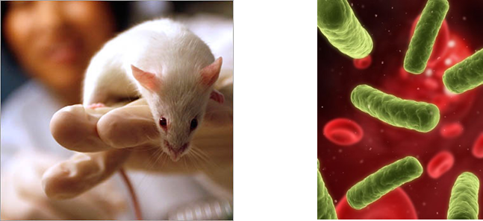
Botulism
DSHS Austin laboratory is only laboratory in the state that can confirm botulism cases
  Culture
  Mouse assay
Please have physician consult with an EAIDB foodborne epidemiologist prior to sample collection and/or submission
DSHS lab requires EAIDB approval

Slide 11
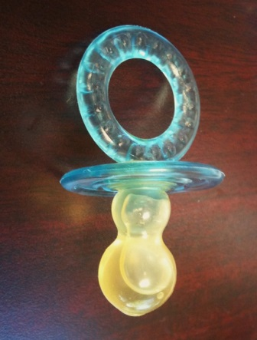

Infant Botulism
  Treatment: BabyBIG Antitoxin
      Released by California Department of Public Health
Investigation Form: Infant Botulism Investigation Form
    Potential sources to consider: honey, homeopathic remedies, inhalation of spore-containing soil

Slide 12
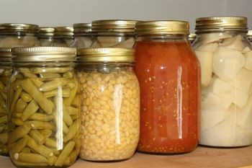

Adult botulism
Treatment: Heptavalent Botulism Antitoxin (H-BAT)
  Released by CDC
Investigation Form: Foodborne Botulism Alert Summary
  Potential sources to consider:
    Foodborne: Improper home-canning, smoking and pickling, home-made oil infusions
    Wound: Skin popping – IVDU
Botulism Outbreaks Rare
  require rapid recognition to identify:
    the disease source
    distinguish outbreak types (between natural, accidental or potentially deliberate)
    prevent additional cases
    effectively administer treatment to affected patients
Notes:
heptavalent botulinum antitoxin
HBAT contains equine-derived antibody to the seven known botulinum toxin types (A--G)

Slide 13
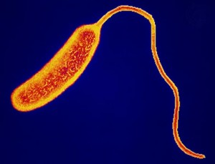
Vibriosis
Isolates required to be sent to DSHS lab
  Confirmation
  PFGE available for V. parahaemolyticus and V. cholerae non-O1
  Serotyping for V. cholerae O1 and O139 available
Investigation Form: CDC- Cholera and other Vibrio Illness Surveillance Report (COVIS)
  Hospitalized cases should be followed until discharge and patient’s outcome recorded on the COVIS form
    Initial reports can be sent to DSHS prior to discharge
  In the event of a death, copies of the hospital discharge or death summary should also be faxed to DSHS EAIDB
  For lost to follow-up (LTF) cases, please complete as much information.
Notes:
Hospitalized cases should be followed until discharge and patient’s outcome recorded on the COVIS form.
o Initial reports can be sent to DSHS prior to discharge.
In the event of a death, copies of the hospital discharge or death summary should also be faxed to DSHS EAIDB.

Slide 14
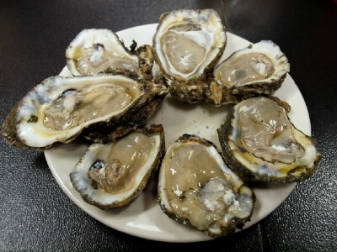
Vibriosis
Raw shellfish consumption
  Coordinate with EH sanitarians to obtain, oyster tags from all restaurants for the dates appropriate for the case's consumption dates
    TFER §228.63 (i)- Oyster TAGs are REQUIRED TO BE ATTACHED UNTIL CONTAINER IS EMPTY OR RETAGGED AND THEREAFTER KEPT ON FILE FOR 90 DAYS”;
  Complete Section IV:
  Seafood Investigation Section
  of the COVIS form
Notes:
If the restaurant is out of your jurisdiction, please contact an EAIDB foodborne epidemiologist and they will request oyster tags from the health department with jurisdiction

Slide 15
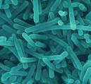

Listeriosis
Isolates required to be sent to DSHS lab
  Confirmation and PFGE
  Sent to CDC for serotyping
Investigation Form: CDC Listeria Case Form
and Supplemental Medical History Form
  Hospitalized cases should be followed until discharge and patient’s outcome recorded on the Listeria Case Form.
    Initial reports can be sent to DSHS prior to discharge
  In the event of a death, copies of the hospital discharge or death summary should also be faxed to DSHS EAIDB.
  For lost to follow-up (LTF) cases, please complete as much information.
For fetal or neonatal (≤1 month of age) infections, only the mother is counted as the case.

Slide 16
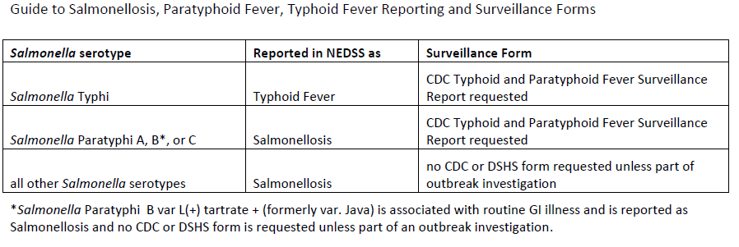
Typhoid Fever & Salmonellosis
Investigation Guidelines: note that typhoid infections (caused by S. Typhi) are reported in NEDSS as Typhoid Fever and will be covered in the Typhoid Fever section.
Paratyphoid infections (caused by S. Paratyphi A, B, and C) are reported in NEDSS as Salmonellosis and are covered in the Salmonellosis Investigation Guidelines.

Slide 17
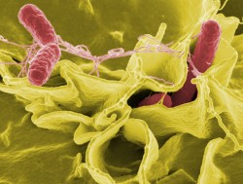
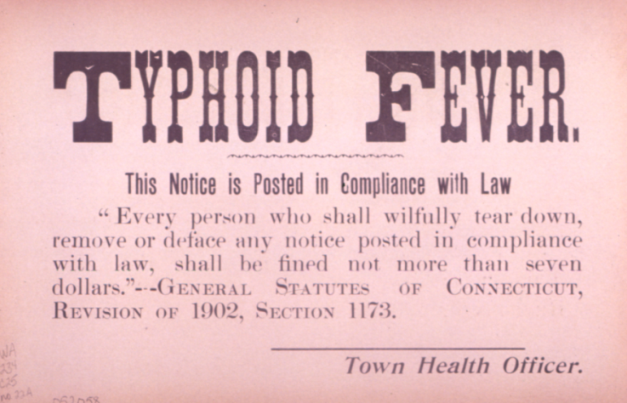
Typhoid Fever
Salmonella Typhi
Isolates strongly encouraged to be sent to DSHS lab
  Confirmation and PFGE available
Investigation Form: CDC Typhoid and Paratyphoid Fever Surveillance Report

Slide 18
Typhoid fever
Exclusions:
  Children with Salmonella Typhi should be excluded from school/child-care until diarrhea free and fever free, antibiotic treatment has been completed and 3 consecutive stool specimens have tested negative for S. Typhi
  Food employees infected with Salmonella Typhi should be excluded from work
    Food employee can be reinstated with approval from the Regulatory Authority and if the following conditions is met:
      Medical documentation by a health practioner stating that the food employee is free of S. Typhi infection.

Slide 19
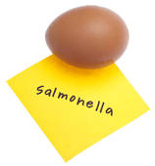
Salmonellosis
Isolates strongly encouraged to be sent to DSHS lab
  Serotyping and PFGE
Investigation Forms:
  CDC Typhoid and Paratyphoid Fever Surveillance Report for paratyphoid fever cases (caused by S. Paratyphi A, B, and C)
  no CDC or DSHS form requested for salmonellosis unless part of outbreak investigation (Hyp-gen questionnaire)
NEDSS: suspect category added to Epi Case Criteria in 2014
  Non-culture lab methods (e.g., PCR)

Slide 20
Salmonellosis
The updated Texas Food Establishment Rules (TFER) which went into effect on October 11, 2015 now include non-typhoidal Salmonella with exclusion/restriction criteria.
Food employee exclusions/restrictions:
  Symptomatic food employees infected with non-typhoidal Salmonella are to be excluded from work.
  Asymptomatic food employees diagnosed with an infection from non-typhoidal Salmonella are to be restricted from work.

Slide 21
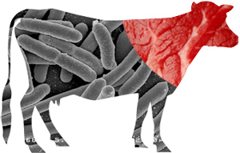
shiga toxin-producing Escherichia coli (STEC)
Isolate or specimen from cases where Shiga toxin activity is demonstrated required to be sent to the DSHS laboratory
  Shiga-toxin detection, serotyping, PCR, and PFGE available
Investigation Form: DSHS form
  Shiga Toxin-Producing E. coli and/or Hemolytic Uremic Syndrome (HUS) Investigation Form
Hemolytic Uremic Syndrome (HUS) reported as a separate condition in NEDSS
Notes:
Confirmed: A case that meets the laboratory criteria for diagnosis; when available, O and H antigen serotype characterization should be reported
Probable:
▪ A case with isolation of E. coli O157 from a clinical specimen, without confirmation of H antigen or Shiga toxin-production, OR
▪ A clinically compatible case that is epidemiologically linked to a confirmed or probable case, OR
▪ Identification of an elevated antibody titer to a known Shiga toxin-producing E. coli serotype from a clinically compatible case, OR
▪ Identification of Shiga toxin in a specimen from a clinically compatible case without the isolation of the Shiga toxin-producing E. coli
▪ Isolation of Shiga toxin-producing Escherichia coli from a clinical specimen
▪ Escherichia coli O157:H7 isolates are assumed to be Shiga toxin-producing. Therefore, isolation alone qualifies a case as “confirmed.”
▪ Escherichia coli non-O157:H7 isolates must also have Shiga toxin-production verified in order to qualify the case status as “confirmed.” Shiga toxin can be demonstrated by EIA or PCR testing.
▪ EIA and/or PCR positive results for Shiga toxin-production, in the absence of an isolate, can only qualify a case as “probable.”

Slide 22


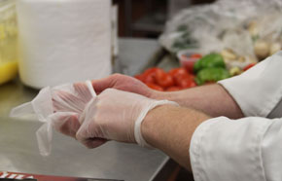
shiga toxin-producing Escherichia coli (STEC)
Food employee exclusions/restrictions:
  Symptomatic food employees infected with Shiga toxin-producing E. coli are to be excluded from work.
  Asymptomatic food employees diagnosed with an infection from Shiga toxin-producing E. coli. are to be:
    excluded from working in a food establishment serving a highly susceptible population or
    restricted if they do not serve a highly susceptible population

Slide 23
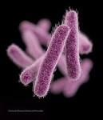
Shigellosis
No isolate requirement
  Serotyping and PFGE available at DSHS lab
    Useful in outbreaks
No Investigation Form required
NEDSS: suspect category added to
Epi Case Criteria in 2014
  Non-culture lab methods (e.g., PCR)
Food employee exclusions/restrictions:
  Symptomatic food employees infected with Shigella spp. are to be excluded from work
  Asymptomatic food employees diagnosed with an infection from Shigella spp. are to be excluded from working in a food establishment serving a highly susceptible population or restricted if they do not serve a highly susceptible population
Notes:
Confirmed: A case that meets the laboratory criteria for diagnosis. When available, O antigen serotype characterization should be reported
Probable: A clinically compatible case that is epidemiologically linked to a confirmed case, i.e., a close contact of a confirmed case or member of a risk group as defined by public health authorities during an outbreak
Suspect: A case with Shigella detected, in a clinical specimen, by use of culture independent laboratory methods (non-culture based)

Slide 24

Campylobacteriosis
No isolate requirement
  Confirmation and PFGE available at DSHS lab
    Useful in outbreaks
No Investigation Form required
NEDSS: new in 2015
    Non-culture lab methods (e.g., EIA, PCR) now included in PROBABLE case definition
Notes:
Confirmed: A case that is laboratory confirmed
Probable: A clinically compatible case that is epidemiologically linked to a confirmed case
Suspect: A case with Campylobacter spp. detected, in a clinical specimen, by use of culture independent laboratory methods (non-culture based)
Note: The use of culture independent methods as standalone tests for the direct detection of Campylobacter in stool appears to be increasing. Data available about the performance characteristics of these assays indicates there is variability in the sensitivity, specificity and positive predictive value of these assays depending on the test (EIA test format -lateral flow or –microplate) and manufacturer. It is therefore useful to collect information on which type of EIA test and manufacturer are used to diagnose a case. Culture confirmation, of culture independent (e.g., EIA) test positive specimens, is ideal.

Slide 25
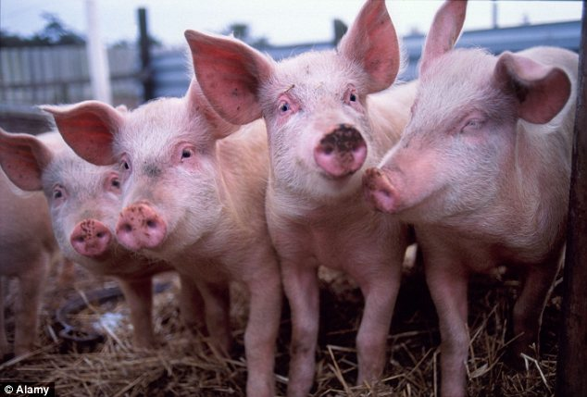

yersiniosis
No isolate requirement
  Confirmation available at DSHS lab
Investigation Form available on DSHS website (not required)
Note: Yersinia pestis reported as Plague, all other species reported as Yersiniosis
Notes:
Confirmed: A case that meets the laboratory criteria for diagnosis Probable: A clinically compatible case that is epidemiologically linked to a confirmed case
Isolation of Yersinia (except Y. pestis)* in a clinical specimen
As required by TAC all Yersinia pestis isolates must be submitted to the DSHS laboratory.
For Yersinia pestis isolates, see Plague

Slide 26
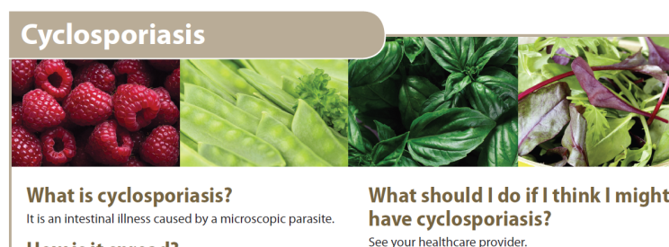
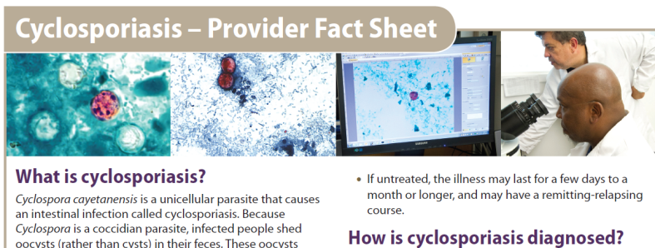
cyclosporiasis
No specimen requirement
  Testing is available at DSHS lab
  DSHS is working with a few laboratories to submit samples for confirmation and/or further molecular studies
Investigation Form: Cyclosporiasis Surveillance Case Report Form
CDC printable resources
  Fact Sheet for the Public and for Providers
  http://www.cdc.gov/parasites/cyclosporiasis/printresources.html
Notes:
Confirmed: A laboratory-confirmed case with or without clinical symptoms
Probable: A clinically compatible case that is epidemiologically linked to a confirmed case
▪ Detection—in symptomatic or asymptomatic persons— of Cyclospora:
▪ Oocysts in stool by microscopic examination, or in intestinal fluid/aspirate or intestinal biopsy specimens, OR
▪ Demonstration of sporulation, or DNA (by PCR) in stool, intestinal fluid/aspirate or intestinal biopsy specimens

Slide 27

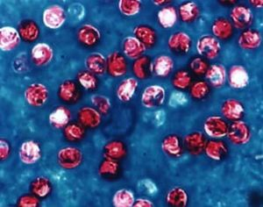
cryptosporidiosis
No specimen requirement
  Testing is available at DSHS lab
No Investigation Form required
Notes:
Confirmed: A case that is laboratory confirmed
Probable: ▪ A case with Cryptosporidium antigen detected by a screening test method such as, the immunochromatographic card/rapid card test or a laboratory test of unknown method,
***OR ▪ A clinically compatible case that is epidemiologically linked to a confirmed case by one of the following means: ▪ Household or other close contact to a lab-confirmed case with onset of symptoms within 1 month (before or after), OR ▪ Exposure to an outbreak at a body of water or water facility involving at least 2 lab-confirmed cases and onset of symptoms within one month (before or after) of one or more of these cases
Detection of Cryptosporidium organisms or DNA in stool, intestinal fluid, tissue samples, biopsy specimens, or other biological sample by certain laboratory methods with a high positive predictive value (PPV), e.g., DFA, PCR, EIA, or light microscopy of stained specimen

Slide 28
Amebiasis
(Entomoeba histolytica)
No specimen requirement
  Testing is available at DSHS lab
No form required
Notes:
Confirmed, intestinal amebiasis: A clinically compatible illness that is laboratory confirmed
Suspect, intestinal amebiasis: A clinically compatible case with E. histolytica detected in stool by use of an antigen-based fecal immunoassay
Confirmed, extra-intestinal amebiasis:
▪ A case with demonstration of the organism, E. histolytica, in at least one extra-intestinal tissue sample, OR
▪ A symptomatic person (with clinical or radiographic findings consistent with extra-intestinal infection) and demonstration of specific antibody against E. histolytica as measured by reliable immunodiagnostic test (e.g. EIA) and PCR based assays
Intestinal amebiasis
▪ Demonstration of cysts or trophozoites of E. histolytica in stool, OR
▪ Demonstration of trophozoites in tissue biopsy or ulcer scrapings by culture or histopathology
Extra-intestinal amebiasis
▪ Demonstration of E. histolytica trophozoites in extraintestinal tissue

Slide 29


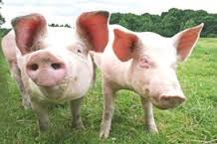
Hepatitis e
Investigation Form: Viral Hepatitis Case Track Record
Most cases reported meet Probable case classification
  positive IgM antibody from labs other than CDC
Notes:
Typical clinical signs and symptoms of acute hepatitis E virus (HEV) are similar to those of other types of acute viral hepatitis and include abdominal pain anorexia, dark urine, fever, hepatomegaly, jaundice, malaise, nausea, and vomiting. Other less common symptoms include arthralgia, diarrhea, pruritus, and urticarial rash. The period of infectivity following acute infection has not been determined but virus excretion in stools has been demonstrated up to 14 days after illness onset. In most hepatitis E outbreaks, the highest rates of clinically evident disease have been in young to middle-age adults; lower disease rates in younger age groups can be the result of anicteric and/or subclinical HEV infection. No evidence of chronic infection has been detected in long-term follow-up of patients with hepatitis E. The case fatality rate is low except in pregnant women where it can reach 20% among those infected during the third trimester of pregnancy.
Confirmed: A case that meets the clinical case description and is laboratory confirmed
Probable: A case that meets the clinical case description with supportive laboratory evidence (positive IgM antibody from labs other than CDC), OR negative tests for other acute hepatitis markers and an epidemiological link to other confirmed cases or travel history to an endemic area during exposure period
Confirm lab method:
IgM anti-HEV from CDC laboratory or PCR positive from reference laboratory
Note: No FDA approved tests to diagnose HEV infection are available in the United States.

Slide 30
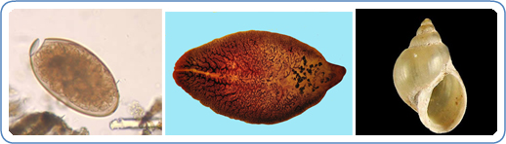
Fascioliasis
New Reportable Condition- added January 2016
Parasitic infection typically caused by Fasciola hepatica
  Aka "the common liver fluke" or "the sheep liver fluke.“
Transmission occurs through consumption of raw watercress or other water plants contaminated with immature parasite larvae
Investigation Form: Fascioliasis Investigation Form

Slide 31
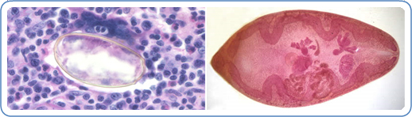
Paragonimiasis
New Reportable Condition- added January 2016
Parasitic infection caused by Paragonimus species.
  Aka "the lung fluke“
Transmission occurs through consumption of raw, salted, pickled, or partially cooked freshwater crabs or crayfish (crawfish) containing infected larvae (metacercariae).
Investigation Form: Paragonimiasis Investigation Form

Slide 32
Exclusions

Slide 33
General Exclusions
School/child-care:
  Children with diarrhea should be excluded from school/child-care until they are free from diarrhea for 24 hours without the use of diarrhea suppressing medications.
  Children with a fever from any infection should be excluded from school/child-care for at least 24 hours after fever has subsided without the use of fever suppressing medications.
Food Employee:
  Food employees are to be excluded if symptomatic with vomiting or diarrhea until:
    Asymptomatic for at least 24 hours without the use of diarrhea suppressing medications or
    Medical documentation is provided stating that symptoms are from a noninfectious condition.

Slide 34

Specific exclusions
Typhoid Fever school/child-care exclusion:
  Children with Salmonella Typhi should be excluded from school/child-care until diarrhea free and fever free, antibiotic treatment has been completed and 3 consecutive stool specimens have tested negative for S. Typhi

Slide 35
Specific Exclusions
Food employee exclusions or restrictions
  Employees diagnosed with an illness due to:
    Norovirus
    Hepatitis A virus
    Salmonella typhi
    Shigella spp.
    Shiga toxin-producing Escherichia coli (STEC)
    Salmonellosis
See Investigation Guidelines- Appendix A:
  Guide to Food Employee Exclusions and Restrictions

Slide 36
PFGE Clusters

Slide 37
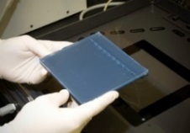
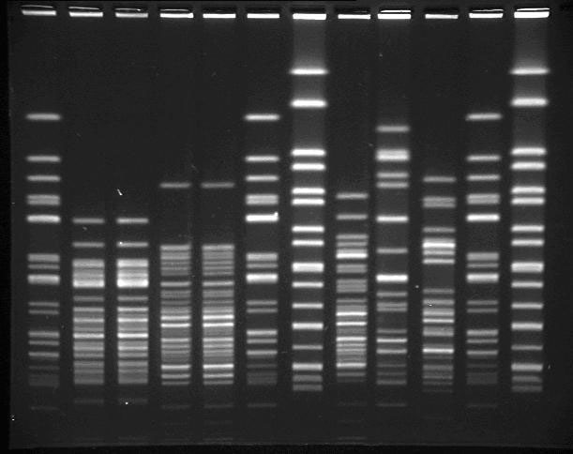

How is a Cluster of Illnesses or an Outbreak Identified?
By a report of more than the usual number of cases
By an apparent common exposure
    Cases have common place of residence, work, school
    Cases attended common event
By identification of common genetic strain
    Generally, by PFGE (of bacterial pathogen)
Notes:
How do we identify a cluster or an outbreak? Sometimes by a report of more than the usual # of cases. --i.e. last year in late summer, an increase of Cyclosporiasis cases was identified and led to further investigation than is normally done for Cyclosporiasis. As a result a restaurant cluster was identified by SA Metro and Region 8, and the overall increase in Texas of Cyclosporiasis cases was investigated as a major cluster. We normally see around 10 cases a year and last year we saw over 300 cases. Another way we identify a cluster is when there is a common exposure --Cases have common place of residence, work, school (daycare outbreak) --Cases attended common event (classic church picnic scenario)
These outbreaks are usually local investigations, contained to a specific geographic location and are easier to detect than outbreaks that occur over many counties and states.
That’s where PFGE comes into play. Molecular testing, such as PFGE allows us to identify clusters that were previously difficult to detect. PFGE and PulseNet can help us determine whether an outbreak is occurring, even if those affected are geographically far apart.
This is important because Food consumption and practices have changed in the the past 20 years in the United States. --We describe it as a shift from the typical point source, or “church picnic” outbreak, to more widespread outbreaks that occur over many communities with only a few illnesses in each community. --For example, we now have large food producing facilities that distribute products throughout the country. Not to mention imported food items.
We can now detect outbreaks with some low level contamination where the products are distributed among many states. --Bulk of our work are clusters determined by PFGE

Slide 38
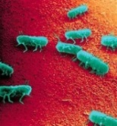
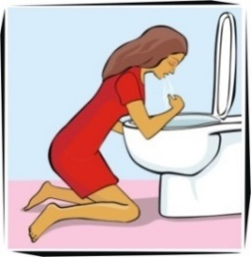

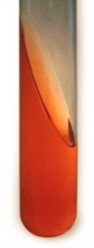

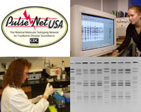
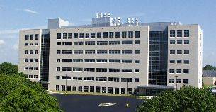
Outbreak Detection by Molecular Methods
Health Care provider
Clinical laboratory
Foodborne
illness
Cluster
identified
PFGE
results
Outbreak
Investigation
CDC PulseNet
TX DSHS
Public Health Laboratory
Notes:
Diagram of what usually happens
--Case-patient becomes ill, severe enough where the visit there health care provider
--Some health care providers collect a sample based on clinical presentation, usually stool and submits to the clinical laboratory --The clinical lab isolates, for example, Salmonella (which reports back to the clinician who will use this information in their treatment plan) and submits the isolate to the DSHS lab
(Many isolates are required to be submitted to the state lab, e.g., Listeria, all Vibrios, STECs; --- Salmonella not required but very strongly requested) --The DSHS lab performs ID and serotyping, if necessary, and PFGE. They upload the results to the PulseNet database (PulseNet - is a national network of public health laboratories at the federal, state, and local level, and coordinated by the CDC)
PulseNet then uses a algorithm to identify clusters (usually look at an statistical increase over baseline of a particular pattern). We, DSHS, receive a notification of the clusters identified and then coordinate the investigation by LHDs and RHDs with jurisdiction. Depending on the illness and time taken to seek treatment - the delay from illness onset to confirmation of being part of a cluster can be up to a month or longer. Therefore investigating the case as soon as possible and interviewing the patient is important.
We also receive notification of Texas only clusters by our DSHS lab…….

Slide 39
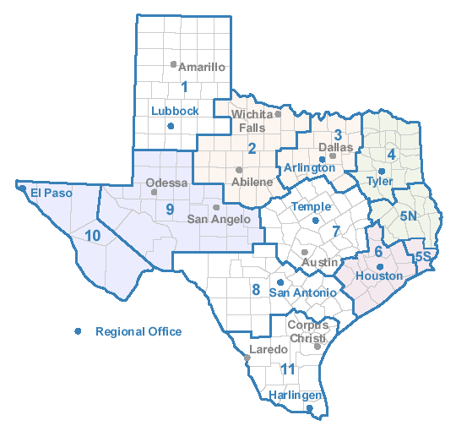
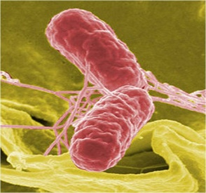
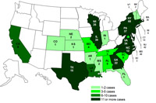
Salmonellosis Clusters
Salmonellosis clusters
  Texas only
  Multi-state
    CDC PulseNet
    CDC OutbreakNet
Notes:
Salmonellosis clusters identified by PFGE are the bulk of our work
--We investigate anywhere from 60-90 clusters a year. --Approximately, 2/3 are multi-state and 1/3 are Texas only clusters --We also typically investigate a few STEC and Listeriosis clusters identified by PFGE a year --Since Salmonellosis clusters are the bulk of the work, I wanted to explain one of the ways we classify clusters— Texas only- as you can imagine involve only Texas cases--- some of these are detected by PulseNet but most are detected by our lab
--the Texas clusters we investigate are not just determined by 2 or 3 more cases of the same pattern, we use an algorithm that includes several factors such as severity of illness, temporal clustering, geographical clustering, clustering of a particular gender, age, or ethnic group, etc..
Multi-state clusters are separated into 2 categories:
--PulsNEt - identified by the PulseNet database group at CDC, they notify states of clusters which have an above baseline increase in a particular pattern (usually over a 60 day period)
--We tend to send out notifications to you all, the LHDs and RHDs, and request an interview of cases.
The cluster gets upgraded or considered a higher priority when the CDC OutbreakNet team gets involved. The OutbreakNet team are the epidemiologists and EIS officers at CDC who are pursuing certain PN clusters. Several factors also go into their algorithm. Once we get notified by the CDC OutbreakNet team, we put a higher priority on those clusters. Hopefully, we would have already received notification from our lab or PulseNet cluster and already requested questionnaires. And then, when the OutbreakNet team at CDC start holding conference calls, there is a bump up in priority and then even higher when there is a strong hypothesis or suspect vehicle.

Slide 40


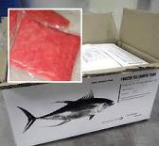

Outbreak examples
E. coli O157:H7→ cookie dough
  Open-ended interviewing
Listeria monocytogenes → cantaloupes
  Listeria initiative case form
Salmonella Bareilly → raw tuna scrape
  Early restaurant cluster identified in Texas
Salmonella Agona → papaya
  Grocery store location information important for traceback activities
Notes:
Here are a few examples where case interviews played a strong part in identifying the vehicle
The E.coli O157 outbreak involving cookie dough in 2009 . Serious condition, some cases developed HUS, noticed a high number of female cases, urgency to figure this one quickly.
--key turning point when a CDC epi conducted open-interviews in the state of Washington of about 5 cases in one night. On her 2nd interview, noticed that the case reported cookie dough as did the 1st case. (Cookie dough was not on the list of food items on the original questionnaire). Asked the remaining cases about cookie dough exposure. They all said yes. Reported findings next day on a call, and so other states started asking about cookie dough. Led to a recall --Listeria outbreak in 2011, multistate outbreak involving cantaloupes and subsequently led to a recall. Colorado noticed the increase and over a weekend had cantaloupes as a leading hypothesis. Other states with cases notified, including Texas (2 cases), and because the Listeria initiative case form is conducted for all Listeria cases, we knew that our cases, as well as the other states cases, reported exposure to cantaloupes. Benefit of interviewing before case is identified as part of a cluster (Not always practical with Salmonella).
--Salmonella Bareilly, in 2012, led to the recall of raw tuna scrape product (found to be commonly used in spicy tuna rolls and a few other sushi dishes). Early and detailed interviews of 2 cases in Texas identified a restaurant cluster that was key in traceback efforts by regulatory folks and to the recall.
---Salmonella Agona, in 2011, led to the recall of papaya. Somewhat complex investigation but getting good, detailed location information of grocery stores was very important in helping regulatory (and RRT) conduct traceback and determine the source of the papayas.

Slide 41


DSHS Hypothesis Generating Questionnaire (v7)
Goal
  Balance CDC and Texas needs
  Balance asking details with asking about more food items
Components
  Tracking sheet
  Demographics and clinical information
  Preliminary questions
  Sources and stores of food at home
  Eating and shopping venues
  Food exposures
  Animal contact
Notes:
Most of you are familiar with our Texas hyp gen- Q but for those who are not, just a quick review…
The goals of the TX hyp-gen Q was to balance CDC and Texas’s needs. And also to balance asking about a lot of details regarding food items with being able to ask about more food items.
CDC came out with their national hyp-gen questionnaire which had less food items but asks for more details on particular items. But we still wanted to be able to ask about more food items and also to add some food items that are specific to Texans. We’ve also included items that would be helpful to LHDs or RHDs that were not on the national Q such as daycare questions.

Slide 42
Importance of case-patient interviews
Essential tool for implicating a specific food item or other exposure
    Prevent additional cases
    Can alter allowed practices and standards along the continuum from farm to table.
Your contribution on each and every interview is critical to the success of identifying causes of foodborne illnesses and is very much appreciated!!
Notes:
So before we begin, as many of you know,
Case-patient interviews, using a standardized questionnaire, are essential tools for implicating a specific food item or other exposure as the cause of a cluster of illnesses.
-- Identification of a source can prevent additional cases and also be used by local, state, and federal regulatory agencies to alter allowed practices and standards along the continuum from the farm to the table.
--Sometimes, an interview of even a single case-patient can identify a suspect item. This doesn’t mean that all clusters will be solved if interviews are conducted in an ideal manner!
But Your contribution on each and every interview is critical to the success of identifying causes of foodborne illnesses and is very much appreciated!!

Slide 43
Submitting specimen to the DSHS lab
GI Outbreak- unknown pathogen

Slide 44

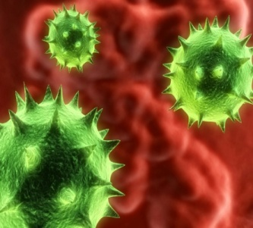
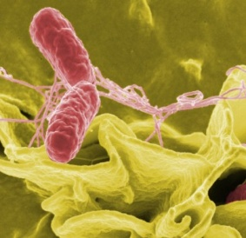
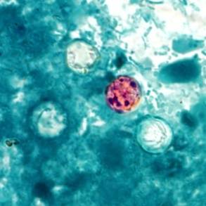
GI Outbreak - Unknown Pathogen
Available Testing at DSHS laboratory
  Viral
    Real time RT-PCR: Norovirus
  Bacterial
    Enteric pathogen isolation and ID
    Shiga-toxin producing E. coli
      EHEC, shiga-like toxin assay
      Real time RT-PCR: STEC
  Parasitic
    Ova and Parasite detection and ID
Notes:
Unknown pathogen, often suspect norovirus

Slide 45

Norovirus testing
Only raw stool accepted
  Transport temperature: 2-8ºC (ice pack)
  Transport time: as soon as possible
Notes:
Transport time: as soon as possible because DNA may degrade over time

Slide 46
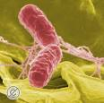
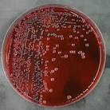
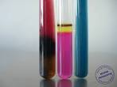
Enteric pathogen isolation
Specimen type | Transport time to lab from time of collection | Transport temperature
Isolate | As soon as possible to ensure viability | Ambient or 2-8ºC (ice pack)
Raw stool [not preferred specimen] | Accepted up to 30 days (ASAP for optimal recovery of bacterial pathogens) | 2-8ºC (ice pack)
Stool in transport solution/medium [preferred specimen] | ≤24 hours | Room Temp or 2-8ºC (ice pack)
Stool in transport solution/medium [preferred specimen] | >24 hours but ≤3 days | 2-8ºC (ice pack)
Stool in transport solution/medium [preferred specimen] | >3 days | Freeze immediately at ≤-70ºC. Ship on dry ice.

Slide 47
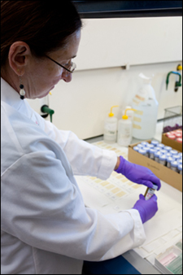
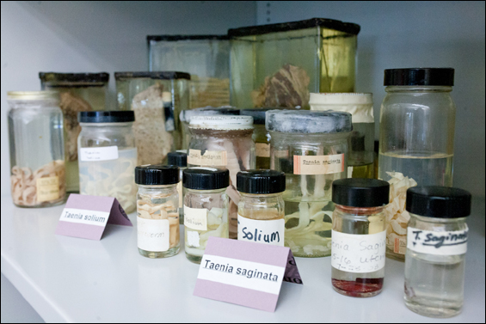
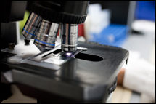
Parasitic testing
  Raw stool should be transferred within a few hours to 10% Formalin & Z-PVA vials
  Can be shipped at Room Temp or 2-8ºC (ice pack)
  Do Not Freeze

Slide 48
Lab Submission Form
Submitter form: G-2B
  Select appropriate test(s):
    Molecular Studies
      Check “PCR” and “Norovirus”
    Bacteriology Check “Culture, stool” under Clinical Specimen
    Parasitology
      Check “Fecal ova and parasite examination”
    AND
    Check “Outbreak association” and write in name of outbreak,
    Payor source:
      Check “IDEAS” to avoid bill for submitter

Slide 49
Foodborne
Additional testing

Slide 50

Additional Testing at DSHS
GI outbreak - known pathogen
  Confirmation and molecular subtyping
PFGE available for:
  Salmonella
  Shigella
  Shiga toxin-producing E. coli (STEC)*
  Campylobacter
  Listeria*
  Vibrio* (V. cholerae non-O1 and
  V. parahaemolyticus)
* Isolate submission required per TAC
Notes:
If known pathogen in an outbreak, Can request hospital/clinic labs to forward specimens to DSHS for confirmation and molecular subtyping.
Molecular subtyping can be useful…

Slide 51
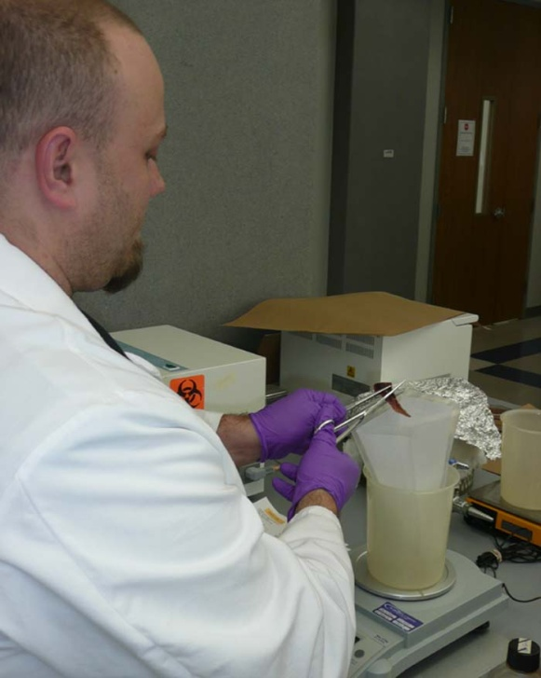
Food
Testing performed by Consumer Microbiology Team at DSHS lab
General policy
  Test only food samples implicated in a suspected outbreak (not associated with single cases)
  In outbreaks, will not test food unless a pathogen has been identified in a clinical specimen
  Food samples must be collected by a registered sanitarian
Contact an EAIDB foodborne epidemiologist to discuss further

Slide 52
Food: Available Tests*
Aerobic Plate Count
Bacillus cereus Enumeration
Campylobacter spp.
Cronobacter sakazakii
Clostridium perfringens Enumeration
Coliform Count
Escherichia coli O157:H7
Escherichia coli count
non-O157 STEC in Meat Products (O26; O45; O103; O111; O121; and O145)
Listeria monocytogenes
Salmonella spp.
Shigella spp.
Staphylococcus aureus enterotoxin
Staphylococcus aureus Enumeration
Vibrio cholerae, Vibrio parahaemolyticus, Vibrio vulnificus
Yeast & Mold Count
Yersinia enterocolitica
*food is tested only upon prior approval
Notes:
Food is tested only upon request from DSHS, local city county health departments, and hospitals. All food testing is done by standard methods following the Bacteriological Analytical Manual, FDA, 8th Edition.
Methods:
Bax system
Traditional Culture Methods (BAM)
mini-VIDAS
E. coli O157:H7 testing
“Big 6” non-O157 testing (O26, O45, O103, O111, O121, O145). But we can
For E. coli O157:H7 there are not limitations. We can test anything only test raw ground beef for this test

Slide 53

Environmental Swabs
Testing performed by Consumer Microbiology Team at DSHS lab
General policy
  Test environmental swabs only from facilities implicated in a suspected outbreak (not associated with single cases)
  In outbreaks, will not test environmental swabs unless a pathogen has been identified in a clinical specimen
  Environmental swabs must be collected by a registered sanitarian
Environmental swabs must be tested by the lab within 48 hours of collection. Environmental samples will not be accepted on Fridays or the day before a holiday
Contact an EAIDB foodborne epidemiologist to discuss further
Notes:
Quik-Swabs (3M) or Spongesicles (Various providers)
If Environmental Swabs are to be collected, we would need a head’s up on how many and they would have be collected by a registered sanitarian.
As far as the Consumer Microbiology Lab, we can only test Salmonella for the following matrices:
Food
Environmental Swabs
That is standard practice that all samples collected should be by registered sanitarian. I understand this could be from opened packages from a case patient and that would be acceptable for investigational purposes. But we need a clear chain of custody from the home to the lab.

Slide 54
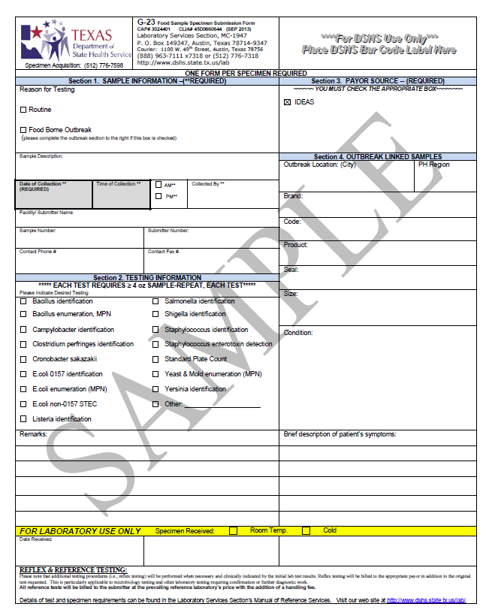
Complete the G-23 form for each food sample or environmental swab submitted

Slide 55
National Outbreak Reporting System
(NORS)

Slide 56
NORS
For NORS reporting, the definition of an outbreak is two or more cases of similar illness associated with a common exposure.
The following should be reported to NORS:
  Foodborne disease, waterborne disease, and enteric illness outbreaks with person-to-person, animal contact, environmental contact, or an indeterminate route of transmission.
  Outbreaks as indicated above with patients in the same household.
Enter outbreaks into NORS online reporting system at https://wwwn.cdc.gov/nors/login.aspx
Forms, training materials, and other resources are available at http://www.cdc.gov/nors/

Slide 57
NORS
To request a NORS account, please email FoodborneTexas@dshs.state.tx.us
  Please put in Subject Line: NORS User Account Request
  Information needed from requestor: name, e-mail address, and agency name
  After an account has been created a reply e-mail will be sent with a username, password, and instructions for logging in.

Slide 58
Other organisms- not covered by FB team
Vaccine-Preventable Diseases (VPD) team
  Hepatitis A
Zoonosis
  Cysticercosis
  Trichinosis
  Taenia
  Intestinal Anthrax
  Brucellosis
Notes:
Intestinal Anthrax- ingestion of inadequately cooked meat from…
Brucellosis- ingestion of raw milk and dairy products (unpasteurized cheeses) from infected animals.

Slide 59
DSHS Foodborne Team Contacts
Venessa Cantu, team lead
  512-776-6648 (office), 512-422-0606 (mobile)
  venessa.cantu@dshs.state.tx.us
Greg Leos
  512-776-3182, greg.leos@dshs.state.tx.us
Irina Cody
  512-776-6611, irina.cody@dshs.state.tx.us
Raymond Dinnan
  512-776-6176, raymond.dinnan@dshs.state.tx.us
Wendy Albers
  512-776-6326, wendy.albers@dshs.state.tx.us

Slide 60
Questions?

