Slide 1
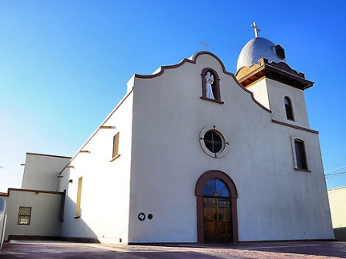
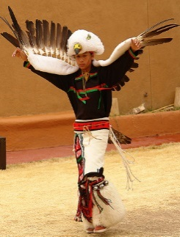
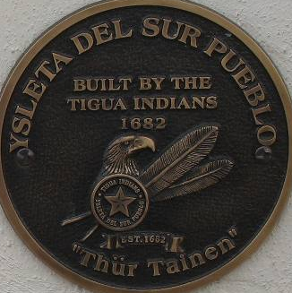
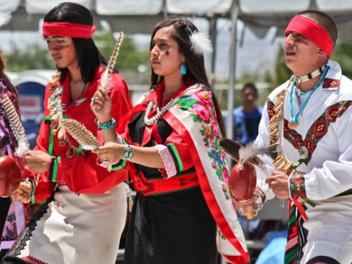
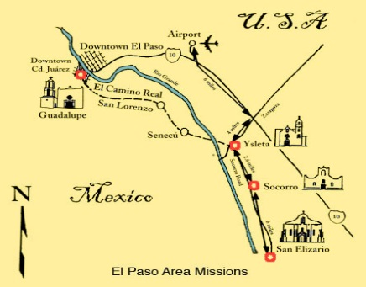
Ysleta Del Sur Pueblo (YDSP) Tigua Tribal Nation Community Assessment for Public Health Emergency Response (CASPER)
Epidemiology and Laboratory Capacity Workshop
Wednesday, February 24, 2016
Vanessa V. Palacios & Miguel A. Cervantes
DSHS HSR 9/10
Notes:
Vanessa
Introductions for both

Slide 2
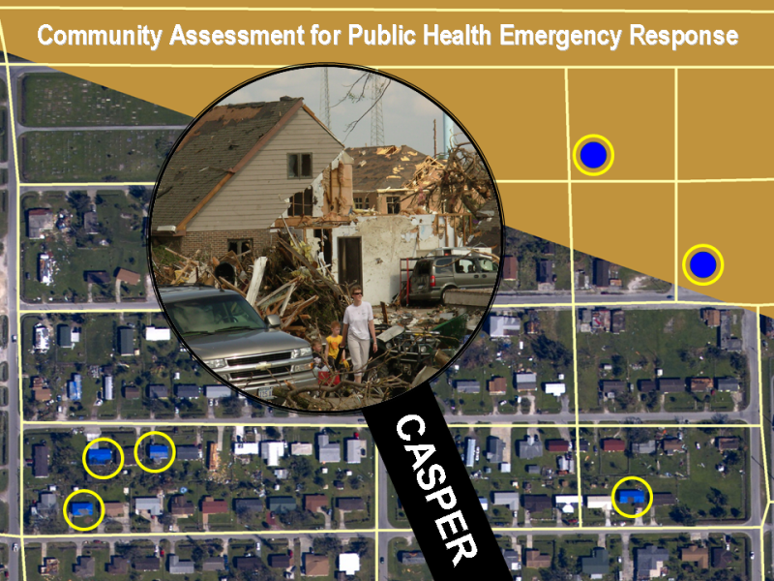
Casper overview
Epidemiologic technique designed to provide quick and low-cost household-based information about an affected community’s needs
After a disaster
Planning purposes in a non-disaster setting
Teams are sent to areas to interview people in homes (sampled) about their public health needs
Door-to-Door, household surveys
210 Interviews completed in 1-2 days (sampling)
~10 Interview teams (2-3 persons each)
Promoted in disaster response
and planning in Texas
Notes:
Vanessa
Sampling used to pick households to interview (random sampling to compile clusters)
This method not used; smaller number of total households so contact with every household was made (335 households)
Advantages of CASPER:
Generalizable data (population estimates)
Raises the visibility of public health
Reassures people that they are not forgotten
Simple reporting format
Relatively low cost
Timely
Flexible

Slide 3
Purpose & Goal of CASPER
Purpose:
To establish a baseline of disaster preparedness knowledge and readiness amongst Ysleta Del Sur Pueblo (YDSP) community residents while providing them preparedness related information.
Goal:
To describe (a “snapshot view” of) disaster preparedness awareness and readiness amongst YDSP Nation households while identifying preparedness strategies based on community input to improve disaster preparedness in two distinct YDSP district communities.
Notes:
Vanessa
Background of CASPER concept - initiated and review overall purpose and goal
OEM wanted to see what their community knew and where their program needed to go in future preparedness planning
Identify preparedness strategies based on community input to improve disaster preparedness
Timeline:
2013: Disaster Epi Conference-Austin-First Introduced to CASPER Concept
March 5, 2015: N95 Training to Tribal First Responders-more discussion on CASPER
April/May/June 2015: Discussion (calls, meetings, SMEs) planning CASPER
June 23, 2015: Presentation of CASPER proposal to Tribal Council – APPROVED
July/August/September: Coordination, partner involvement, training calls and meetings
February 2016: Tribal Council Summary Report ???

Slide 4
YDSP Casper video
https://www.youtube.com/watch?v=pQtpKoAaV_w
Notes:
Vanessa
Introduce video

Slide 5
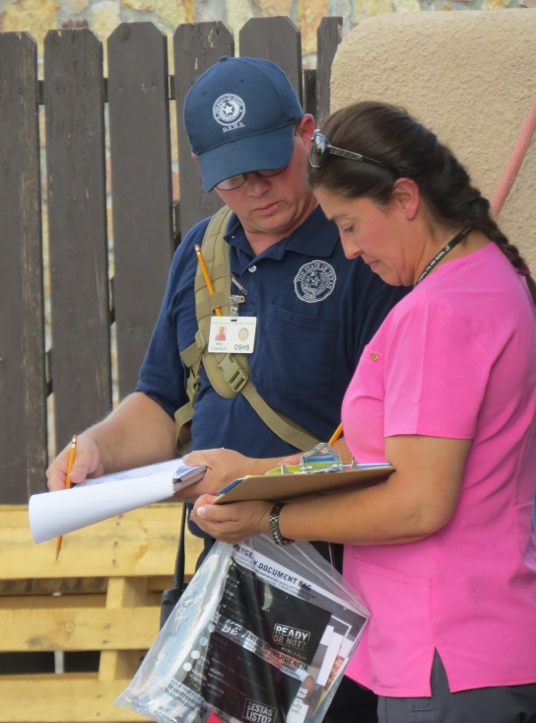
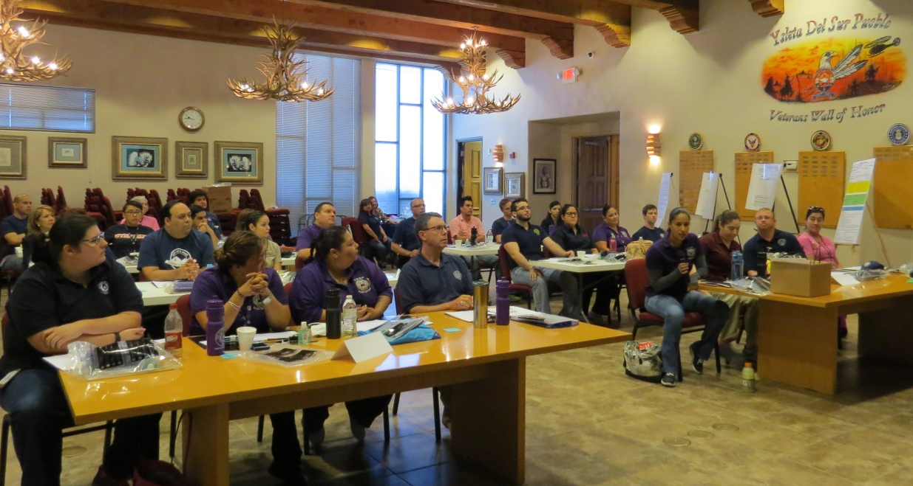
YDSP Casper Timeline
Day #1 – Tuesday, September 15, 2015
Just-in-Time Training
Field Team Interviews
Hotwash and Operational Period Checkout
Day #2 – Wednesday, September 16, 2015
Check-In & Operational Briefing
Field Team Interviews
Hotwash/After-Action/Demobilization
Notes:
Vanessa
Overview of timeline for 2-day event
Approximately 10 hours field interview work
Day #1 – Tuesday, September 15, 2015
Just-in-Time Training (9:00 am-2:00 pm)
Field Team Interviews (2:00 pm-5:15 pm)
Hotwash and Operational Period Checkout (5:30 pm-6:00 pm)
Day #2 – Wednesday, September 16, 2015
Check-In & Operational Briefing (9:00 am-9:45 am)
Field Team Interviews (10:00 am-5:00 pm)
Hotwash/After-Action/Demobilization (5:15-6:00 pm)
Participant Feedback Survey Monkey distributed following week
Hotwash at end of each operational period
AAR compiled and also shared with Field Report

Slide 6
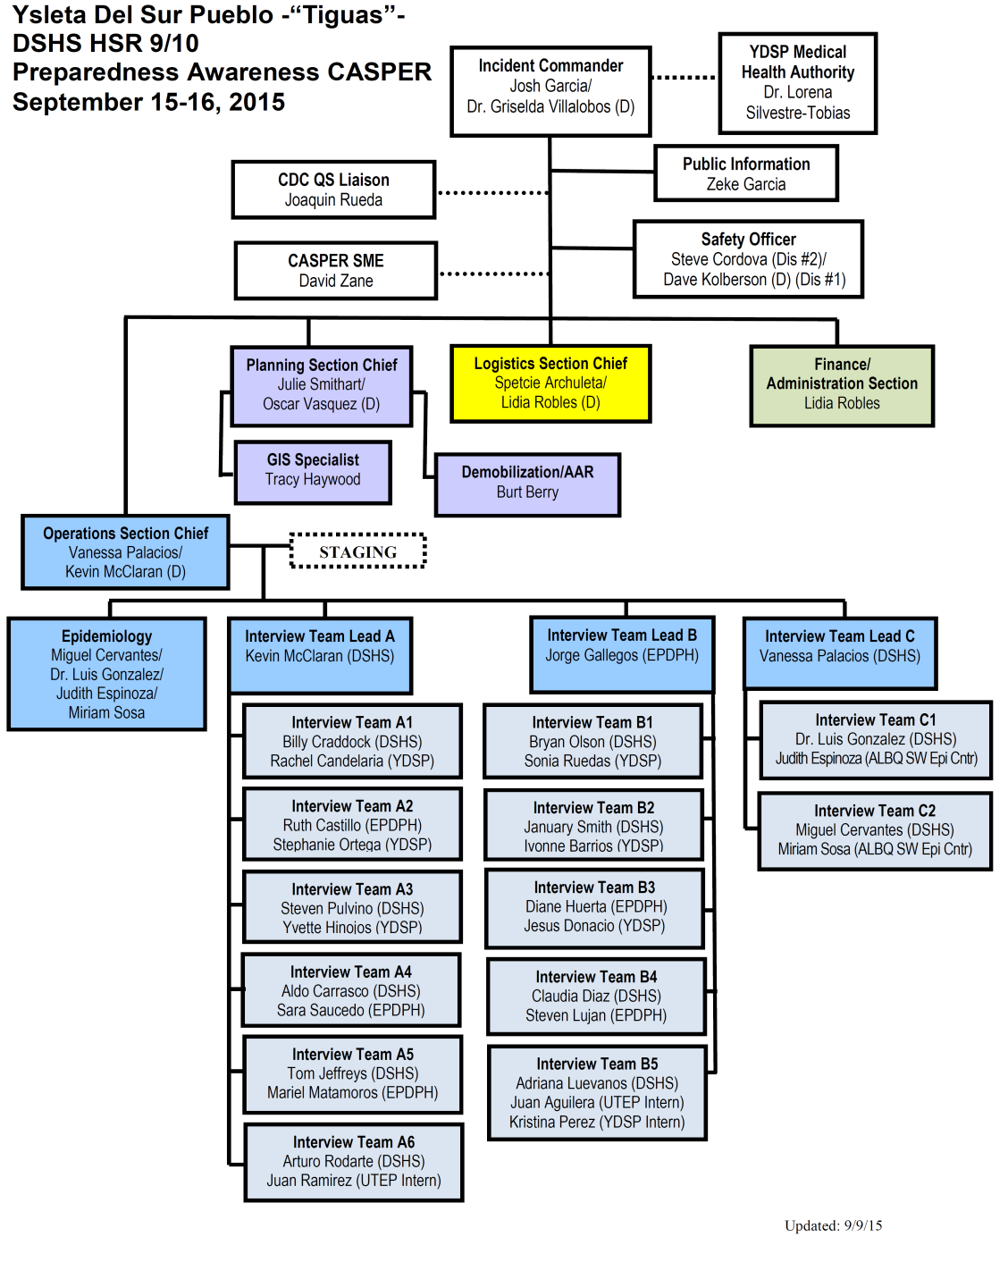
Incident command structure
Notes:
Vanessa
ICS used to maintain span of control, maintain participant safety, utilize preparedness equipment (radios, ICS forms), PRACTICE
Day #1 (PM)
13 teams total (27 total personnel)
3 Team Leads (A, B, C)
Day #2 (AM/PM)
11 teams total (23 total personnel)
2 Team Leads
(Team C-Epi Desk with 4 people)

Slide 7
Assessment areas
District #1 (“Old Rez”):
Established in 1976
Mature, more established population
6 miles from District #2
Primary Basecamp
District #2 (“New Rez”):
Newer development (1998-2001)
Younger, working population
Further expansion/growth
Socorro Entertainment Center
Secondary Basecamp
Notes:
Vanessa
1,728 tribal members per 2014 demographics
6 miles apart from one another-long stretch of Socorro Road
Explain primary and secondary base camps-one in each district
Explain use of Socorro Entertainment District (restrooms, water fountains, A/C, restaurant, another option for rest area)
Safety – “Rez Dogs” – heat – hydration mobile unit – traffic between two districts)

Slide 8
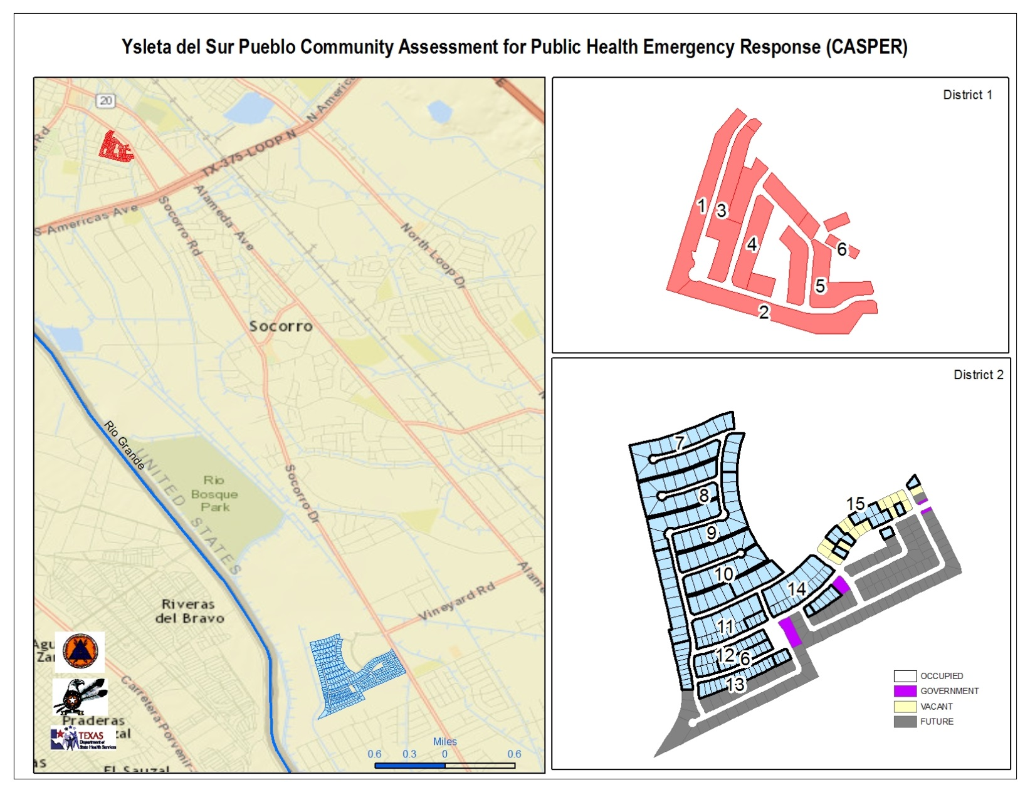
Notes:
Vanessa
Point out Socorro Road and distance between both District #1 and District #2 (6 miles)
Safety of driving-traffic congestion between each
Note #2 different structures (legend)

Slide 9
methods
Clusters – 15 total clusters
District #1: 6 clusters (1-6A)
Approximately 122 household units
District #2: 10 clusters (6B-15)
Approximately 210 household units
Each cluster (15) has approximately 22 housing units = 330
Complete canvass of both District #1 and District #2
Educational material packets shared
Notes:
Miguel
Method-complete canvass of both districts
No Sampling

Slide 10
Data Overview
335
Total number of households approached
140
Completed interviews
16
Worksite interviews completed
17
Total number of households not successfully approached
Locked gates, loose animals, no trespassing signs
84%
Cooperation rate
16%
Households that did not complete interview
24 Refusals, 2 not > 18, 1 incomplete
Households not successfully reached during first attempt, revisited a second time
Notes:
Miguel
Weather related incidents believed most likely to affect households
- Act of Terrorism (5%)
- Other (12%)

Slide 11
Household concerns
Notes:
Miguel
Types of emergencies that are most concerning to surveyed households.

Slide 12
Trusted Sources of
Information
Notes:
Miguel

Slide 13
Communication
Notes:
Miguel
Value not showing??

Slide 14
evacuation points
Notes:
Miguel
Large-category name/percentage??

Slide 15
Strengths
Multi-agency, multi-level coordination
First Tribal CASPER in Texas
Implementation of Incident Command Structure (ICS)
Use of WebEOC to provide real-time updates
Inclusion of Tribal Members/Staff for “Boots on the Ground”
Safety top priority
Participant Evaluation Feedback Survey/Hotwash/After-Action Report
Greater understanding of disaster preparedness in Tigua Tribal Nation
Local partners trained for future CASPERS and disaster response
Notes:
Vanessa
Multi-agency: Local, state, federal partners – assistance from other HSR ERTs throughout Texas (HSR 1, 2/3, 4/5, 6/5S)
10 program areas (reference video slide)
First: Tribal Government and leadership very supportive-sent out letter to residents beforehand – to avoid ”survey fatigue”-sanctioned by Tribal Council signed by Tribal Governor
Other regions now interested in how we conducted this CASPER (Kickapoo HSR 8 San Antonio)
WebEOC updated to tribal leadership and law enforcement – safety
Boots on ground: helped make community feel at ease, know area, know residents, know where people work when not at home (worksite interviews)

Slide 16
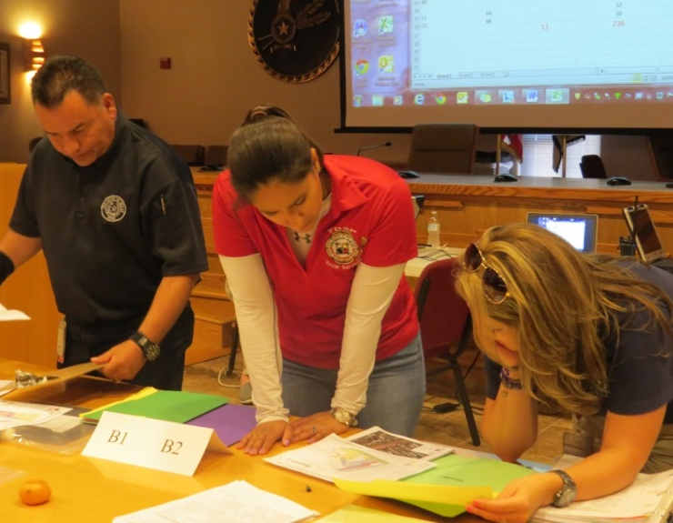
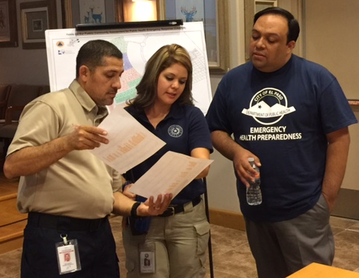
lessons learned
Adjust times of field work
Weekends, evening hours
Have questionnaire translated to Spanish
Adjust season of planned non-disaster CASPER
Cooler months
Many tribal residents also work in pueblo
Work site interviews
Small, rural/frontier counties
Age of Respondents
Head of household
Notes:
Vanessa
Times: Tues and Wed 9am-6pm – not as many people home as would have liked
Spanish: Every team paired w/bilingual but misunderstanding of the question could have impact on how questions are answered-questions translated independently by the interviewer
Season: Can plan when non-disaster – not so much in disaster setting!
Work in pueblo: Total staff interviews assessed – 16 worksite done!!
Can mirror how smaller, rural, frontier counties would respond to an incident or a disaster, responders live in affected area – know whereabouts of community members
Small very tight-knit community
Age: Completed by any household member over age 18 - not necessarily head of household & may not have been familiar with all information being asked

Slide 17
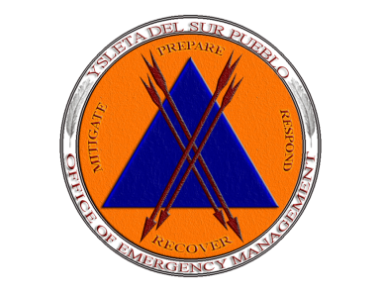
YDSP OEM Next Steps
Communication –
Mass Notification System Implementation (e.g. Texting)
Emergency alerts, contacts, updates
Preparedness related activities/events/trainings
Community Outreach –
Address needs on specific trainings
Fire Extinguisher use and maintenance
Distribution of Emergency Contact List
Emergency Communications Plan
Volunteer Management & Recruitment –
Youth Involvement
Trainings focused on Tribal Youth & Youth Government Council
Community Activities
Presence at Tribal Events (booths, demonstrations, exercises)
Volunteer Opportunities
Boost number of participants in trainings/response activities
Notes:
Vanessa
Communications – “ . . . survey shows that a large percentage of individuals use text messaging to obtain and share information during an emergency.” (reference Miguel’s data slide)
- Mass system used for various reasons, but now will expand on disaster related preparedness activities – survey helped with texting awareness
Community Outreach – Emergency Communications Plan (e.g. Training on MNS)
- Through pre-planned outreach events
- Tribal SharePoint and Housing Department can share
- Engage community members in plans through their feedback
Volunteer Management – CERT Training with a focus on Tribal Youth (Spring Break, Summer Youth Program)
- Community service hours requirement anyway – engage those already signed up in schools and gauge/increase interest in disaster preparedness
Community Activities – Sandbag filling, manning booths at events, training auxiliaries for community response training, exercise participation
Volunteer Opportunities with various VOADs (Volunteer Organizations Active in Disaster)
Analyzed data can be used as part of ongoing strategic planning to better prepare tribal community for a disaster
Continue with preparedness education efforts and outreach to pueblo community members
Data obtained will assist OEM mitigate identified risks, lessening their impact on tribal community
Continued collaboration and coordination with both internal and external participating partners

Slide 18
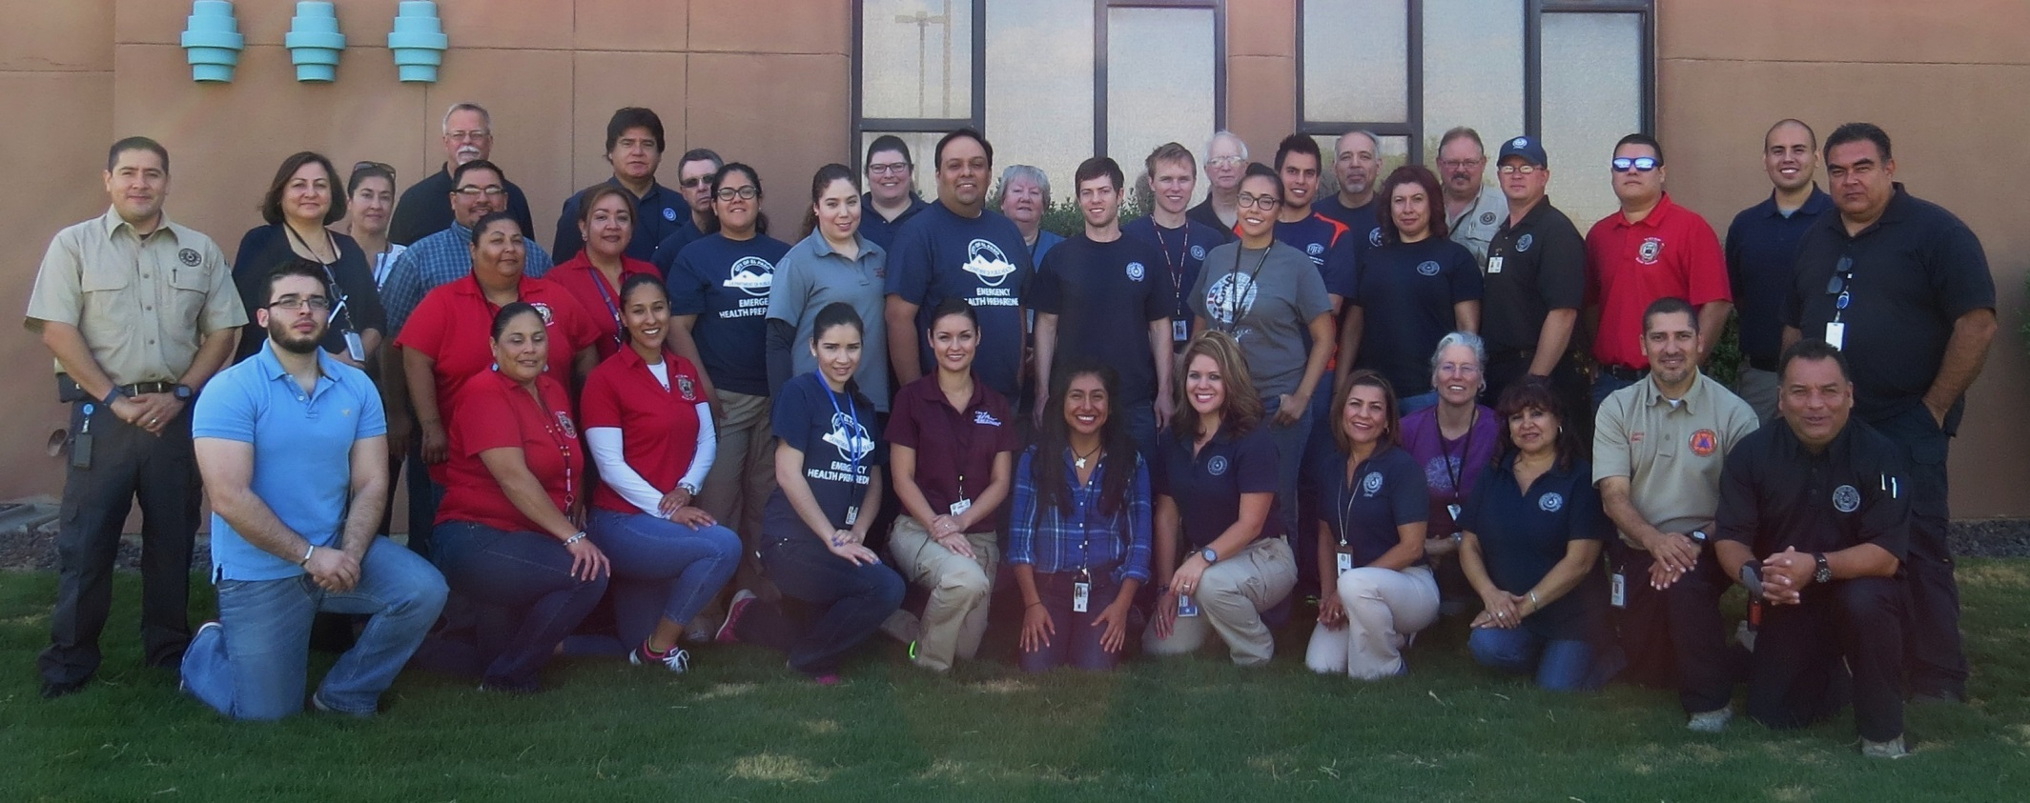
September 2015 ysleta del sur pueblo (YDSP) casper
Questions?
Notes:
Vanessa
- Questions & Answers
- Thank you!!

