Slide 1
MICROCEPHALY IN TEXAS AND ZIKA
Peter Langlois PhD, Lisa Marengo MS, Mary Ethen MPH, Adrienne Hoyt MS, Mark Canfield PhD
Birth Defects Epidemiology and Surveillance Branch,
Texas Department of State Health Services

Slide 2
OUTLINE
Clinical picture of microcephaly
Challenges for public health surveillance
Zika virus
Conducting surveillance in Texas
The Texas Birth Defects Registry
Enhanced surveillance of microcephaly in Texas
Descriptive epidemiology: Texas results
General
Time trend

Slide 3
CLINICAL PICTURE OF MICROCEPHALY

Slide 4
DEFINITION
Clinical finding of a small head (when compared with infants of the same sex and age).
CONGENITAL MICROCEPHALY: present prenatally or at birth/delivery.
Notes:
No universal accepted definition. Abnormal smallness of the head in relation to the weight, age, length and sex of infant. In congenital/primary microcephaly the defect originates from a disturbance in the cerebral cortex neurogenesis with a reduction in neuron production and/or migration into the cortex. The reduced brain volume results in a reduced skull size.
Antenatal ultrasound- detection of microcephaly usually 18-20 weeks gestation
Disproportionate-head is small and out of proportion to the weight and length which may be normal for age and sex
Proportionate-head size, weight and length all are small for age and sex but proportional to each other
Relative-head size measures within the normal range for age and sex, but is small and out of proportion to weight and length
Definitions webinar “Surveillance of Microcephaly02182016”
Definition of microcephaly ontogeny from [Kallen B. Epidemiology of Human Congenital Malformations. DOI 10.1007/978-3-319-01472-2_7. Springer International Publishing. Switzerland 2014.] Secondary/acquired microcephaly normal continued brain development is arrested by some defined insult / event. [Dr Bruno Di Muzio and Radswiki et al Microcephaly http://radiopaedia.org/articles/microcephaly, Radiopaedia.org accessed 3/7/2016] Radiopaedia.org is a rapidly growing, open-edit radiology resource, compiled by radiologists and other health professionals from across the globe.]
Image CDC Mother2Baby.org.

Slide 5
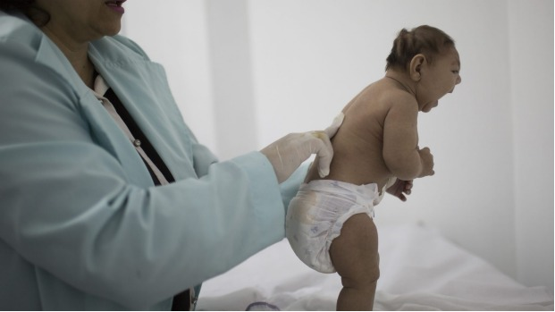
APPEARANCE

Slide 6
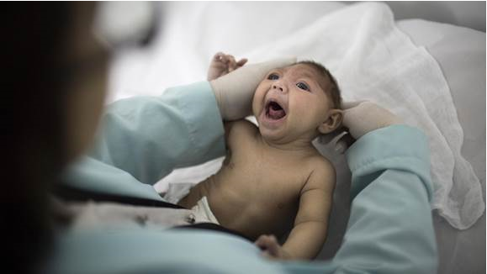
APPEARANCE

Slide 7
HEAD CIRCUMFERENCE
Used to measure “severity”
Severe: < 3rd percentile for age and sex
Also called occipital-frontal circumference (OFC)
Notes:
Can also be acquired after birth. Ideally head circumference ?? Hours after birth.

Slide 8
SOME CHALLENGES FOR PUBLIC HEALTH SURVEILLANCE
No universally accepted definition of congenital microcephaly
Some clinicians use different cut-points
< 5th percentile
< 10th percentile
Based on standard deviations below average
Subjective assessment
HC measurement sometimes missing

Slide 9
CAN BE A FEATURE OF OTHER BIRTH DEFECTS
Craniosynostosis
Conjoined twins
Also…

Slide 10
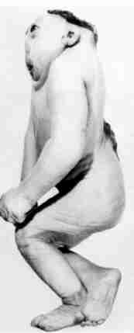
Anencephaly
Spina Bifida

Slide 11
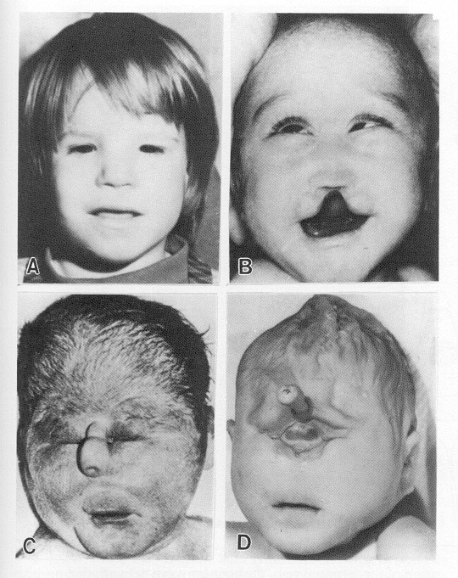
Holoprosencephaly

Slide 12
KNOWN CAUSES OF CONGENITAL MICROCEPHALY
In utero infection
Toxoplasmosis
Rubella
Cytomegalovirus (CMV)
Herpes simplex
Human Immunodeficiency Virus (HIV)
Lymphocytic Choriomeningitis Virus (LCMV)
Syphilis
Zika Virus?

Slide 13
KNOWN CAUSES OF CONGENITAL MICROCEPHALY
Maternal conditions
Poorly controlled diabetes, hyperphenylalaninemia
Genetic causes
Single gene disorders (syndromes)
Chromosomal abnormalities
Mitochondrial mutations
In utero ischemia/hypoxia
Examples: placental insufficiency or abruption
Teratogens
Maternal alcohol, medications
Radiation
Mercury

Slide 14
CONSIDERING THAT IN EPIDEMIOLOGIC ANALYSES
Stratify by severity:
< 3rd percentile (“severe” microcephaly)
> 5th percentile
Stratify by cause of the microcephaly
Explained
Feature of other birth defect
Documented known cause
Unexplained

Slide 15
ZIKA VIRUS

Slide 16
ZIKA VIRUS IN BRAZIL
Fall 2015: NE Brazil reported a twenty-fold microcephaly increase that coincided with autochthonous transmission of Zika virus
11/2015: Brazilian authorities detect Zika in blood and tissue of a microcephalic newborn
12/1/2015: Pan-American Health Organization Epi Alert about Zika and microcephaly
2/1/2016: World Health Organization declares Zika to be a global Emergency
Notes:
Asian type in S. America

Slide 17
ZIKA VIRUS IN BRAZIL – WHAT WE KNOW
A number of positive test results for Zika virus infection in infants with microcephaly
Clinical picture:
Microcephaly cases were of the most severe types
Consistent with Fetal Brain Disruption Sequence
Often had intracranial calcifications
Notes:
In Brazil the microcephaly is consistent with Fetal Brain Disruption Sequence
Brain destruction resulting in collapse of the fetal skull, scalp rugae and neurologic impairment

Slide 19
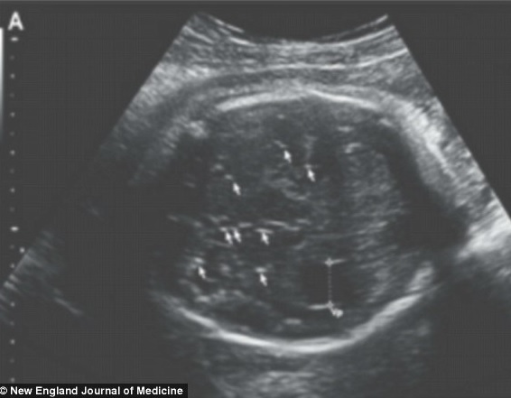
Intracranial calcifications
A
B
Notes:
A-Classic periventricular intracranial calcifications due to CMV infection http://pediatricneuro.com/alfonso/pg277.htm
B-Zika diffuse intracranial calcifications http://i.dailymail.co.uk/i/pix/2016/02/10/23/3111A8AA00000578-3441308-The_researchers_at_the_University_Medical_Center_in_Ljublijana_n-a-31_1455146391637.jpg Zika Virus Associated with Microcephaly
Jernej Mlakar, M.D., Misa Korva, Ph.D., Nataša Tul, M.D., Ph.D., Mara Popović, M.D., Ph.D., Mateja Poljšak-Prijatelj, Ph.D., Jerica Mraz, M.Sc., Marko Kolenc, M.Sc., Katarina Resman Rus, M.Sc., Tina Vesnaver Vipotnik, M.D., Vesna Fabjan Vodušek, M.D., Alenka Vizjak, Ph.D., Jože Pižem, M.D., Ph.D., Miroslav Petrovec, M.D., Ph.D., and Tatjana Avšič Županc, Ph.D. N Engl J Med 2016; 374:951-958March 10, 2016DOI: 10.1056/NEJMoa1600651

Slide 20
ZIKA VIRUS IN BRAZIL – WHAT WE KNOW
Prenatal infection by Zika virus causes microcephaly and other serious brain anomalies
Support:
Infection at times during development consistent with the observed birth defects
A specific, rare phenotype involving microcephaly and other brain anomalies
Data that strongly support biologic plausibility
Includes finding Zika in brain tissue of affected fetuses and infants
Notes:
In Brazil the microcephaly is consistent with Fetal Brain Disruption Sequence
Brain destruction resulting in collapse of the fetal skull, scalp rugae and neurologic impairment

Slide 21
ZIKA VIRUS IN BRAZIL – WHAT WE DON’T KNOW
Magnitude of possible risk
Full spectrum of outcomes in affected infants
Impact of timing of infection during pregnancy
Impact of severity of maternal infection
Notes:
In Brazil the microcephaly is consistent with Fetal Brain Disruption Sequence
Brain destruction resulting in collapse of the fetal skull, scalp rugae and neurologic impairment

Slide 22
ZIKA VIRUS AND TEXAS
Texas has had 231 reported cases of Zika virus disease as of October 17, 2016
2 cases sexually transmitted
All others travel related
14 confirmed Zika+ cases among pregnant women
2 Zika+ neonates with microcephaly
Additionally, 59 pregnant women and 3 neonates with evidence of unspecified flavivirus infection
Zika virus is spread to people primarily through the bite of an infected Aedes species mosquito
Notes:
Counties shown in yellow had Ae. aegypti presence records for 1 year within the specified time period, those shown in orange had 2 years of presence records within the specified time period, and those shown in red had 3 or more years of presence records within the specified time period.
Texas has had 41 reported cases of Zika virus disease. Of those, 40 were in travelers who were infected abroad and diagnosed after they returned home; one of those travelers was a pregnant woman. One case involved a Dallas County resident who had sexual contact with someone who acquired the Zika infection while traveling abroad.
http://jme.oxfordjournals.org/content/early/2016/06/07/jme.tjw072
Rasmussen, S. A., Jamieson, D. J., Honein, M. A., & Petersen, L. R. (2016). Zika virus and birth defects—reviewing the evidence for causality. N Engl J Med, 2016(374), 1981-1987.

Slide 23
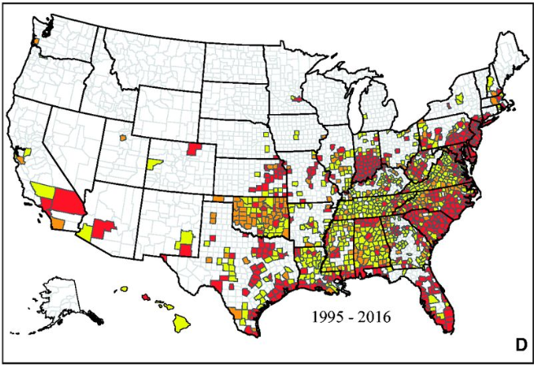
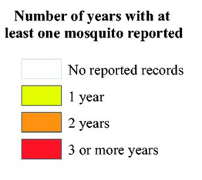
Reported occurrence of Aedes aegypti & albopictus by county in the United States
A
B
Maps showing the reported occurrence of Ae. aegypti (A) and of Ae. Albopictus (B) by county between 1 January 1995 and March 2016 in the United States.
Micah B. Hahn et al. J Med Entomol 2016;jme.tjw072
Notes:
Maps showing the reported occurrence of Ae. aegypti by county between 1 January 1995 and March 2016 in the United States. (A) Reported occurrence from 1 January 1995 through 1999, (B) reported occurrence from 1 January 1995 through 2004, (C) reported occurrence from 1 January 1995 through 2009, and (D) reported occurrence from 1 January 1995 through March 2016, representing the best knowledge of the current distribution of this mosquito based on collection records. Counties shown in white had no reported Ae. aegypti presence records within the specified time period. Counties shown in yellow had Ae. aegypti presence records for 1 year within the specified time period, those shown in orange had 2 years of presence records within the specified time period, and those shown in red had 3 or more years of presence records within the specified time period.
Maps showing the reported occurrence of Ae. albopictus by county between 1 January 1995 and March 2016 in the United States. (A) Reported occurrence from 1 January 1995 through 1999, (B) reported occurrence from 1 January 1995 through 2004, (C) reported occurrence from 1 January 1995 through 2009, and (D) reported occurrence from 1 January 1995 through March 2016, representing the best knowledge of the current distribution of this mosquito based on collection records. Counties shown in white had no reported Ae. albopictus presence records within the specified time period. Counties shown in yellow had Ae. albopictus presence records for 1 year within the specified time period, those shown in orange had 2 years of presence records within the specified time period, and those shown in red had 3 or more years of presence records within the specified time period.

Slide 24
CONDUCTING SURVEILLANCE OF MICROCEPHALY IN TEXAS

Slide 25
THE TEXAS BIRTH DEFECTS REGISTRY: WHAT IT IS
One of the largest active birth defects surveillance systems
Passive vs. active surveillance
Extensive quality control checks
Includes review of roughly 60% of records by clinical geneticists
Computerized database of infants and pregnancies affected by birth defects

Slide 26
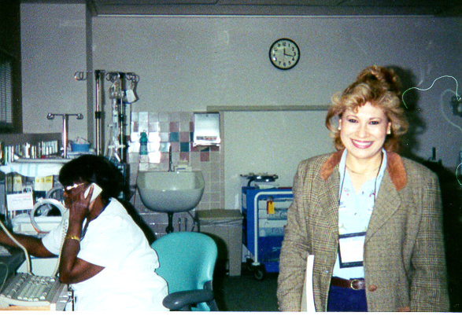

Slide 27
THE TEXAS BIRTH DEFECTS REGISTRY: CASE DEFINITION
Infant/fetus has structural or chromosomal anomaly
Mother resident in TX at delivery
Birth defect diagnosed prenatally or within one year after delivery
Includes all pregnancy outcomes

Slide 28
THE TEXAS BIRTH DEFECTS REGISTRY: WHAT IT DOES WITH THE DATA
Describe occurrence of birth defects in Texas
Conduct cluster investigations
Work with others in:
Research
Prevention
Linking families to available services

Slide 29
MICROCEPHALY-RELATED ACTIVITIES BY B.D.E.S.B.
Establish a consistent microcephaly case definition: focus on unexplained severe cases (HC < 3rd percentile)
Run baseline data so can detect any increases
Explain the current increases given that Zika is not in Texas yet
Collaborate with other programs
Zoonosis Control
DSHS laboratory
NBDPN / CDC
Local and regional health departments

Slide 30
ENHANCED SURVEILLANCE OF MICROCEPHALY IN TEXAS
Collecting additional information for cases of microcephaly
Rapid ascertainment
In Texas
Reporting to National Birth Defects Prevention Network/CDC
100% review by clinical geneticists

Slide 31
DESCRIPTIVE EPIDEMIOLOGY OF MICROCEPHALY IN TEXAS

Slide 32
GENERAL PATTERNS IN TEXAS, 2008-2012
CATEGORY | CASES | % OF TOTAL CASES | BIRTH PREVALENCE (CASES/10,000 LIVE BIRTHS)
Explained Cases | 856 | 30% | 4.4
Unexplained Cases | 2,013 | -- | 10.3
Unexplained Severe Cases | 615 | 21% | 3.2
Unexplained Less Severe Cases | 1,398 | 49% | 7.2
Total Cases | 2,869 | 100% | 14.7

Slide 33
MICROCEPHALY BY MATERNAL AGE Severe Unexplained Cases, TX 2008-2012
Mother’s Age
Notes:
This is a very well established maternal age pattern for Down Syndrome, in which rates increase exponentially with older age groups.

Slide 34
MICROCEPHALY BY MATERNAL RACE/ETHNICITY Severe Unexplained Cases, TX 2008-2012
Mother’s Race/Ethnicity
Notes:
This is a very well established maternal age pattern for Down Syndrome, in which rates increase exponentially with older age groups.

Slide 35
MICROCEPHALY BY MATERNAL RACE/ETHNICITY AND EDUCATION Severe Unexplained Cases, TX 2008-2012

Slide 36
MICROCEPHALY BY HEALTH SERVICE REGION Severe Unexplained Cases, TX 2008-2012
Texas statewide prevalence = 3.2 cases per 10,000 live births
2.5
2.2
↑4.9
2.2
1.5
1.6
↓2.1
4.6
4.0
↓2.4
↓1.7

Slide 37
Notes:
Increase driven primarily by less severe cases (ex. small head)

Slide 38
MICROCEPHALY TIME TREND BY CLINICAL VARIABLES
VARIABLE | % INCREASE/YR | P VALUE _{(Intn)}
OVERALL | 8.5 | n/a
ISOLATED STATUS Isolated Multiple | 12.1 6.8 | < 0.0001
DOCUMENTED CAUSE No Yes–OtherMalformation Yes-Other Cause | 10.1 6.7 2.6 | < 0.0001
HEAD CIRCUMFERENCE Severe (smaller than 3 SD) Less Severe (2-3 SD) Normal (larger than 2 SD) | 4.7 8.1 11.8 | < 0.0001

Slide 39
MICROCEPHALY TIME TREND BY DEMOGRAPHIC VARIABLES
VARIABLE | % INCREASE/YR | P VALUE _{(Intn)}
OVERALL | 8.5 | n/a
MATERNAL RACE/ETHNICITY NH White NH Black Hispanic NH Other | 7.1 7.3 12.2 8.2 | < 0.01
HEALTH SERVICE REGION El Paso, San Antonio, DFW | 18.6, 13.8, 12.1 | < 0.003
PAYMENT FOR DELIVERY Medicaid Private Insurance Self Pay Other | 9.1 4.6 31.3 12.7 | < 0.0001

Slide 40
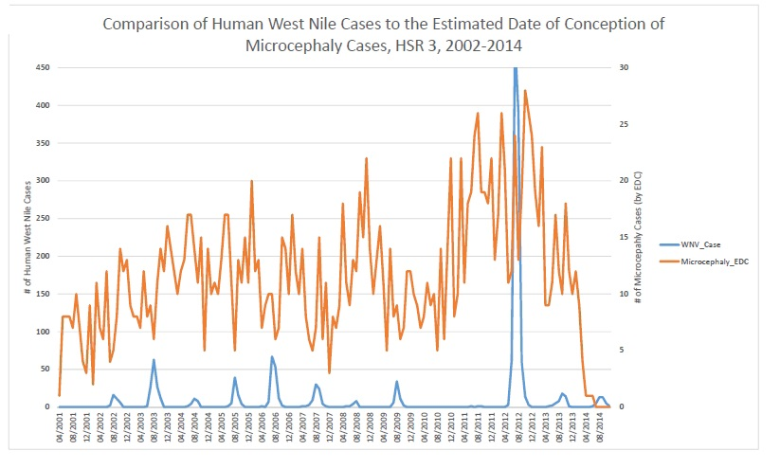

Slide 41
MICROCEPHALY TIME TREND IDEAS
NOT due to Zika virus
May be due to other undiagnosed prenatal infections(?)
May be partly due to changes in clinical practice / billing
Suggested by seeing greatest increase in:
Cases with no documented cause
Milder cases
Certain regions of Texas
Certain forms of payment

Slide 42
MICROCEPHALY AND WHAT ELSE?
BIRTH DEFECT | # CASES/YR
MICROCEPHALY (causal association) | 819
OTHER BRAIN AND SKULL ANOMALIES Abnormal brain cortex, corpus callosum Fetal brain disruption sequence | 2438
NEURAL TUBE DEFECTS + HOLOPROSENCEPHALY Anencephaly, spina bifida, encephalocele Holoprosencephaly | 337
OTHERS Eye abnormalities Congenital contractures (e.g. arthrogryposis) Congenital deafness | 591
TOTAL | 3550

Slide 43
Thank you
THANKS
To request birth defects data:
birthdefects@dshs.state.tx.us
Web site:
http://www.dshs.texas.gov/birthdefects/

