Slide 1
David G. Bastis, MPH Data Group Manager/ELC Principal Investigator Emerging & Infectious Disease Branch Texas department of state health services
Public Health in Texas
Welcome Texas epidemiologists!

Slide 2
Objectives
Describe public health system in Texas with a focus on:
Infrastructure
Reporting Requirements
Resources
Notes:
Good morning, this morning I will describe for you the disease reporting requirements in Texas.

Slide 3
The Public Health “System”
CDC
Notes:
This slide emphasizes the need to think outside the box when considering who should be concerned about public health and disease reporting. Public health preparedness and infectious disease need to be integrated into your community’s community health assessment and community health improvement plan.
How can you prevent flu outbreaks and importation of HCID without involving businesses and schools/universities?
Are there school nurses in the audience? You are essential employees are the front line of disease reporting and we truly value your contribution. Social workers are also essential, particular during the recovery period of a disaster. Think of the World Trade Center and hurricanes….the long term impact is devastating.

Slide 4
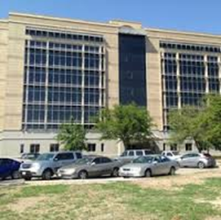
Public Health Service Areas
Notes:
There are 11 public health regions in Texas managed by 8 regional offices.

Slide 5
Epidemiology Capacity in Texas
Notes:
There are currently six epidemiologists certified in infection control that are managed administratively out of the central office that specialize in healthcare-associated infections (HAI). They work closely with the regional epidemiologists and LHDs in addressing the growing problem of drug resistant organisms in healthcare facilities.

Slide 6
Day to Day Operations
Public health surveillance and disease investigations are primarily carried out by local and regional health department staff:
Follow standardized procedures and guidelines for disease investigations, reporting, and outbreak response:
Work closely with local and regional partners to conduct case investigations and respond to outbreaks
Data entry into NEDSS
Implements necessary control measures
Provides information on prevention
Assist in data clean-up and quality assurance

Slide 7
Central Office Role
Maintain guidance and standardize procedures
Serve as liaison with main laboratory in Austin
Provide technical assistance (subject matter expertise) and support as needed or requested
Develop and provide training
Process electronic laboratory data
Data management and quality assurance - NEDSS
Submit reports on notifiable conditions to the CDC
Provide situational updates and summaries of data

Slide 8
ELC Epidemiology Workshops
For Epidemiologists
February 23 – 25, 2016 and October 19 – 20, 2016
JJ Pickle Center, Austin
https://www.dshs.state.tx.us/idcu/default.shtm
Notes:
Plan is move the conference to October

Slide 9
Key Points
Texas is a home rule state
DSHS Regional Offices serve as the “local health department” in the absence of a city or county department
Each region/local health department is organized differently

Slide 10
Public Health Surveillance
The systematic collection, analysis, interpretation, and dissemination of health data on an ongoing basis, to gain knowledge of the pattern of disease occurrence and potential in a community, in order to control and prevent disease in the community.
Relies on use of standardized case definitions and consistent follow-up to initial reports of suspect cases and possible outbreaks.
Notes:
Passive Surveillance:
Suspected cases and outbreaks are reported by healthcare providers and other parts of the public health system
Required by law
Diseases underreported because very difficult it not impossible to enforce reporting requirements
Positive aspects of passive surveillance
Monitor trends over time
Occurs continuously
Requires few resources
Likely miss certain populations (e.g. people who don’t utilize the traditional healthcare delivery system
Active Surveillance:
Health department is proactive and contacts health care providers or laboratories requesting information about diseases
Costly and labor intensive
Depends on condition, but usually provide a better estimate of disease frequency
Syndromic surveillance:
Screen for clinical signs and symptoms that have been recorded for patients in medical facilities
A "syndrome" is a cluster of signs and symptoms
Example: influenza is characterized by the sudden onset of fever, shivering, chills, dry (non-productive) cough, general malaise, body aches, and sometimes nausea. However, these symptoms could be caused by influenza or by any number of other upper respiratory tract infections, including the common cold,
Some combination of these symptoms might be defined as indicating a "flu-like illness" and the frequency of this syndrome has been found to correlate with the frequency of documented influenza. The use of syndromic surveillance is attractive because of the possibility that automated surveillance systems might be created,
OTHER SURVEILLANCE
Laboratory based, within hospital and other healthcare facilities

Slide 11
Public Health Surveillance – Why?
Early warning of potential threats to public health
Provides data for planning and evaluation of disease prevention and control programs
Evaluation of control measures/interventions
Notes:
Advance warning of possible attack or natural pandemic
Provides baseline
Helps answer vital public health questions:
How do we know if vaccines are working?
How can we detect changes in the microbiology of a particular virus or bacteria
How do we know an occurrence of disease is “unusual”?
How do we track the effectiveness of control measures implemented for an outbreak?
Increase awareness throughout the public health system of conditions/diseases and their impact on communities throughout Texas
Provides vital data for community health assessments

Slide 12
Statutory Authority for Reporting
Texas Health & Safety Code
Chapter 81: Communicable Diseases
Chapter 96: Respiratory Syncytial Virus
Chapter 98: Reporting of Healthcare-Associated Infections (HAI)
Chapter 200: Report of HAI & Preventable Adverse Events
Texas Administrative Code
Title 25, part 1, Chapter 97 Communicable Diseases
Title 25, part 1, Chapter 96 Blood borne Pathogen Control
Notes:
In Texas, as in other states, there are laws which require reporting of notifiable conditions. As mentioned earlier, there isn’t enforcement and compliance varies greatly by condition.

Slide 13
HIPAA & Disease Reporting
45 CFR 164.512 - Uses and disclosures for which an authorization
or opportunity to agree or object is not required.
(b) Standard: Uses and disclosures for public health activities.
(1) Permitted uses and disclosures. A covered entity may use or disclose protected health information for the public health activities and purposes described in this paragraph to:
(i) A public health authority that is authorized by law to collect or receive such information for the purpose of preventing or controlling disease, injury, or disability, including, but not limited to, the reporting of disease, injury, vital events such as birth or death, and the conduct of public health surveillance, public health investigations, and public health interventions; or, at the direction of a public health authority, to an official of a foreign government agency that is acting in collaboration with a public health authority;
The investigation of communicable diseases by a health department is exempted from HIPAA
Notes:
Many times we are asked by facilities for consent form to obtain the information. This is the exact language out of 45 CFR 164.512 which states that consent is not required and facilities are authorized to share data with the health department as part of public health investigation.

Slide 14
What to Report?
Notifiable conditions
Any outbreaks, exotic diseases, and unusual group expressions of disease must be reported
All diseases shall be reported by name, age, sex, race/ethnicity, DOB, address, telephone number, disease, date of onset, method of diagnosis, and name, address, and telephone number of physician.
Notes:
Note the unusual expressions of disease and outbreaks are reportable even if they are NOT on the official notifiable conditions list
Listed on this slide are the bare minimum data requirements for submitting a report
Lets take a second and brainstorm other variables, especially for HCIDs that you think are vital
TRAVEL
ANIMAL EXPOSURES
MERS-CoV has been found in some camels, and some MERS patients have reported contact with camels. However, we do not know exactly how people become infected with MERS-CoV—many people with MERS have had close contact with a person sick with MERS.
Pigs may become infected with flu viruses from people and from birds. This cross-species spread and possible mixing of flu viruses can lead to new and very different flu viruses that might gain the ability to spread easily between people.
Most people who get sick from anthrax are exposed while working with infected animals or animal products such as wool, hides, or hair
WATER EXPOSURES – RWI
LABORATORY TEST RESULTS
FOOD HISTORY

Slide 15
Notifiable Conditions List
https://www.dshs.state.tx.us/idcu/investigation/conditions/
Notes:
Changes in the list require a formal rules change process…input from stakeholders, etc.

Slide 16
How to Report?
Link to reporting forms:
https://www.dshs.state.tx.us/idcu/investigation/forms/
Notes:
Electronic files are in PDF format
Epi-2 for more detailed single case medical care provider reports
Epi-1for less detailed multiple reports

Slide 17
Who Reports?
HEALTH CARE PROVIDERS
INSTITUTIONS
LAB
COUNTY LOCAL HEALTH DEPARTMENTS/DISTRICTS
STATE REGIONAL OFFICES
OTHERS
STATE HEALTH DEPARTMENT
CDC
Notes:
The central office processes thousands of electronic laboratory results every week
Start off a high % of case investigations
Beginning of data collection for a high % of records in the National Electronic Disease Surveillance System (NEDSS)
The arrows are two-way because communication in an effective surveillance system must be two-way.
QUESTION for audience:
What entities would you include in “others” and “institutions”? ISDs, businesses, day cares, urgent care centers, etc.

Slide 18

Not all statutes are rigorously enforced. Compliance varies by condition. Most conditions are under-reported.

Good surveillance systems receive duplicate reports from different parts of the public health system.

State of the art reporting technology

Slide 19
Laboratory Response Network (LRN)
Maintain an integrated national and international network of laboratories that are fully equipped to respond quickly to
Acts of biological or chemical terrorism
Emerging infectious diseases, and
Other public health threats and emergencies
Diverse network
Federal
Military
State and Local Public Health
Veterinary/Agricultural
International
Hospital/Clinical
Notes:
I wanted to make sure everyone was aware of what an LRN. LRN was created to
maintain an integrated national and international network of laboratories that are fully equipped to respond quickly to
- Acts of biological or chemical terrorism
- Emerging infectious diseases, and
- Other public health threats and emergencies
The LRN is a diverse network made up of laboratories at all levels: federal, military, state and local public health, veterinary, agricultural, international, hospital and clinical

Slide 20
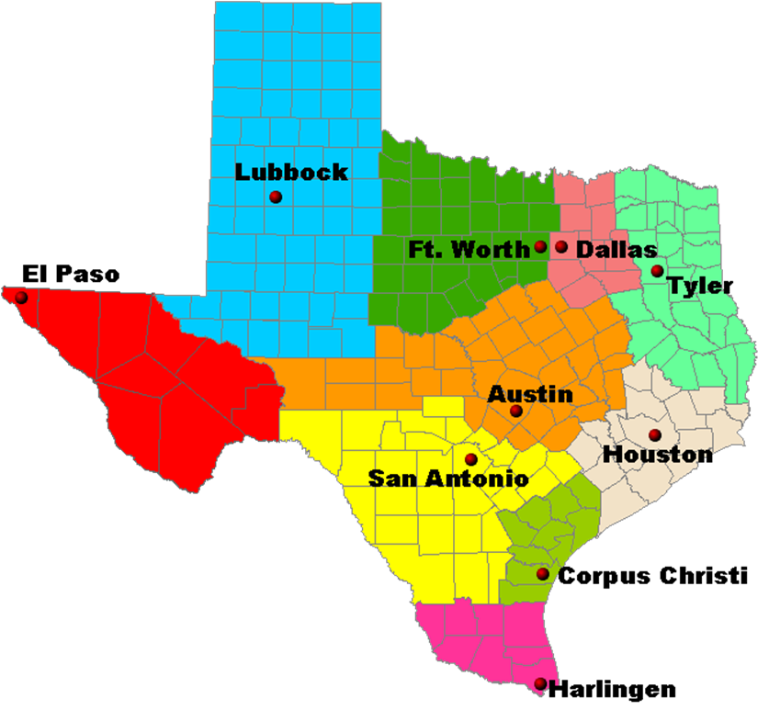
Laboratory Response Network
Notes:
There is also a laboratory response network (LRN) covering the state with laboratories in: Austin (central office), Corpus Christi/Nueces County, Dallas, Houston, Tyler, San Antonio, South Texas, Tarrant County, and Lubbock (Texas Tech)

Slide 21
Packaging/Shipping
Triple-contained
Use appropriate labeling for boxes
Use enough ice packs/dry ice to maintain temperature (if applicable – it is hot in Texas during the summer!)
Send overnight mail
Use FedEx or courier of choice
Don’t ship on Friday or the day before a state holiday
Use physical address (1100 W 49th, lab services) for FedEx, couriers
Notes:
Isolates (pure cultures) or specimens from patients suspected of having an exotic, newly emerging or extremely rare pathogen may be classified as Category A agents.

Slide 22
How to Submit Specimens to the DSHS Lab
Must have a submitter ID
Email Labinfo@dshs.state.tx.us or contact Lab Reporting at 512-776-7578 to get one
Use current versions of form
EAIDB has copies of Regional and Local forms, if you cannot find yours and you have a submitter #
Each specimen needs a form
Form(s) should be included in shipment with specimen(s)
Form should be completely filled out
Information on form should match information on specimen (e.g. name, DOB)
Results will probably be in NBS, definition in Labware
To apply for access to LabWare, go to: http://www.dshs.state.tx.us/lab/remotedata.shtm

Slide 23
Emerging and Acute Infectious Disease Branch Investigation Guidelines
Organized alphabetically
by disease
Exposure notifications
Enhanced laboratory guides
Flow charts
Additional resources and
glossary
New: Updates tracking section
Updated annually
http://www.dshs.state.tx.us/IDCU/health/infection_control/Investigation-Guidance/
Notes:
Refer to the IRID/VPD guidelines

Slide 24
Books Every Epi and Disease Investigator Should Own
Control of Communicable Diseases Manual
Red Book
Pink Book
Field Epidemiology
CIFOR Guidelines for Foodborne Disease Outbreak Response
A Dictionary of Epidemiology
Notes:
Pink book is available on line, CIFOR is online. For DSHS employees, the red book is available online.

Slide 25
Crisis Emergency Risk Communication
http://emergency.cdc.gov/cerc/
http://www.cdc.gov/healthcommunication/risks/index.html
Division of High-Consequence Pathogens and Pathology (DHCPP) http://www.cdc.gov/ncezid/dhcpp/
Notes:
The CDC is an excellent source of information on many different topics, often offering very specific recommendations on situations you may be dealing with.

Slide 26
2012 Hantavirus Outbreak Yosemite National Park
“The outbreak, which killed three, didn’t only attack the lungs of its victims. It messed with the psyche of the rest of us, too”.
Notes:
10 confirmed cases of hantavirus infection in people who recently visited Yosemite National Park. The visitors to Yosemite are residents of: California (8), Pennsylvania (1), and West Virginia (1).
Three of the confirmed cases were fatal.
NPS public health officials believe that 9 of the 10 people with confirmed hantavirus infection were exposed to the virus while staying at the Signature Tent Cabins in Curry Village in Yosemite National Park. The other park visitor with hantavirus infection was probably exposed to the virus while hiking or staying at the High Sierra Camps, located about 15 miles from Curry Village.

Slide 27
Keys to Your Success #1
Establish and maintain relationships with the health authority, public health department director, emergency manager, hospital administrators, and infection control
Know your department’s role during EOC activations
Exercise response plans with partners frequently
Distribution of countermeasures to first responders and general population
Offer to give an introductory presentation or training on epidemiology or public health
Ensure public health is included in 24/7/365 communication plans within your jurisdiction and with your DSHS Regional Office

Slide 28
Keys to Your Success #2
Accessibility to and ability to use resources
Knowledge of…
TAC
Infectious Disease
Surveillance & Reporting Procedures
Control Measures
Laboratory Procedures (from specimen collection to results reporting)
Do Not Hesitate to Ask for Help!

Slide 29
Communication is Vital With…
Your local, regional, state, federal, and international partners (follow the chain of command)
The general public
Physicians and other health providers
EMS and Hospitals
Long term care
School Districts, Daycares, Businesses

Slide 30
Thank you!
David G. Bastis, MPH
Emerging and Acute Infectious Disease Branch
512-776-7676

